Slide 1
Accessible Communications
Providing information that everyone can use and understand
Notes:
Standard title slide

Slide 2
Exercise 1 pre-edit (83 words)
The clinical tariff payment is a payment which is intended to provide a contribution to the funding of placement coordination and practice-based learning (this can be defined as a setting where trainees learn clinical skills and gain experience towards their placement hours) for all eligible clinical professions. The funding is provided for clinical education and training and should be used to support all professions for which it has been allocated and it is funded by the Department of Health and Social Care (DHSC).
Notes:
Here is an example of a recently published paragraph about the clinical tariff payment.

Slide 3
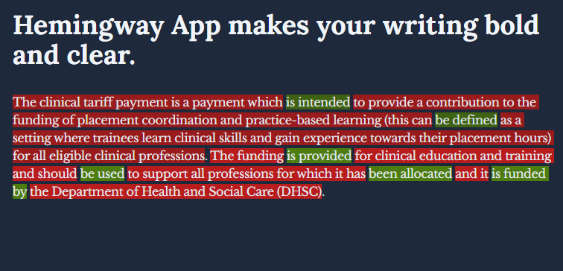
Exercise 1 using Hemingwayapp.com
Notes:
Hemingway editor is one tool that makes a useful test to see if your writing is meeting recommended levels for good accessibility.
You can also try inbuilt read aloud tools in Office 365 software, which gives a helpful guide towards suitability for read aloud technologies. It also indicates words and punctuation that may confuse or be ignored, like e.g. and the use of hyphens and m dashes between words.

Slide 4
Exercise 1 post-edit (54 words)
The clinical tariff payment is for clinical education and training. It can help fund the coordination of training placements and practice-based learning. During practice-based learning, trainees gain clinical skills and experience towards their placement hours.
The Department of Health and Social Care (DHSC) funds the clinical tariff payment. The funding supports all allocated professions.
Notes:
Plain slide with subhead and bullets

