Slide 1

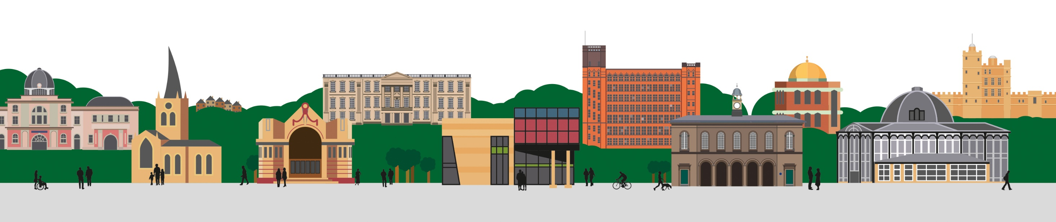

Community Pharmacy Services
Paula Whitehurst, Community Pharmacy Integration Programme Manager

Slide 2
Background
May 2023 – NHS England published a delivery plan for recovering access to primary care
Empower patients by rolling out tools they can use to manage their own health, and invest up to £645 million over two years to expand services offered by community pharmacy.
Launch Pharmacy First so that by end of 2023 community pharmacies can supply prescription-only medicines for seven common conditions.

Slide 3
Primary Care Access and Recovery Plan
Pharmacy Contraception Service
Community Pharmacy Blood Pressure Check Service
Pharmacy First
PCARP
Nationally expected to free up an additional 10 million GP appointments per year

Slide 4
Oral Contraception Service
This service enables people to obtain supplies of oral contraception from community pharmacies without first visiting a GP or sexual health clinic.
Pharmacists in community pharmacy can initiate and continually supply oral contraception.
Find a local pharmacy offering this service here:
NHS Find a pharmacy offering contraception tool
Supports the Women’s Health Strategy for England which highlighted that community pharmacy had a part to play in increasing choice in the ways people can access contraception.
A separate local authority commissioned service is also available for people to access emergency hormonal contraception. Pharmacies offering that service are listed on the DCHS sexual health service finder webpage.

Slide 5
Blood Pressure Checks - Service Background
Cardiovascular disease (CVD) is the second most common cause of premature death in England, after cancer, affecting seven million people. One in four premature deaths are caused by CVD, and 1.6 million disability adjusted life years can be attributed to it.
High blood pressure significantly increases the risk of having a heart attack or stroke, but early detection and treatment can help people live longer, healthier lives. The NHS Long Term Plan focuses on tackling health inequalities and the prevention of ill health and aims to prevent 150,000 strokes and heart attacks as a result of CVD, over the next ten years.

Slide 6
Blood Pressure Check Service
A community pharmacist will opportunistically measure the blood pressure of consenting adults who come into the pharmacy, by offering anyone a free blood pressure check who:
is over the age of 40;
has not previously been identified as having hypertension or a related condition; and
has not had their blood pressure measured by a health professional within the previous six months.
Watch this video to find out more about the service.
Find a local pharmacy offering this service here:
Find a pharmacy that offers free blood pressure checks

Slide 7
Blood Pressure Check Outcome
At the end of a consultation, where readings indicate:
Normal blood pressure - the pharmacist will promote healthy behaviours.
High blood pressure - the pharmacist will offer Ambulatory Blood Pressure Monitoring (ABPM) from the pharmacy and will also promote healthy behaviours.
Very high blood pressure - the pharmacist will urgently refer the patient to see their GP within 24 hours and the pharmacist will inform the patient’s GP practice by NHS mail or via another locally agreed platform.
Low blood pressure - the pharmacist will provide appropriate advice and may also refer the patient to their GP if there are any concerns.
All blood pressure readings are sent to the general practice from the community pharmacy so records can be updated and appropriate action taken.
General practices can refer patients to a participating community pharmacy for a clinic blood pressure reading or for 24 hour ambulatory blood pressure monitoring.

Slide 8
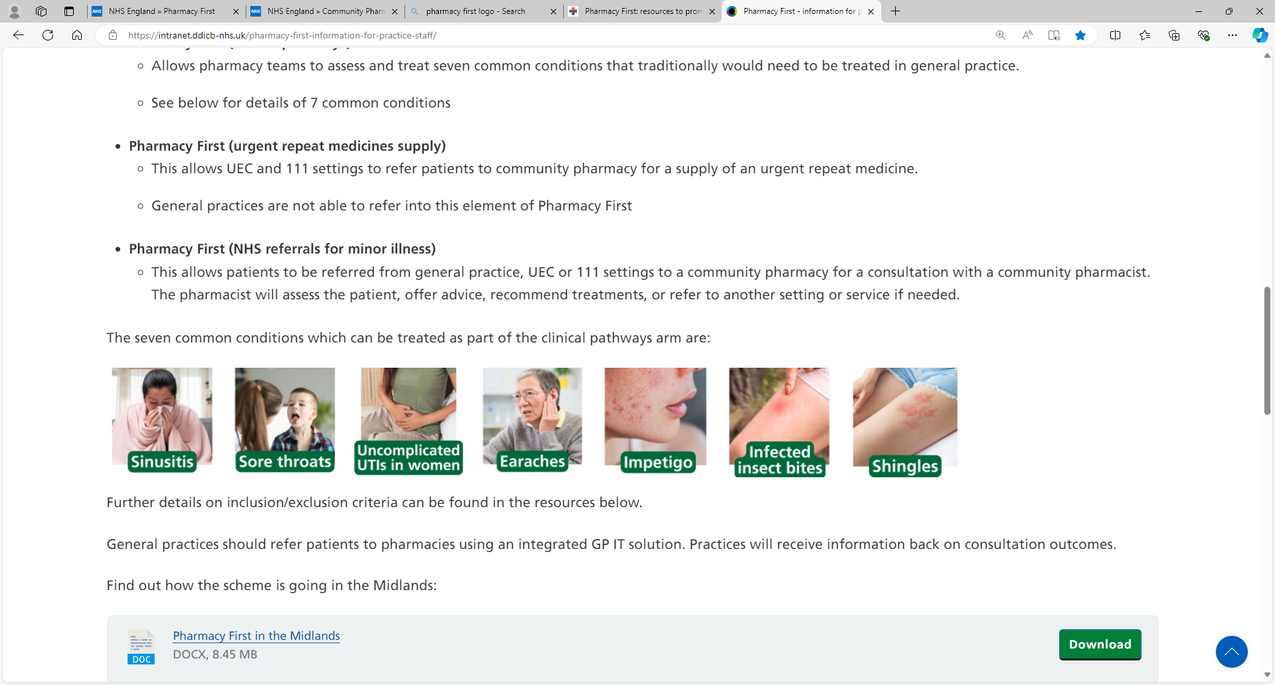
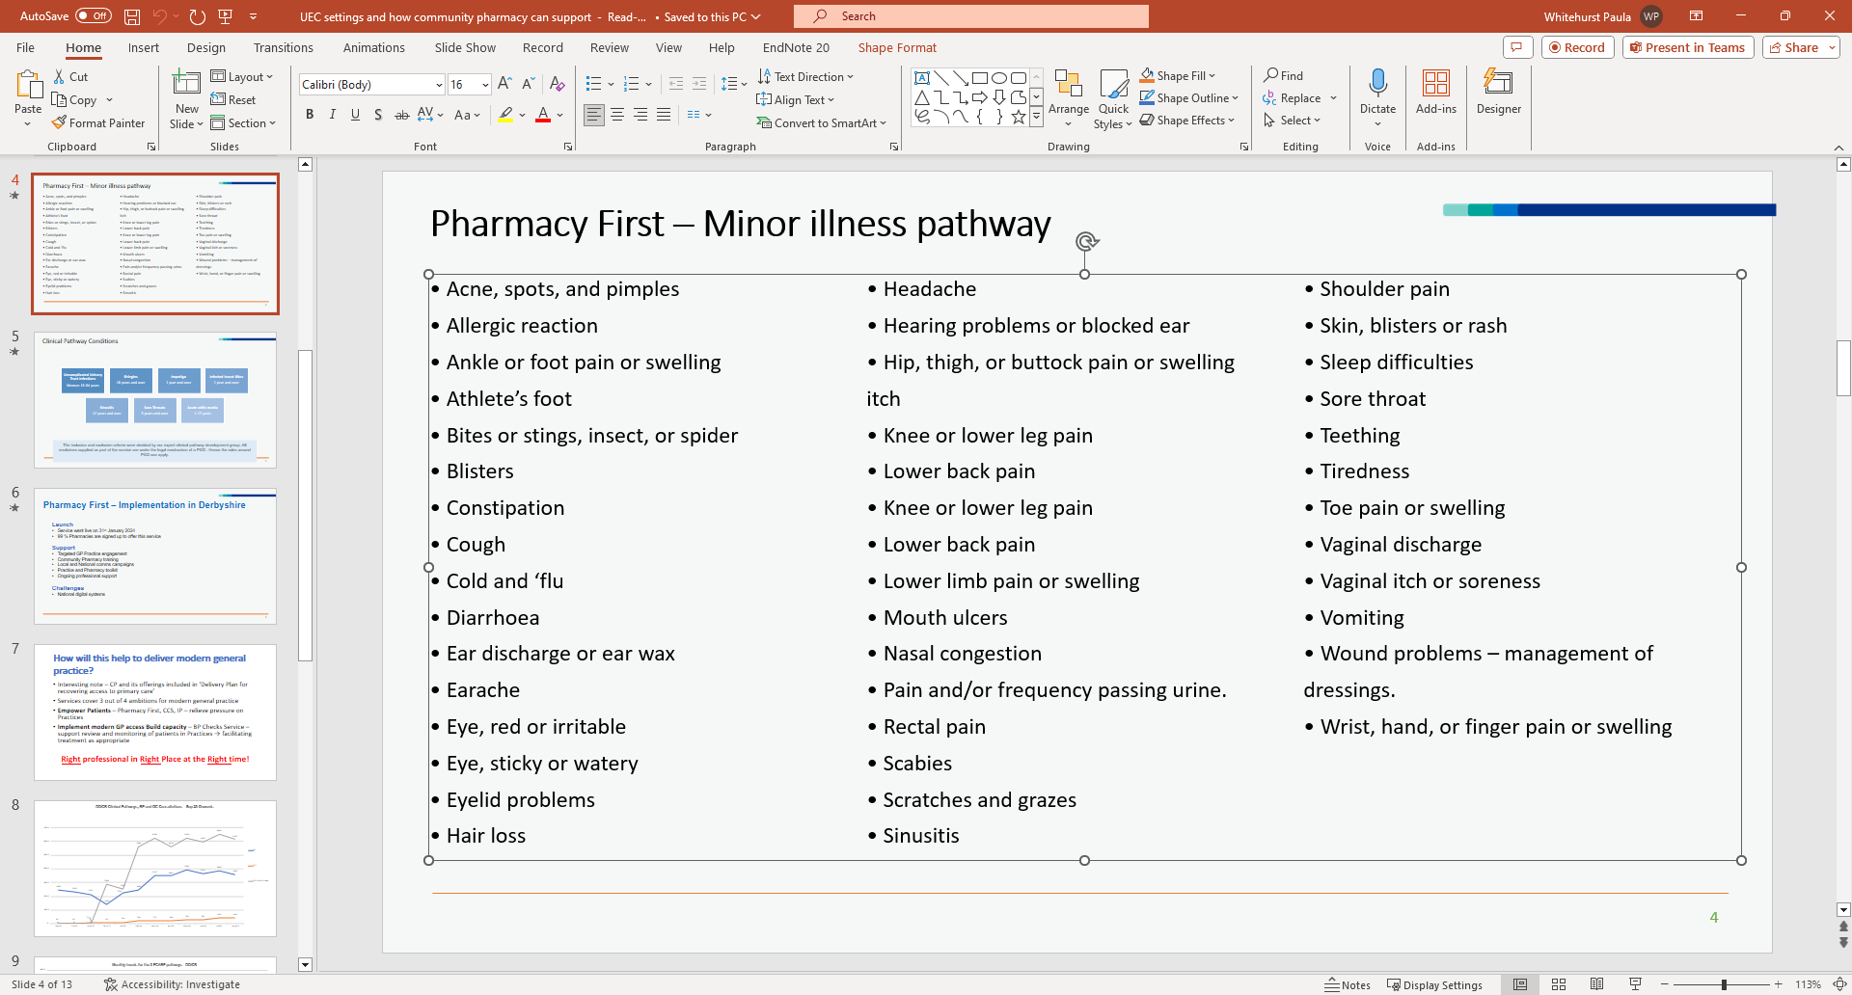
Community Pharmacy Services – Pharmacy First
Pharmacy First - Clinical Pathways
Pharmacy First - NHS Referrals For Minor Illness
Urgent repeat medicines supply (NHS 111 referral to Pharmacy)

Slide 9
Pharmacy First – Integration
Lots of work is being done across the system and in collaboration with Community Pharmacy Derbyshire and Healthwatch to promote the services that community pharmacy offer and integrate those services into processes and pathways
Engagement Role Funding is supporting PCNs to upskill staff on the referral process and increase electronic referrals to community pharmacy
UTC scoping
Communications – utilising the national resources:
Think Pharmacy First
Oral Contraception Comms Plan

Slide 10
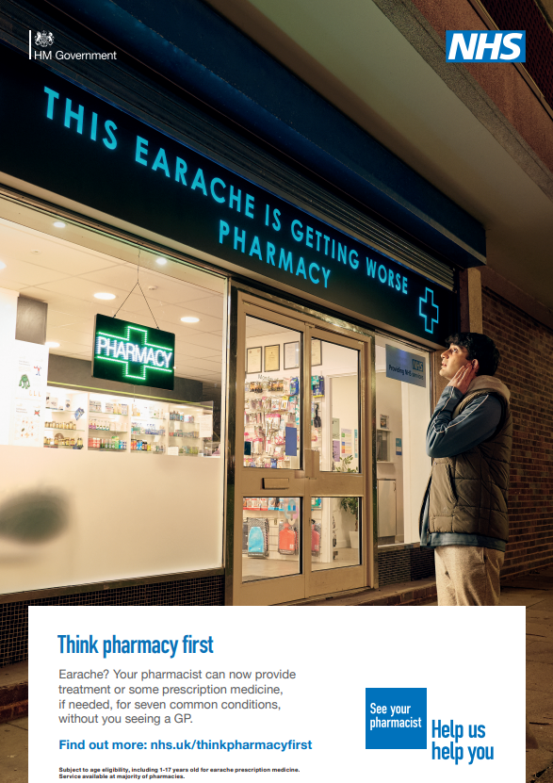
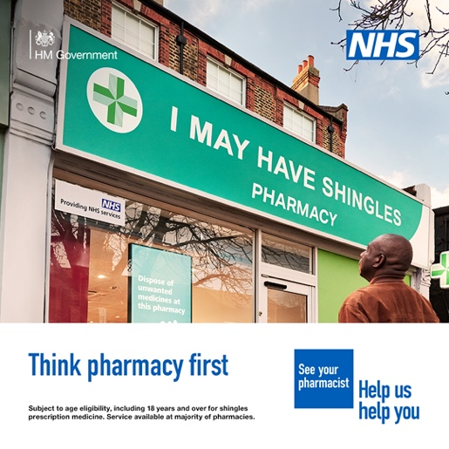
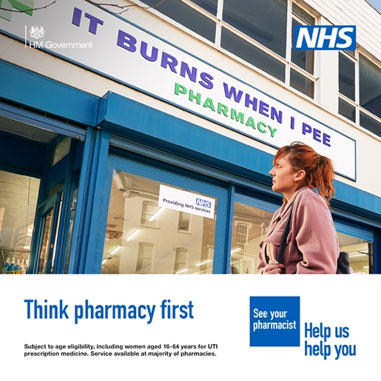
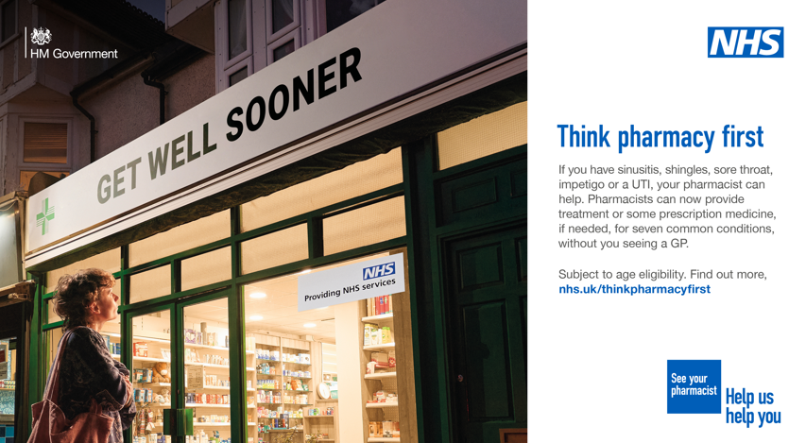
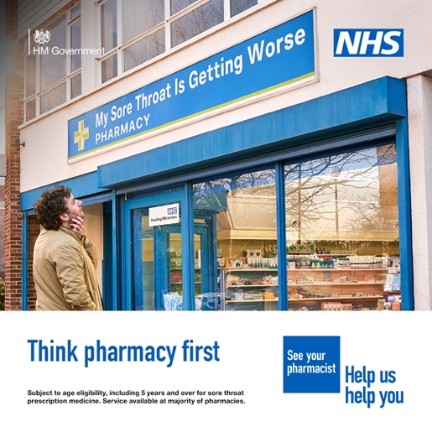
Pharmacy First Promotion
Digital Screens
Social Media Assets
Posters

Slide 11
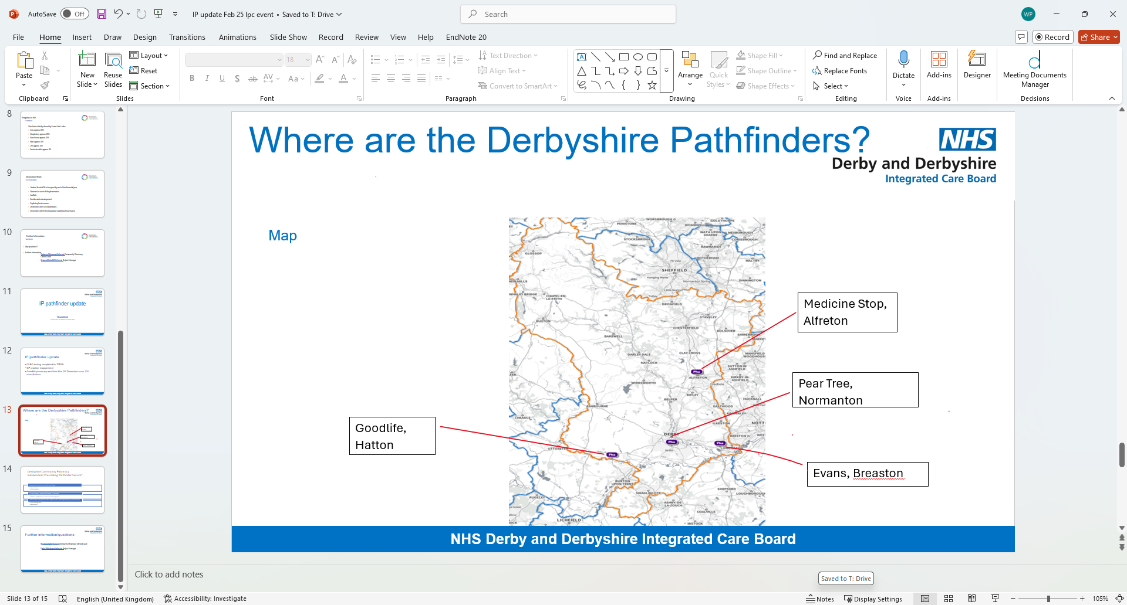
IP Pathfinder Sites
4 sites in Derbyshire
From 2026 all pharmacists will be independent prescribers when they leave university

Slide 12







NHS COMMUNITY PHARMACY OVERVIEW – Derby and Derbyshire ICB
April 2024 – December 2024
Sickness to Prevention
Analogue to Digital
Hospital to Community
NHS Community Pharmacy is one pillar of Primary Care, alongside GP Practices, Optometry and Dentistry. Together they support more patients every working day than any other single part of the health system.
ACCESS
Pharmacy First
PREVENTION
56,937
UEC SUPPORT
Cardiovascular Disease
Discharge Medicines Service
NHS Community Pharmacy Teams in Derbyshire have completed 56,937 Pharmacy First consultations that would otherwise have happened in GP practices, urgent care settings or at NHS111.
NHS Community Pharmacy Teams in Derbyshire have opportunistically measured the Blood Pressure of
9,490 Hours Saved
32,586 patients
NHS Community Pharmacy teams in Derbyshire have completed 9409 Discharge Medicines Service referrals from hospital trusts. Thereby avoiding 941 hospital readmissions resulting in better patient care, increased patient safety and saving financial costs of
NHS Community Pharmacies have improved access for patients and saved 9490 hours of GPs and other healthcare professional time.
They have confirmed high blood pressure using ambulatory monitoring in 976 of these patients so their high blood pressure can be managed.
That equates to 10 additional
full-time clinicians!
Assuming these patients comply with management for the next 5 years 8 deaths, 15 strokes and 10 myocardial infarctions have been prevented!
Oral Contraception Service
£2,117,966
3,962 consultations completed for Initiation and ongoing supply of oral contraception. NHS Community Pharmacies are helping to improve access to contraception and help prevent unplanned pregnancies.
INDEPENDENT PRESCRIBING PATHFINDER PROGRAMME
Strategic aim: Establish a framework for the future commissioning of NHS community pharmacy clinical services incorporating independent prescribing for patients in primary care:
Models using prescribing instead of PGDs in existing Advanced Services (Acute Illness, Contraception)
Models to support patients with Long Term Conditions (CVD, respiratory)
Novel Models (opioid deprescribing, anticoagulation, menopause, prescription management)
3,962
No of IP Sites Live: 1/4
No. of consultations: >224
The Pharmacy started delivering the clinical models in November 24
There are 201 NHS Community Pharmacies in Derbyshire situated in the heart of communities
Notes:
NHS Community Pharmacy Overview Data
Blood Pressure Service
Calculations based on data from Size of the Prize – Helping the NHS to Prevent Heart Attacks and Strokes at Scale (Size of the Prize for high blood pressure)
Blood Pressure calculations are based on the following and have the caveat of a patient being compliant with treatment for a period of 5 years.
Numbers needed to treat as follows if BP medication given for 5 years:
1 in 125 to prevent death (i.e. treat 125 to prevent 1 death)
1 in 67 to prevent stroke (i.e. treat 67 to prevent 1 stroke)
1 in 100 to prevent MI/rapid cardiac death (i.e. treat 100 to prevent 1 MI/rapid cardiac death)
Data Set: NHSE Blood Pressure Check Service Report Aggregated Activity Data
DMS
The DMS impact is based on the following:
Evidence shows that for every 10 DMS referrals, 1 avoidable re-admission is prevented.​
Cost of an urgent hospital admission due to avoidable adverse drug reaction shown to be £2251.​
e055551.full.pdf (bmj.com)
DMS Data Set: NHSBSA DMS Pharmacy Claims and NHS Trust Referrals
Pharmacy First
The time saved is based on number of consultations completed under pharmacy first and a GP appointment time of 10 minutes.
As these patients have attended community pharmacy rather than being seen by another healthcare professional its appointment time saved.
Pharmacy First Data Set: Operational Report

Slide 13
Contact Details
Name: Paula Whitehurst
Title: Community Pharmacy Integration Programme Manger
Email: paula.whitehurst1@nhs.net
Web: https://joinedupcarederbyshire.co.uk

