Slide 1


Public Sector Equality Duty (PSED)
Report 2023/2024
NHS Derby and Derbyshire Integrated Care Board

Slide 2
Contents
Introduction
Introduction to Equality, Health & Social Care Legislation
Section 3: Joined Up Care Derbyshire Integrated Care System (ICS)
Section 4: Derby and Derbyshire Integrated Care Board (ICB)
Section 5: System Partners across JUCD
Section 6: Our Joint Forward Plan
Section 7: Governance, Oversight and the Equality Delivery System
Section 8: Equality Objectives and Progress
Section 9: Reducing Healthcare Inequalities through Core20plus5
Section 10: Workforce Information/Workforce Analysis:
  Gender
  Ethnicity
  Disability
  Age
  Sexual Orientation
Section 11: Workforce Initiatives
Section 12: Contact us
NHS Derby and Derbyshire Integrated Care Board
NHS Derby and Derbyshire Integrated Care Board

Slide 3
Introduction
As the first Public Sector Equality Duty report of NHS Derby and Derbyshire Integrated Care Board (DDICB) since it was formally established on July 1st 2022, this report sets out how DDICB has and will show due regard to its equality duties with respect to patients/service users and staff.
It highlights arrangements currently being made within the ICB, collaborations underway with partners and key levers being adopted to mainstream equality, diversity and inclusion as an employer, commissioner of services and facilitator of partnerships.
The scope of the report focuses on the ICB as an employer and includes a section on its role in levelling up performance on workforce priorities across the ICS partners, including Trusts and Local authorities. For the work on health inequalities, the report details arrangements made through the standard conditions of contracts with providers and health inequality plans as a commissioner and collaborator of partnerships.
NHS Derby and Derbyshire Integrated Care Board
NHS Derby and Derbyshire Integrated Care Board

Slide 4
Introduction to Equality, Health and Social Care Legislation
Equality Act 2010: The Equality Act 2010 consolidated and replaced previous discrimination legislation for England, Scotland and Wales. It covers discrimination because of age, disability, gender reassignment, marriage and civil partnership, pregnancy and maternity, race, religion or belief, sex and sexual orientation – known as ‘protected characteristics’. The Act introduced a new Public Sector Equality Duty (PSED) which replaced the previous three equality duties for race, disability and gender and applies to the ‘relevant protected characteristics’ of age, disability, gender reassignment, pregnancy and maternity, race, religion and belief, sex and sexual orientation and, to a limited extent, to marriage and civil partnership. The purpose of the PSED is to actively integrate equality and diversity considerations into everyday business. This report fulfils the second specific requirement.
Public Sector Equality Duty The general equality duty under the Equality Act 2010 requires DDICB to show due regard to three aims: Eliminate discrimination, harassment, and victimisation and other prohibited conduct. Advance equality of opportunity, and Foster good relations between people who share a protected characteristic and those who do not. To meet the General Duty, the ICB has to fulfil 3 requirements as part of their Specific Duty under the Act: 1. Publish gender pay gap information on their employees by March 30, 2024 and thereafter annually. 2. Publish an annual PSED report. 3. Publish one or more equality objectives, every four years, focussing on priorities related to employment and/or populations. These will be informed by evidence and insight - informed by the EDS 2022 review and emerging ED&I priorities. | The Health and Care Act 2022 formally established Integrated Care Boards (ICBs) as statutory bodies responsible for planning and arranging healthcare provision within a designated area in collaboration with provider Trusts, social and primary care partners, who collectively form the Integrated Care System. They are responsible for the following 4 aims: improving outcomes in population health and healthcare tackling inequalities in outcomes, experience and access enhancing productivity and value for money helping the NHS support broader social and economic development. | Showing ‘due regard’ In order to demonstrate ‘due regard’, and to fulfil the ICB’s annual requirements, the ICB will: Undertake equality analyses Engage with staff and communities sharing a protected characteristic to inform employment and service design and delivery. Use benchmarking and performance improvement tools, such as the Workforce Race Equality Standard (WRES), Workplace Disability Equality Standard (WDES), Gender Pay Gap and the Equality Delivery System 2022 to initiate change and improvement for all.
NHS Derby and Derbyshire Integrated Care Board
NHS Derby and Derbyshire Integrated Care Board

Slide 5
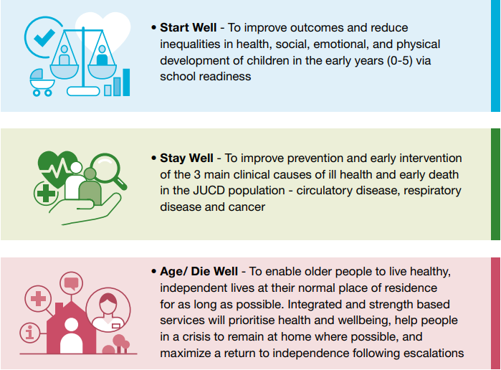
Joined Up Care Derbyshire Integrated Care System
Joined Up Care Derbyshire is the Integrated Care System, responsible for coordinating health and social care across Derby and Derbyshire. It is one of 42 Integrated Care Systems across England, and brings together NHS bodies, local authorities and voluntary sector organisations to deliver better care for our whole community.
Our priority is to make improvements to the Derby and Derbyshire population’s life expectancy and healthy life expectancy levels in comparison to other parts of the country, and reduce the health inequalities that are driving these differences.
Integrated Care Partnership (ICP) Priorities
The process for developing the Strategy has resulted in system-wide agreement on three Key Areas of Focus that will help deliver prioritised population health and service delivery outcomes, they are:
NHS Derby and Derbyshire Integrated Care Board
NHS Derby and Derbyshire Integrated Care Board

Slide 6
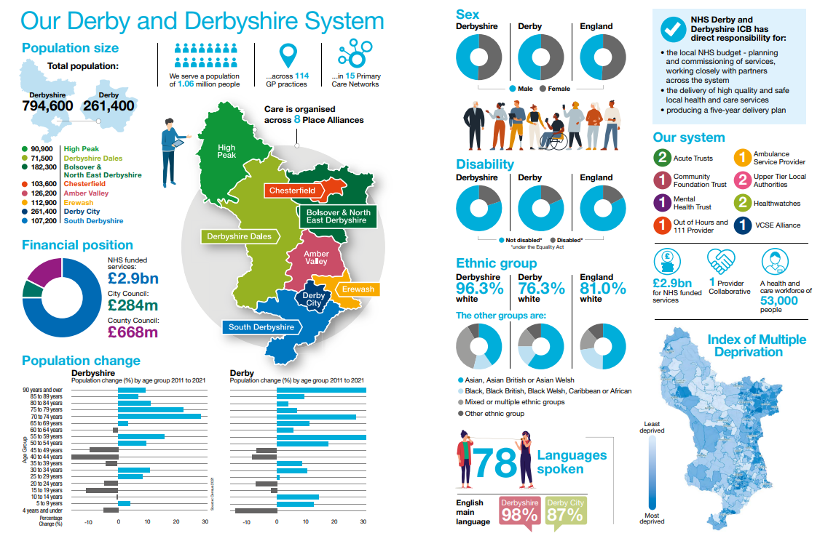
NHS Derby and Derbyshire Integrated Care Board
NHS Derby and Derbyshire Integrated Care Board

Slide 7
Integrated Care Board
NHS Derby and Derbyshire Integrated Care Board (ICB) is the organisation responsible for:
planning to meet local health needs
managing the NHS budget and allocating resources
ensuring services are in place to deliver against ambitions
overseeing delivery of improved outcomes for their population.
NHS Derby and Derbyshire is part of the Joined Up Care Derbyshire integrated health and care system, working with partners in our local authorities, the voluntary sector and others, and helping the NHS to support broader social and economic development.
NHS Derby and Derbyshire brings together all NHS organisations and it also facilitates the work of the Integrated Care System, including supporting the coordination and implementation of our Integrated Care Strategy.
NHS Derby and Derbyshire Integrated Care Board is working to a five-year delivery plan 2023-28.
NHS Derby and Derbyshire Integrated Care Board
NHS Derby and Derbyshire Integrated Care Board

Slide 8
Our Joint Forward Plan
The ICB has a duty to prepare a Joint Forward Plan (JFP) with partner NHS Trusts for 2024/25.
The JFP will act as a delivery plan for the key priorities outlined in the ICP strategy and set out how the ICB and its partner trusts intend to arrange and/or provide NHS services to meet their population’s physical and mental health needs – including its universal commitments for all, the four ICS core purposes and legal requirements under the Health and Care Act.
The ICB Five Year Plan 2023-2028 outline the actions the ICB needs to take to improve population and healthcare outcomes, reduce inequalities, enhance productivity, and support broader social and economic development.
NHS Derby and Derbyshire Integrated Care Board
NHS Derby and Derbyshire Integrated Care Board

Slide 9
Governance, Oversight and the Equality Delivery System
The Integrated Care Board (ICB) is led by the Chair and Chief Executive of the ICB, and supported by five Non-Executive Directors, seven Executive Directors and five partner members. The board is responsible for system oversight and assurance around planning and progress against key population health and workforce indicators and building accountability through the ICB.
The Board is supported by the following committees:
Audit and Governance Committee
People and Culture Committee
Population Health and Strategic Commissioning Committee
Public Partnership Committee
Quality and Performance Committee
System Finance and Estates Committee
Equality Delivery System (EDS) 2023-2024
The Equality Delivery System (EDS) is a system that helps NHS organisations improve the services they provide for their local communities and provide better working environments, free of discrimination, for those who work in the NHS, while meeting the requirements of the Equality Act 2010.
NHS Derby and Derbyshire Integrated Care Board
NHS Derby and Derbyshire Integrated Care Board

Slide 10
Equality Objectives and Progress
The equality objective for the ICB for 2024-2026 centres on the development of community profiles to support communications and engagement projects.
The community profiles build on the work developed during the Covid-19 pandemic and aim to make information about the NHS accessible to all sections of the Derby and Derbyshire population.
The community profiles will give analysis and advise how to best engage and communicate with the whole community. This will include communication preferences (e.g. younger people and a reliance on Social Media) as well as language needs, health literacy and ways in which to engage people in their own environment (e.g. Faith settings or working with social housing engagement groups).
Further developments
The Integrated care Board is in the process of developing staff based objectives for 2025-2026.
NHS Derby and Derbyshire Integrated Care Board
NHS Derby and Derbyshire Integrated Care Board

Slide 11
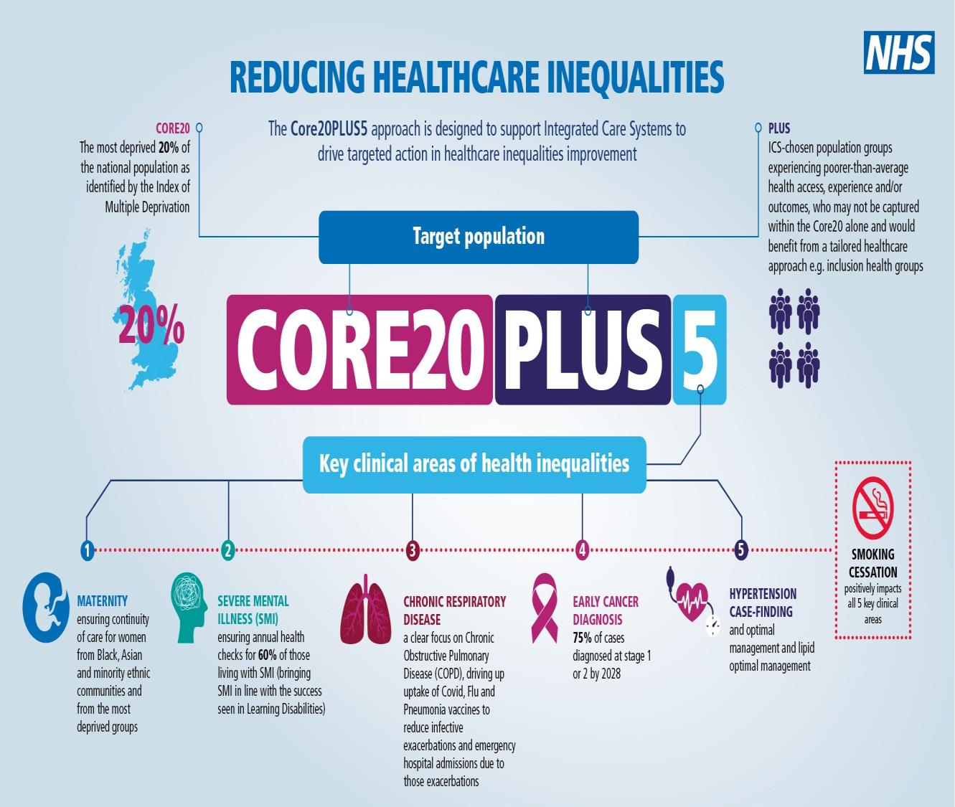
Reducing Healthcare Inequalities through CORE20PLUS5
To develop a targeted approach to addressing health inequalities, the ICB is looking at new ways of working and planning for services, including:
Using data to identify populations and communities where there are inequalities of access, experience and outcomes or individuals and communities at higher risk of developing a disease.
Developing detailed and tailored approaches to support people and communities in a way that is culturally relevant and competent.
As these methods will take time to mature, the ICB will continue to align priorities to the Core20plus5* approach, targeting specific communities and diseases or conditions as priorities for both adults and children. These plans will be reviewed to ensure they are fit for purpose.
* Core20plus5 is a national NHS England approach to inform action to reduce healthcare inequalities at both a national and system level. The approach defines a target population and identifies 5 focus clinical areas requiring accelerated improvement.
NHS Derby and Derbyshire Integrated Care Board
NHS Derby and Derbyshire Integrated Care Board

Slide 12
Workforce Information
This section provides information on the ICB’s workforce – it provides a snapshot as of 31 March 2024, and includes the overall workforce profile analysis in terms of protected characteristics and information on starters and leavers.
As of 31 March 2024, the ICB employed 493 staff.
The data on the protected characteristics of staff has been drawn from the ICB’s Employee Staff Records. Employee disclosures on Age and Gender have been found to be complete. For the other protected characteristics, the analysis found: 2% did not declare their ethnicity, 9.7% did not declare their disability status, 18.8% did not declare their sexual orientation, 26.2% did not declare their religion or belief and 3.4% did not declare their marital status. The analysis is limited to that extent and does not reflect a full picture of its workforce.
Over the coming months, we will proactively work to encourage staff to feel confident in updating their personal information as part of our efforts toward creating an inclusive organisation and building a more accurate workforce profile. The data will continue to be updated periodically.
NHS Derby and Derbyshire Integrated Care Board
NHS Derby and Derbyshire Integrated Care Board

Slide 13
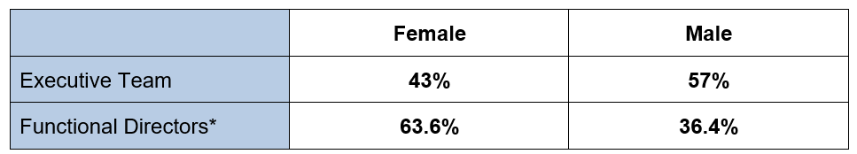
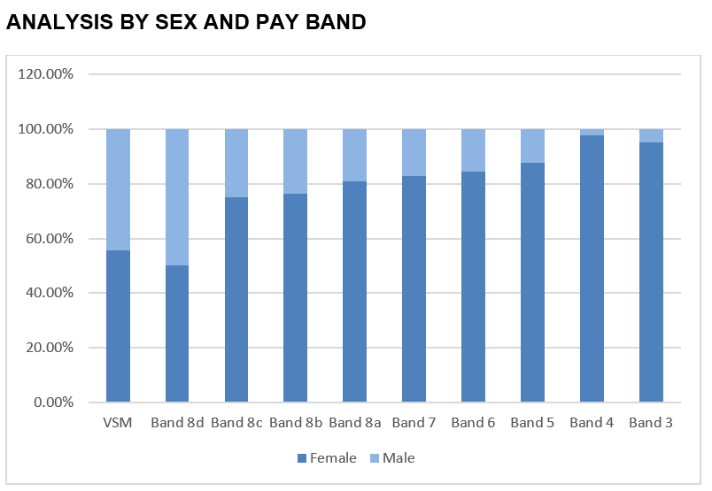
Workforce Analysis: Gender
Of the 493 staff 84.2% were Female and 15.8% male.
The majority of female staff were employed within the lower pay bands within the ICB
55.6% of the staff in Very Senior Manager ‘VSM’ pay bands, which are executive director or director positions were female.
90% of males and 97% of females are on NHS Agenda for Change terms and conditions.
NHS Derby and Derbyshire Integrated Care Board
NHS Derby and Derbyshire Integrated Care Board

Slide 14
Workforce Analysis: Ethnicity
88.2% of the ICB’s workforce identified as White, 6.7% as Asian, 2% as Black, 0.6% as Mixed, 0.4% as Chinese and 2% did not state their ethnicity.
The 2023 staff survey identified that our ethnically diverse staff feel less satisfied with the level of pay, and less satisfied that the organisation acts fairly regarding career progression
The ICB recruitment data also shows that our ethnically diverse candidates are less likely to be successful during the recruitment process.
The ICB has agreed the following actions to address this:
Overhaul recruitment and selection processes
All recruiting managers to undertake Fair & inclusive recruitment and unconscious bias training
Board members to actively participate in the Building Leadership for Inclusion development programme
Co-produce an Anti-Racism Strategy
A wider roll out of reciprocal mentoring
Leadership and Management development (to include being a kind, compassionate and inclusive manager with a focus on wellbeing)
The ICB will work with the Diversity and Inclusion Network to implement the above.
NHS Derby and Derbyshire Integrated Care Board
NHS Derby and Derbyshire Integrated Care Board

Slide 15
Workforce Analysis: Ethnicity 2/2
NHS Derby and Derbyshire Integrated Care Board
NHS Derby and Derbyshire Integrated Care Board

Slide 16
Workforce Analysis: Disability
9.7% of the ICB’s workforce declared they had a disability
79.9% stated they did not have a disability
10.4% did not declare their disability
0.2% preferred not to state if they had a disability
New Starters
81.8% of new starters did not have a disability, 4.5% did not specify and 13.5% declared having a disability.
Leavers
83.3% of leavers did not have a disability, 6.7% did not specify and 10% had a disability.
The ICB is a Disability Confident Employer and has a Disability and Reasonable Adjustment Policy. In the 2023 Staff Survey 89.3% of disabled staff stated that the ICB had made reasonable adjustment(s) to enable them to carry out their work.
The ICB is committed to ensuring all disabled staff have the reasonable adjustments they need at work.
NHS Derby and Derbyshire Integrated Care Board
NHS Derby and Derbyshire Integrated Care Board

Slide 17
Workforce Analysis: Age
NHS Derby and Derbyshire Integrated Care Board
NHS Derby and Derbyshire Integrated Care Board

Slide 18
Workforce Analysis: Sexual Orientation
This information is not being reported by pay band owing to the very small number of declarations and to protect anonymity.
NHS Derby and Derbyshire Integrated Care Board
NHS Derby and Derbyshire Integrated Care Board

Slide 19
Workforce Initiatives – Equality, Diversity & Inclusion
Implementing the 6 High Impact Actions (detailed in the nhs equality diversity and inclusion improvement plan published June 2023)
All internal workforce policies are being developed in line with current legislative requirements, including the Equality Act 2010. These policies cover the recruitment, selection and appointment process, as well as all aspects of working for DDICB.
Collaborative / aligned development and education plans focused on equality, diversity and inclusion, compassionate leadership and the importance of kindness, civility and respect.
Wider roll out of Reciprocal Mentoring.
Co-produce anti-racism strategy.
Review of reasonable adjustments and the reasonable adjustment passport.
Delivering the Workforce Race Equality Standard’s (WRES) and the Workforce Disability Equality Standard’s (WDES) model employer goals.
Delivery of fair and inclusive recruitment processes and talent management strategies that target under-representation and lack of diversity in the workforce.
Continued focus on our flexible working offer across the system with the aim of increasing the availability of flexible working arrangements.
Diversity in Health and Care Partners Programme - Advancing equality and inclusion in the workplace.
NHS Derby and Derbyshire Integrated Care Board
NHS Derby and Derbyshire Integrated Care Board

Slide 20
Workforce Initiatives
Diversity and Inclusion Network
The diversity and inclusion network is an open forum run by staff and for staff to provide a safe and supportive environment in which to discuss issues relating to their protected characteristics to support equality and diversity by ensuring that the various protected characteristics have vision and impact.
The D&IN recognises that people have a number of identities and can face challenges associated with their gender, gender identity, ethnicity, disability, pregnancy, religion and sexual orientation.
The Network has a key role in making diversity and inclusion part of our DNA. Key initiatives have included:
Celebrating and promoting key dates in the inclusion calendar
Introducing of a programme of reciprocal mentoring with senior directors
Raising awareness of the lived experiences of under-represented staff
Informing the WRES, WDES and Staff Survey action plans
The terms of reference for the Network are being reviewed to provide a clear purpose, line of accountability and clarification how the Network is to be integrated into the decision making of the ICB.
Members of the Network are supporting the ICB to implement the recommendations from the ‘Too Hot to Handle’ report into racism in the NHS.
NHS Derby and Derbyshire Integrated Care Board
NHS Derby and Derbyshire Integrated Care Board

Slide 21
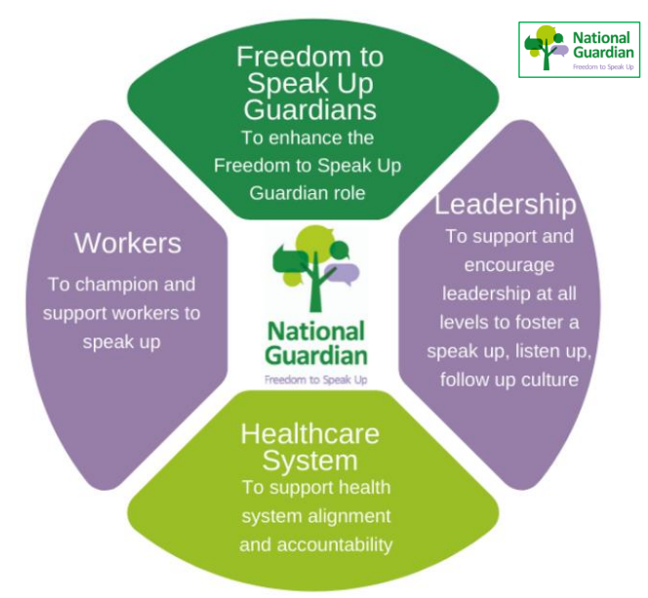
Workforce Initiatives – Freedom to Speak Up
Freedom To Speak Up (FTSU) Guardians are employed across the NHS. Freedom to Speak Up is for anyone who works in health. This includes any healthcare
professionals, non-clinical workers, senior, middle, and junior managers, volunteers, students, locum, bank and agency workers, and former employees.
This role was created as a result of the recommendations published in 2015 by Sir Robert Francis following his review of the Mid Staffordshire Hospital. Please see the
full report here.
The ICB’s has a FTSU Guardian and FTSU Ambassadors who act as an independent and impartial outlet for ICB staff to raise issues or concerns confidentially. The themes gathered from the issues raised with the FTSU Guardian will help the ICB make improvements for patients and staff.
NHS Derby and Derbyshire Integrated Care Board
NHS Derby and Derbyshire Integrated Care Board

Slide 22
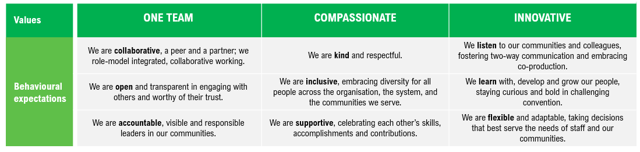
Workforce Initiatives – Values & Behaviours
The ICB is developing an organisational development plan to embed our values of
One Team, Compassionate, and Innovative
NHS Derby and Derbyshire Integrated Care Board
NHS Derby and Derbyshire Integrated Care Board

