Slide 1
Derbyshire Dental
Recovery
Derbyshire Dialogue
25 June 2025
NHS Derby and Derbyshire Integrated Care Board

Slide 2
During this session we will…
Share our dental achievements since finalising our 3-year plan in 2024
Acknowledge how much we still need to do
Ask for your views on barriers to dental treatment and your experience in using these services
Tell you our upcoming plans and priorities for the rest of this year and next year
Share some information we would appreciate you passing on
And finally end with how we plan to keep our population informed on the work we are doing
NHS Derby and Derbyshire Integrated Care Board
NHS Derby and Derbyshire Integrated Care Board

Slide 3
What do we mean by…
Urgent dental treatment
Treatment that is not routine. This could be due to toothache with an unknown cause or a cracked tooth or filling causing discomfort or pain.
General access
Registering at a Dental Practice for NHS treatment is not the same as registering at a General Practice. Firstly, dentists will see patients for NHS treatment (if they have availability to do so) regardless of where you live, there’s no “catchment” area. Secondly it is important to note that registration with an NHS dentist has not existed since 2006, many practices have maintained a list of NHS patients they offer to recall for check ups, but it is not the same as being registered with a GP.
Units of Dental activity
You might hear the term units of dental activity, which is a way of measuring jobs done by a dentist e.g. how many routine check ups they’ve done or how many x-rays, fillings, crowns, extractions etc. there are set payments for each type of treatment the dentist will receive payment upon completing these treatments.
Procure
To procure services means to formally buy services from an external provider, typically through a structured process involving selection, negotiation, and contracting called a procurement process.

Slide 4
Achievement highlights 2024/25
Several steps were taken to improve NHS dental services:
Contract uplift was nationally offered to encourage dentists to stay in the NHS.
"Golden hello" payments, four practices in Derby and Derbyshire expressed an interest and these dentists will have to commit to working in the NHS for at least 3 years to receive these payments.
Dentists were allowed to go 10% over their budget to treat more patients.
NHS Derby and Derbyshire Integrated Care Board
NHS Derby and Derbyshire Integrated Care Board

Slide 5
Achievement highlights 2024/25
Additional funding was introduced so dentists could focus on seeing high-priority patients.
Additional community dental service funding allocated for children and more vulnerable patients.
Additional urgent dental appointments.
More urgent and routine appointments were funded in Bolsover, an area with some of the worst dental health and access in the county.
NHS Derby and Derbyshire Integrated Care Board
NHS Derby and Derbyshire Integrated Care Board

Slide 6
Access achievements
The dental contract works on Units of Dental Activity
In 2024/25, dentists did more work than the year before. They completed 4.1% more units of contracted dental activity.
Last year, they finished 87 out of every 100 units they were asked to do. This year, they finished about 91 out of every 100.
That means they did 1,359,411.8 dental units of activity this year.
Last year, they did 1,335,118. So, they did 24,293 more units this year than the year before.
These units include activity like routine NHS checks, fillings, crowns, scale and polish etc.
NHS Derby and Derbyshire Integrated Care Board
NHS Derby and Derbyshire Integrated Care Board

Slide 7
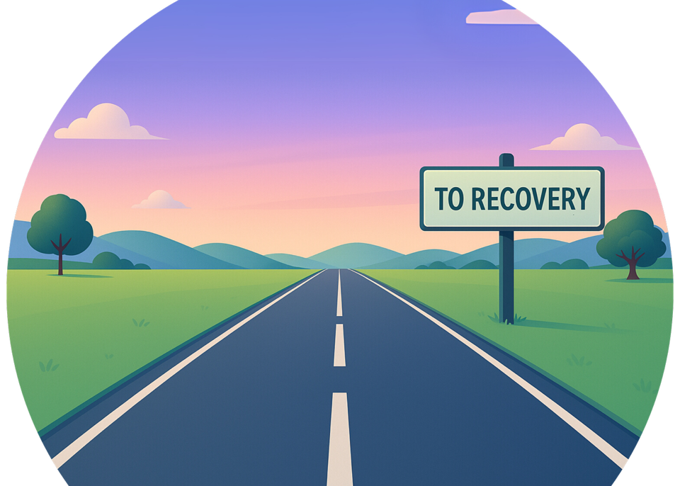
Our road to recovery
We know that for some people general access is a problem
There is a lot of work underway to improve general dental access as mentioned, such as; improved pay, Governments national target for 700,000 new urgent dental appointments, more money to support services for children and vulnerable people.
There are some areas more in need than others
We are already focusing our efforts on areas like Bolsover and Amber valley where we know people struggle to register with an NHS dentist. To target the areas most in need we refresh and map out access data and map out the services around these areas to understand where we need to keep focusing our efforts.
Some groups of people more in need
We’re looking at doing some targeted engagement with groups of people who generally struggle to access health and social care services. We are also taking part in new national projects this year such as dental checks in special educational needs settings and training staff to do tooth brushing in early years settings like pre schools and nurseries.
NHS Derby and Derbyshire Integrated Care Board

Slide 8
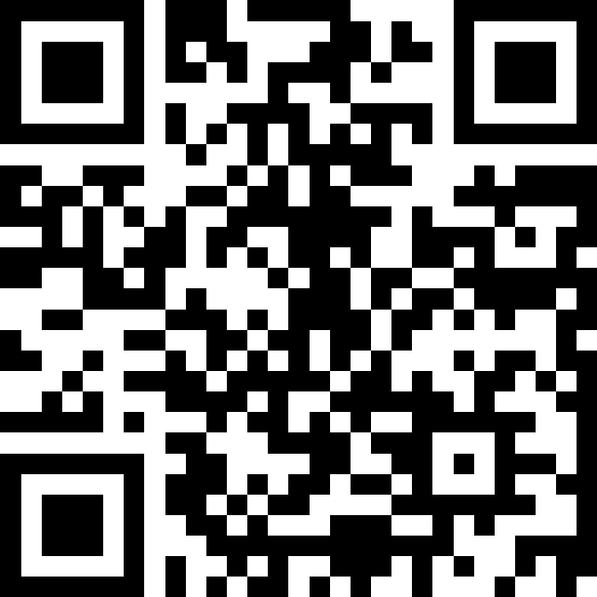
Do not edit How to change the design
What do you think are the main things that prevent someone from seeing an NHS dentist?
The Slido app must be installed on every computer you’re presenting from
Notes:
https://app.sli.do/event/wMpgvs4fecMjDkPhhAfqW5

Slide 9
Do not edit How to change the design
If you or a family member have visited a dentist in the last year, tell us what went well?
The Slido app must be installed on every computer you’re presenting from
Notes:
https://app.sli.do/event/wMpgvs4fecMjDkPhhAfqW5

Slide 10
Do not edit How to change the design
If you or a family member have visited a dentist in the last year, tell us what didn't go well?
The Slido app must be installed on every computer you’re presenting from
Notes:
https://app.sli.do/event/wMpgvs4fecMjDkPhhAfqW5

Slide 11
Our top priorities for this year and next
Make sure everyone who needs urgent dental care can get it:
So far 14,000 out of the ICB's target of 16,298 urgent care appointments have been arranged to meet the Government commitment of 700k additional appointments.
We will also arrange more appointments to stabilise dental issues at the same dentist.
2. Dental care for those most in need:
Focus on reaching people who don’t usually get dental care.
Make sure the care process is very clear and quick.
3. Routine Dental Care Planning:
As we mentioned earlier, we will target the areas most in need by refreshing and mapping out access data and mapping out the services around these areas with poor access to understand where we need to keep focusing our efforts and then keep funding going to stabilise these areas.
NHS Derby and Derbyshire Integrated Care Board
NHS Derby and Derbyshire Integrated Care Board

Slide 12
Our top priorities for this year and next
4. Dental checks in special educational needs settings:
• We are exploring the possibility of taking up the national free dental checks being offered at some special educational need residential settings. We may be able to roll this out in stages across Derby and Derbyshire but are currently looking at expressions of interest from the settings.
• The aim of these check-ups would be to look for potential issues and possibly even undertake minor work such as applying fluoride varnish or demonstrating effective toothbrushing.
5. Procure the following services:
Intermediate Minor Oral Surgery services
Clinical Waste management – Safe disposal of medical waste.
Domiciliary Care – Care provided at patients’ homes.
Interpreter Service – Language support for patients.
Urgent Care (Unscheduled) – Existing contracts for emergency urgent treatment.
Ongoing services in Bolsover (area of concern with dental access).
NHS Derby and Derbyshire Integrated Care Board
NHS Derby and Derbyshire Integrated Care Board
Notes:
IMOS: Sometimes oral surgery is too complex to be undertaken in a general dental practice, but not sufficiently complex to be undertaken in a hospital. In these instances, treatment may be undertaken by an Intermediate Minor Oral Surgery (IMOS) service. IMOS services treat patients aged 16 years and over and are usually specialists based in select community dental surgeries.

Slide 13
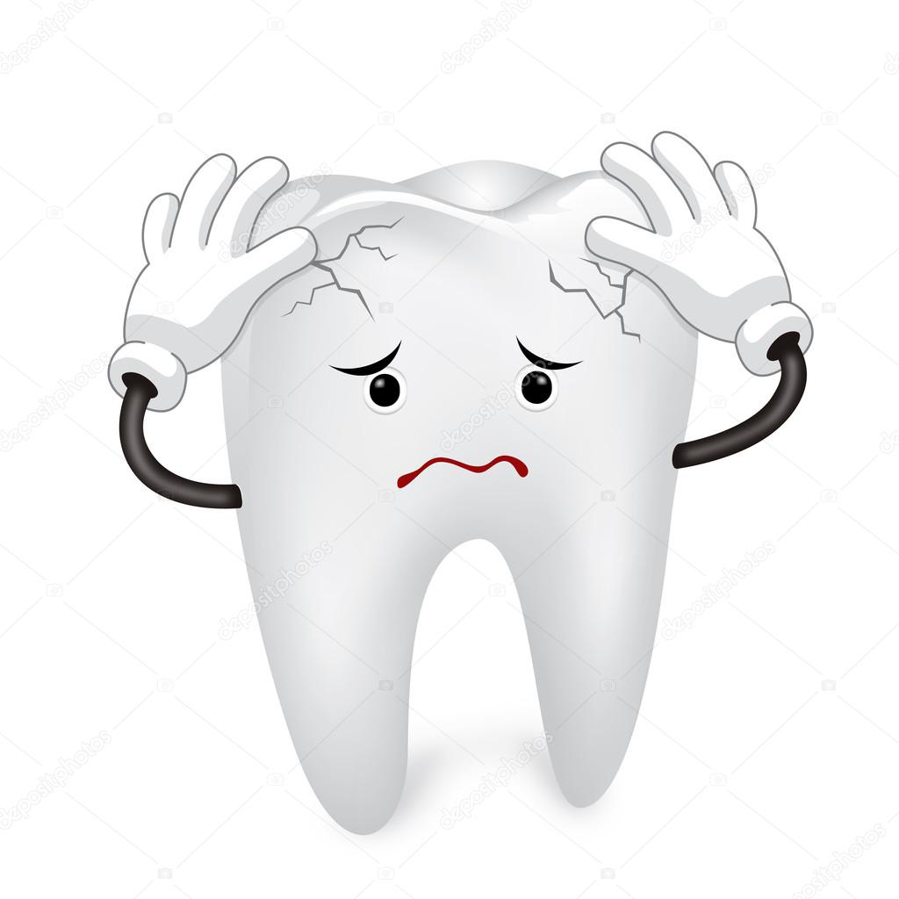
Did you know…
You can access urgent dental treatment by calling 111
If you don’t have an NHS dentist or can’t see your regular dentist for urgent treatment you can call 111 who will triage you and support, you to get the care you need.
111 can find you an out of hours dental service too
If you have a need for urgent treatment and your regular dental practice is closed, you can call 111 and they will find an out of hours service for you.
111 can offer advice while you wait to be seen
111 can also advise on pain management, such as taking paracetamol while you’re waiting to receive treatment.
Please don’t contact your GP or A&E, call 111 first.
NHS Derby and Derbyshire Integrated Care Board
NHS Derby and Derbyshire Integrated Care Board

Slide 14
Informing our population
How we plan to keep people updated on dentistry
We will share dental updates in our Joined Up Care Derbyshire newsletter; you can sign up here
Work is underway on the Dental & Dentistry page to better inform and direct people to dental services
Engagement with people who generally struggle to access dental and other health and community services
We are organising a system dental summit with our local authority council colleagues, and organisations such as Healthwatch to ensure we are all working together and communicating the right messages.
NHS Derby and Derbyshire Integrated Care Board
NHS Derby and Derbyshire Integrated Care Board

Slide 15
For more information
Email: ddicb.dental@nhs.net
Web: www.derbyandderbyshire.icb.nhs.uk
Web: joinedupcarederbyshire.co.uk
NHS Derby and Derbyshire Integrated Care Board
NHS Derby and Derbyshire Integrated Care Board

