Slide 1



Derbyshire Dialogue – Place 15th May 2024
Angela Wright – Assistant Director Place Development & Delivery Derby & Derbyshire ICB

Slide 2
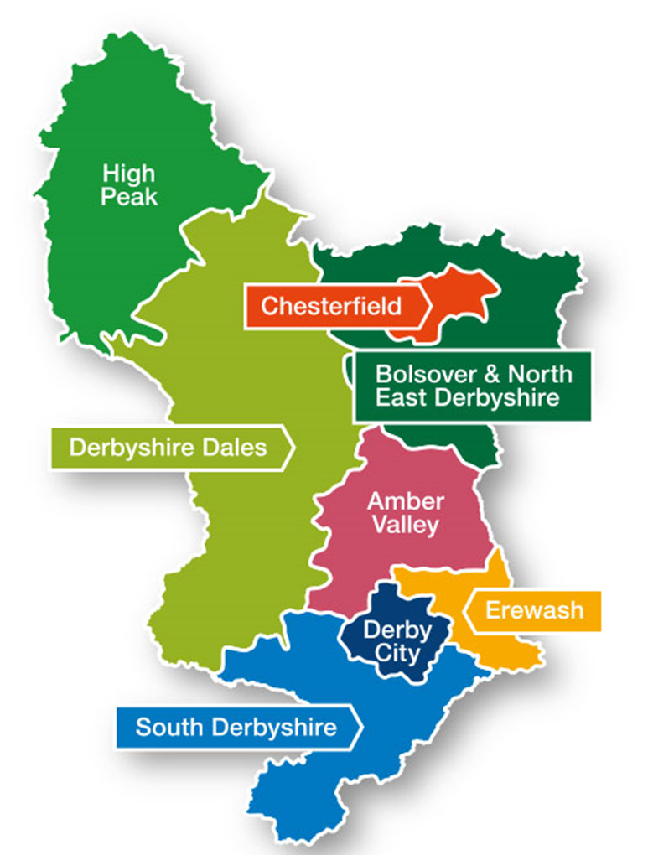
Place – What is it?
Way of Organising Ourselves
  Roughly co-terminous with council boundaries
Way of Doing things
  Partnership – the relationship is the driver – Collaboration not Competition
  Learning & Innovative Culture – trying things to see if they work
  Empowering local teams – Working within a framework less central control
Essentially its Joint Working

Slide 3
Place – Why is it Important?
Our health is only 15% related to the NHS care we receive. Other factors have a lot greater influence on our health;
  our housing,
  urban/rural environment,
  job,
  lifestyle factors.
We want our population to receive coordinated care and use Derbyshire resources efficiently.

Slide 4
Place – How does it Work?
Local service manager forums for communication, coordination and transformation
Delivery of care and support working AND those responsible for the factors that affect our health such as housing , the environment etc
Aim to improve local population health & provide a better experience for staff, patients by
  Better coordination of services,
  Identifying local population needs and working together to meet them,
  Breaking down organisational barriers

Slide 5
Place – Local Examples
Amber Valley – Innovative use of resources to support Families
Chesterfield – Supporting the population of Barrow Hill
High Peak – Working with Derbyshire Carers Association

Slide 6
Place – The stages and What’s next
Working in this way since 2018
Noticed a number of stages of development
  Communication – establishing the relationship , building trust and understanding
  Coordination – operating in a coordinated manner, joint projects
  Transformation – we can do this better – lets change it
Transformation
  Team Up Programme – subject of next Derbyshire Dialogue
  Tackling Health Inequalities

Slide 7
Place - How can you help?
Start to think system
  - your patient/client is someone else's too. Is the way that you deliver your care / support assisting someone else in a different organisation to also do their best for that person
  - are the rules of your organisation helping partnership working or do they make it more difficult for people from different organisations to work together to help local communities
Identify duplication in organisational procedures or effort between organisations which means resources aren’t being used effectively
Engage with your local Place partnerships
Everyone can be thinking what would enable joint working

Slide 8
Contact Details
Name: Angela Wright
Title: Assistant Director Place Development & Delivery
Email: ad.place@nhs.net or ddicb.communications@nhs.net
Web: https://joinedupcarederbyshire.co.uk

