Slide 1

Welcome to the Derby and Derbyshire ICB
Developing a One Workforce Ethos and Approach Presentation
Presented by
Lee Radford – ICB Chief People Officer
Sukhi Mahil – Associate Director of Workforce Strategy, Planning and Transformation and CPLG Management Lead
Susan Spray - Programme Lead – Careers and Anchor Development

Slide 2
What is the problem we are trying to solve ?
To attract, develop and retain a sustainable workforce and talent supply and to create a consistent inclusive and compassionate culture across the system to deliver integrated care to our communities.
So why are we doing this?
High levels of vacancies in the System Workforce Variable cultural experiences mean people don’t stay
People choosing different lifestyles post covid Cost of living crisis creating better paid opportunities
Our Vision and Purpose for a One Workforce Approach and Ethos
“Our vision is that anyone working in health and care within Derby and Derbyshire feels part of ‘one workforce’ which is focused on enabling our population to have the best start in life, to stay well and age well and die well.
Our workforce will feel valued, supported and encouraged to be the best they can be and to achieve the goals that matter to them wherever they work in the system.”

Slide 3
The principles of developing this One Workforce strategy, approach and ethos
Retain and support the wellbeing of all our people.
Develop a sense of belonging and embedding equality, diversity and inclusion throughout to ensure we reach and develop a diverse workforce.
Develop a culture which is compassionate and inclusive and supports our people to thrive and that will retain our existing workforce as well as attracting future talent into Derbyshire.
Develop our people to fully utilise and invest in the skills and talents of the current workforce to enable them to do more throughout their careers, as well as identifying future skills needed.
Create new routes into local careers across different workforce sectors and professions across Derbyshire.
Develop shared solutions to shared problems.

Slide 4
National Strategic Workforce Context
As of March 2024, NHS vacancy statistics demonstrate that there are 100,700 vacancies in the NHS.​
The NHS sector with the highest vacancy rate is mental health – currently 11.7%.​​
Low Staff satisfaction in NHS - 29% state that they often think about leaving with the top two reasons for leaving are to improve work life balance or because of health issues.
In adult social care in 2023/24, there were 131,000 vacancies, equivalent to 8.3% of the total workforce. Turnover is also high, at 28.3%.
Nursing applications to Universities are down by 32% compared to 2021 and a further 10% in England from 2023. This will create a significant pressure on workforce supply in three years time.
Significant increase in young people declaring mental health conditions which will require employers to ensure that organisations have an inclusive and compassionate culture to attract and retain future workforce pipelines.

Slide 5
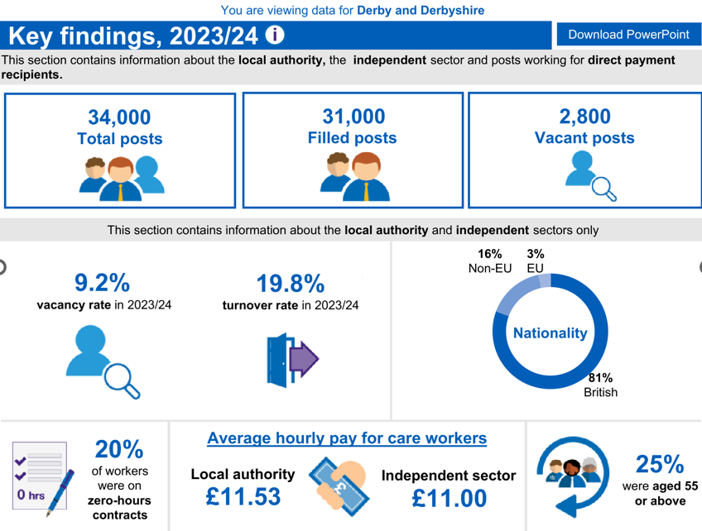
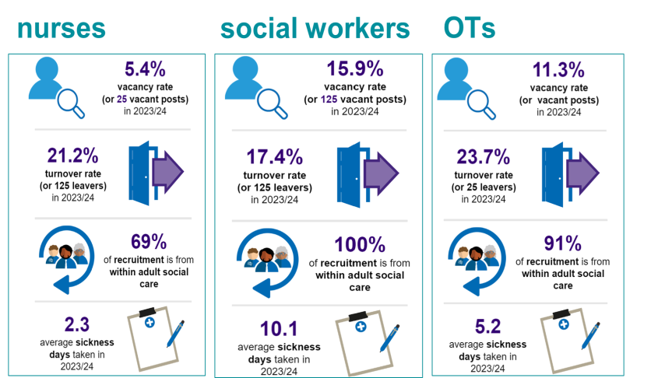


Derby and Derbyshire Workforce Context
NHS Workforce (at M9)
Social Care Workforce
30,508
Substantive Posts
30.370
Filled Posts
138
Vacant Posts
6.7%
Vacancy rate
9.2%
Turnover rate
JUCD Sickness rate 6.0% against Midlands 5.8%
VCFSE Workforce
Approximately 5000 VCFSE organisations in Derbyshire
Impacts on recruitment challenges – source national VCFSE sector portal
Had to pause some operations | 49.4%
Employees working increased hours | 48.2%
Unable to meet demand | 39.6%
Had to recruit temporary workers | 18.9%

Slide 6
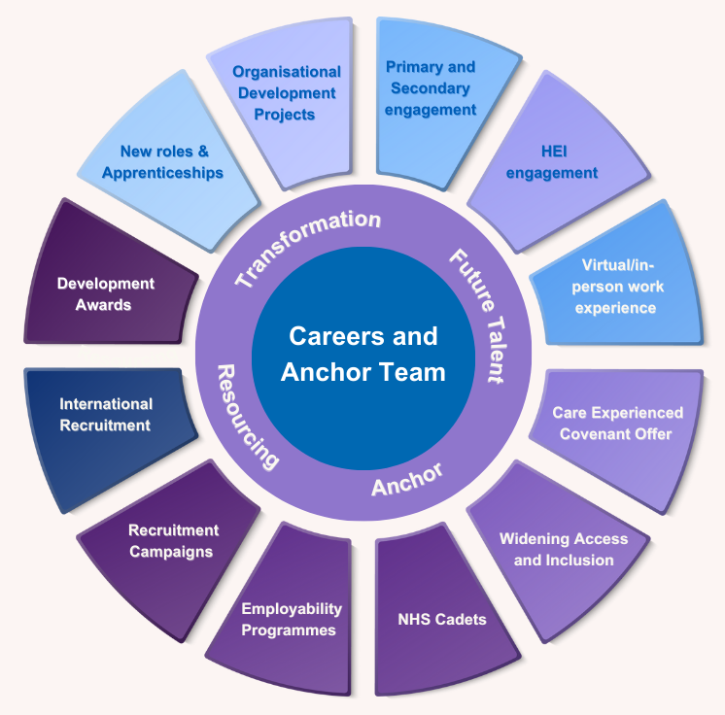
We are starting from a strong position and we are currently doing work to support the Anchor Ambition and social mobility
Scaling up system wide recruitment campaigns including engagement with Schools, local HEI's/Colleges to grow our own local workforce supply, collaborative recruitment and hosting of system-wide careers recruitment events
BME RESPITE SITTING SERVICE new cohort 2024 - progression route into Step Into Work or employment
COMMUNITY ENGAGEMENT – Community Action (Derby) – Derby City Council – Careers Service – REED REP - Normanton Partnership
CARE COVENANT PROGRAMME – system employability offer to care experienced young people including coaching and guaranteed interviews
A JUCD Health and Social Care Workforce Charter has been developed as a commitment to improving the wellbeing and overall workplace in order to recruit and retain new staff.
Working with Derbyshire BME Forum and Refugee communities - Neurodivergent - Care Experienced
Step Into Work is an established flexible pre-employment training programme provides broad access to employment across the sector including NHS Trusts, Local Authority and PVI providers of social care and has a distinct identity and role as a programme to support and to enable inclusion and diversity through active recruitment and referral partnerships.

Slide 7
What do we need to do next?
We need to undertake an extensive system wide engagement process across all health, care, local authority and VCFSE sectors to understand the current state of the workforce, areas of under representation, social mobility cold spots, culture, areas of best practice, challenges and risks.
To identify system collaboration opportunities and learning from all sectors to develop shared approaches where appropriate to attract, develop and retain a workforce and talent supply as part of a One Workforce approach.
To create new innovative routes and approaches into employment from college to work for our local population and to remove barriers to applying to join the System workforce as part of our Anchor ambition and to improve social mobility.
To identify ways to create a consistent and inclusive and compassionate culture to attract and retain our people across Derby and Derbyshire supported by a system EDI approach to feel part of the system workforce.

Slide 8
Next Steps
Feb 25 | Establishment of a One Workforce Steering group with multi sector and professional representation
Mar – Jun 25 | Engagement and diagnostic phase to understand the current system workforce, area of under representation, social mobility cold spots, culture, areas of best practice, challenges and risks.
Jul-Aug 25 | Analysing results of diagnostic phase, play back findings to the system, to identify opportunities for collaboration and to test recommendations.
Sept – Nov 25 | Develop draft strategy, test approaches and future desired state with system partners.
Jan 26 | Present the One Workforce Strategy, approach and ethos to ICB People and Culture Committee and ICB/ICP Boards for approval.

Slide 9
Thank you for listening
Any Questions?

