Slide 1
Notes:
Introduction
Our programmes
How to refer and self-refer
Eligibility criteria
Exclusion criteria
Marketing Materilas
Venues

Slide 2
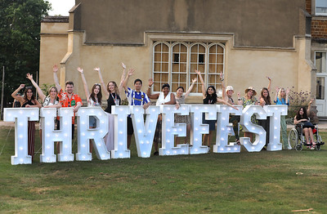
Who are we?
An experienced healthy lifestyles services provider, delivering high quality provision across the country for the last 15 years. Our mission:
To empower over 1 million people to change their behaviour and thrive!
Notes:
Intro to company
A healthy lifestyles service provider
We have been around for about 15 years
We have recently launched our NDPP programme
We help people make lasting changes

Slide 3
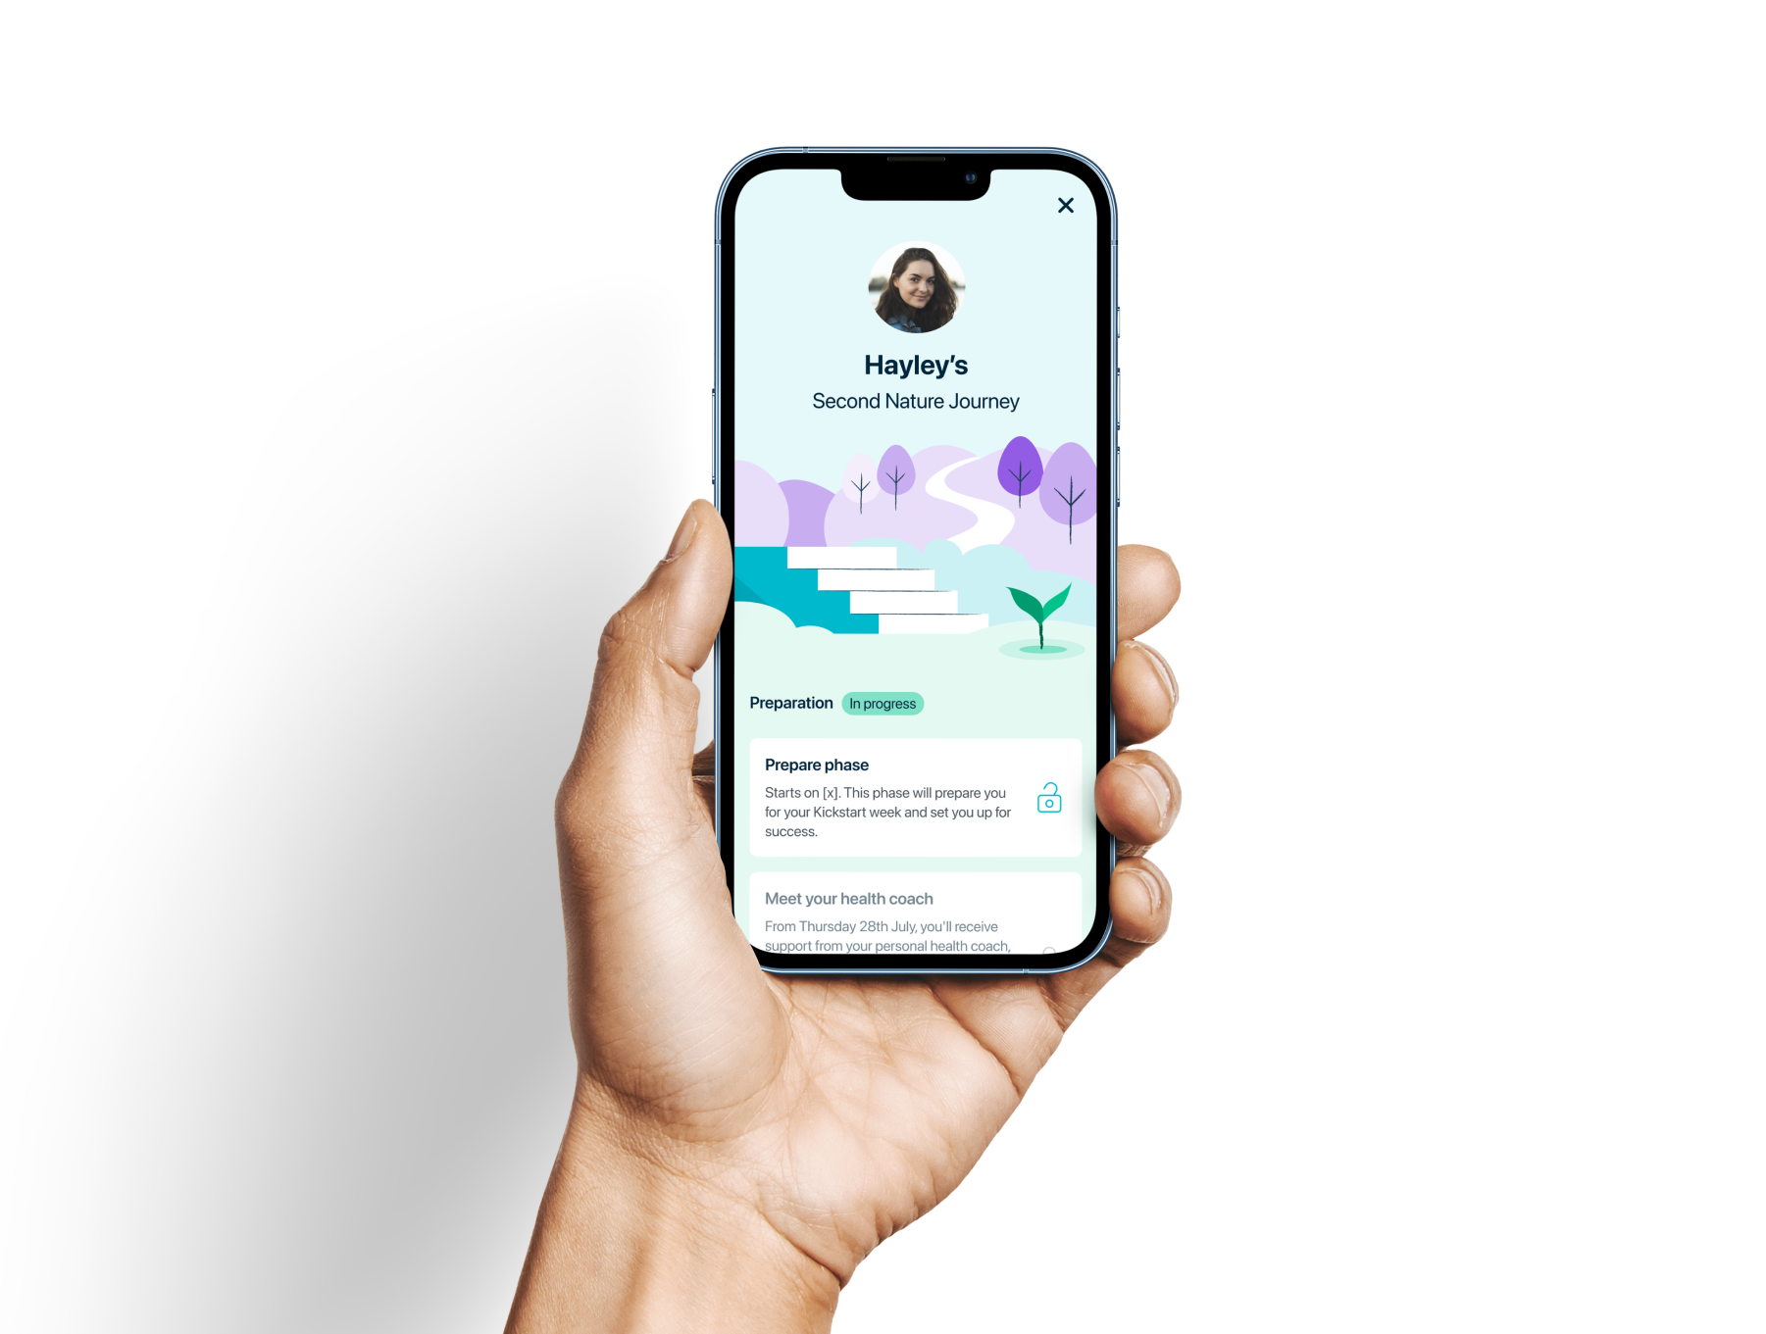
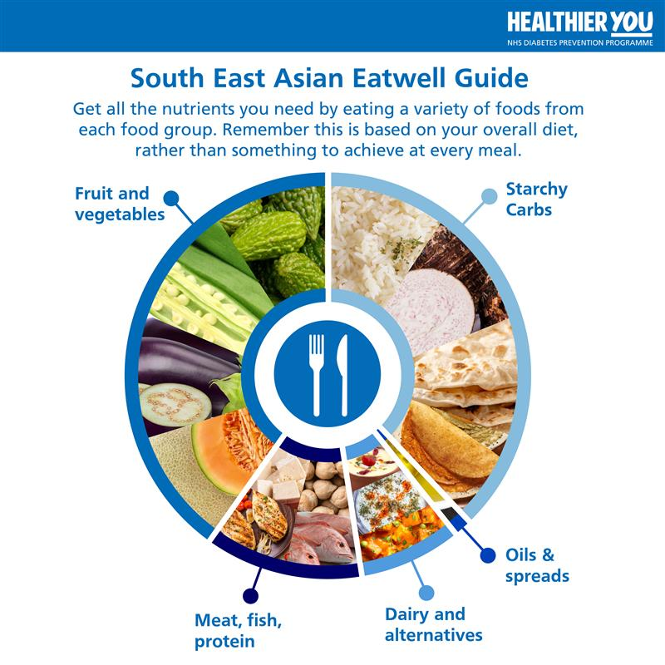
Our Programmes
Thrive Tribe’s F2F Group Programme
Digital – provided by Second Nature
Thrive Tribe’s Tailored Remote Courses – adapted for specific cohorts of patients.
Notes:
Group Programme – 13 sessions over 9 months, initially fortnightly, then on to monthly. Designed by renowned clinicians (GP Lead, Dietitian, Behaviour Change Experts), based around the idea of 1% experiments and targeting the wider determinates of health. Delivered in the community for patients, all face-face but with automated digital reminders, opportunities for patients to catch up on missed sessions and initial ‘get to know you sessions’ delivered over the phone. Digital – A 9-month digital programme provided by Second Nature. Completely phone based, via their app. Online group support, 1-1 support from a registered nutritionist and patients encouraged to engage with the app daily for 10-15 minutes. Huge amounts of content for patients as well as tools and accessories – Digital scales etc.
Tailored Remote Courses - Building tailored programmes in collaboration with RNIB, Faheera Jay & Yvonne Cobb. Tailored resources specifically for South Asian, African & Caribbean populations.

Slide 4
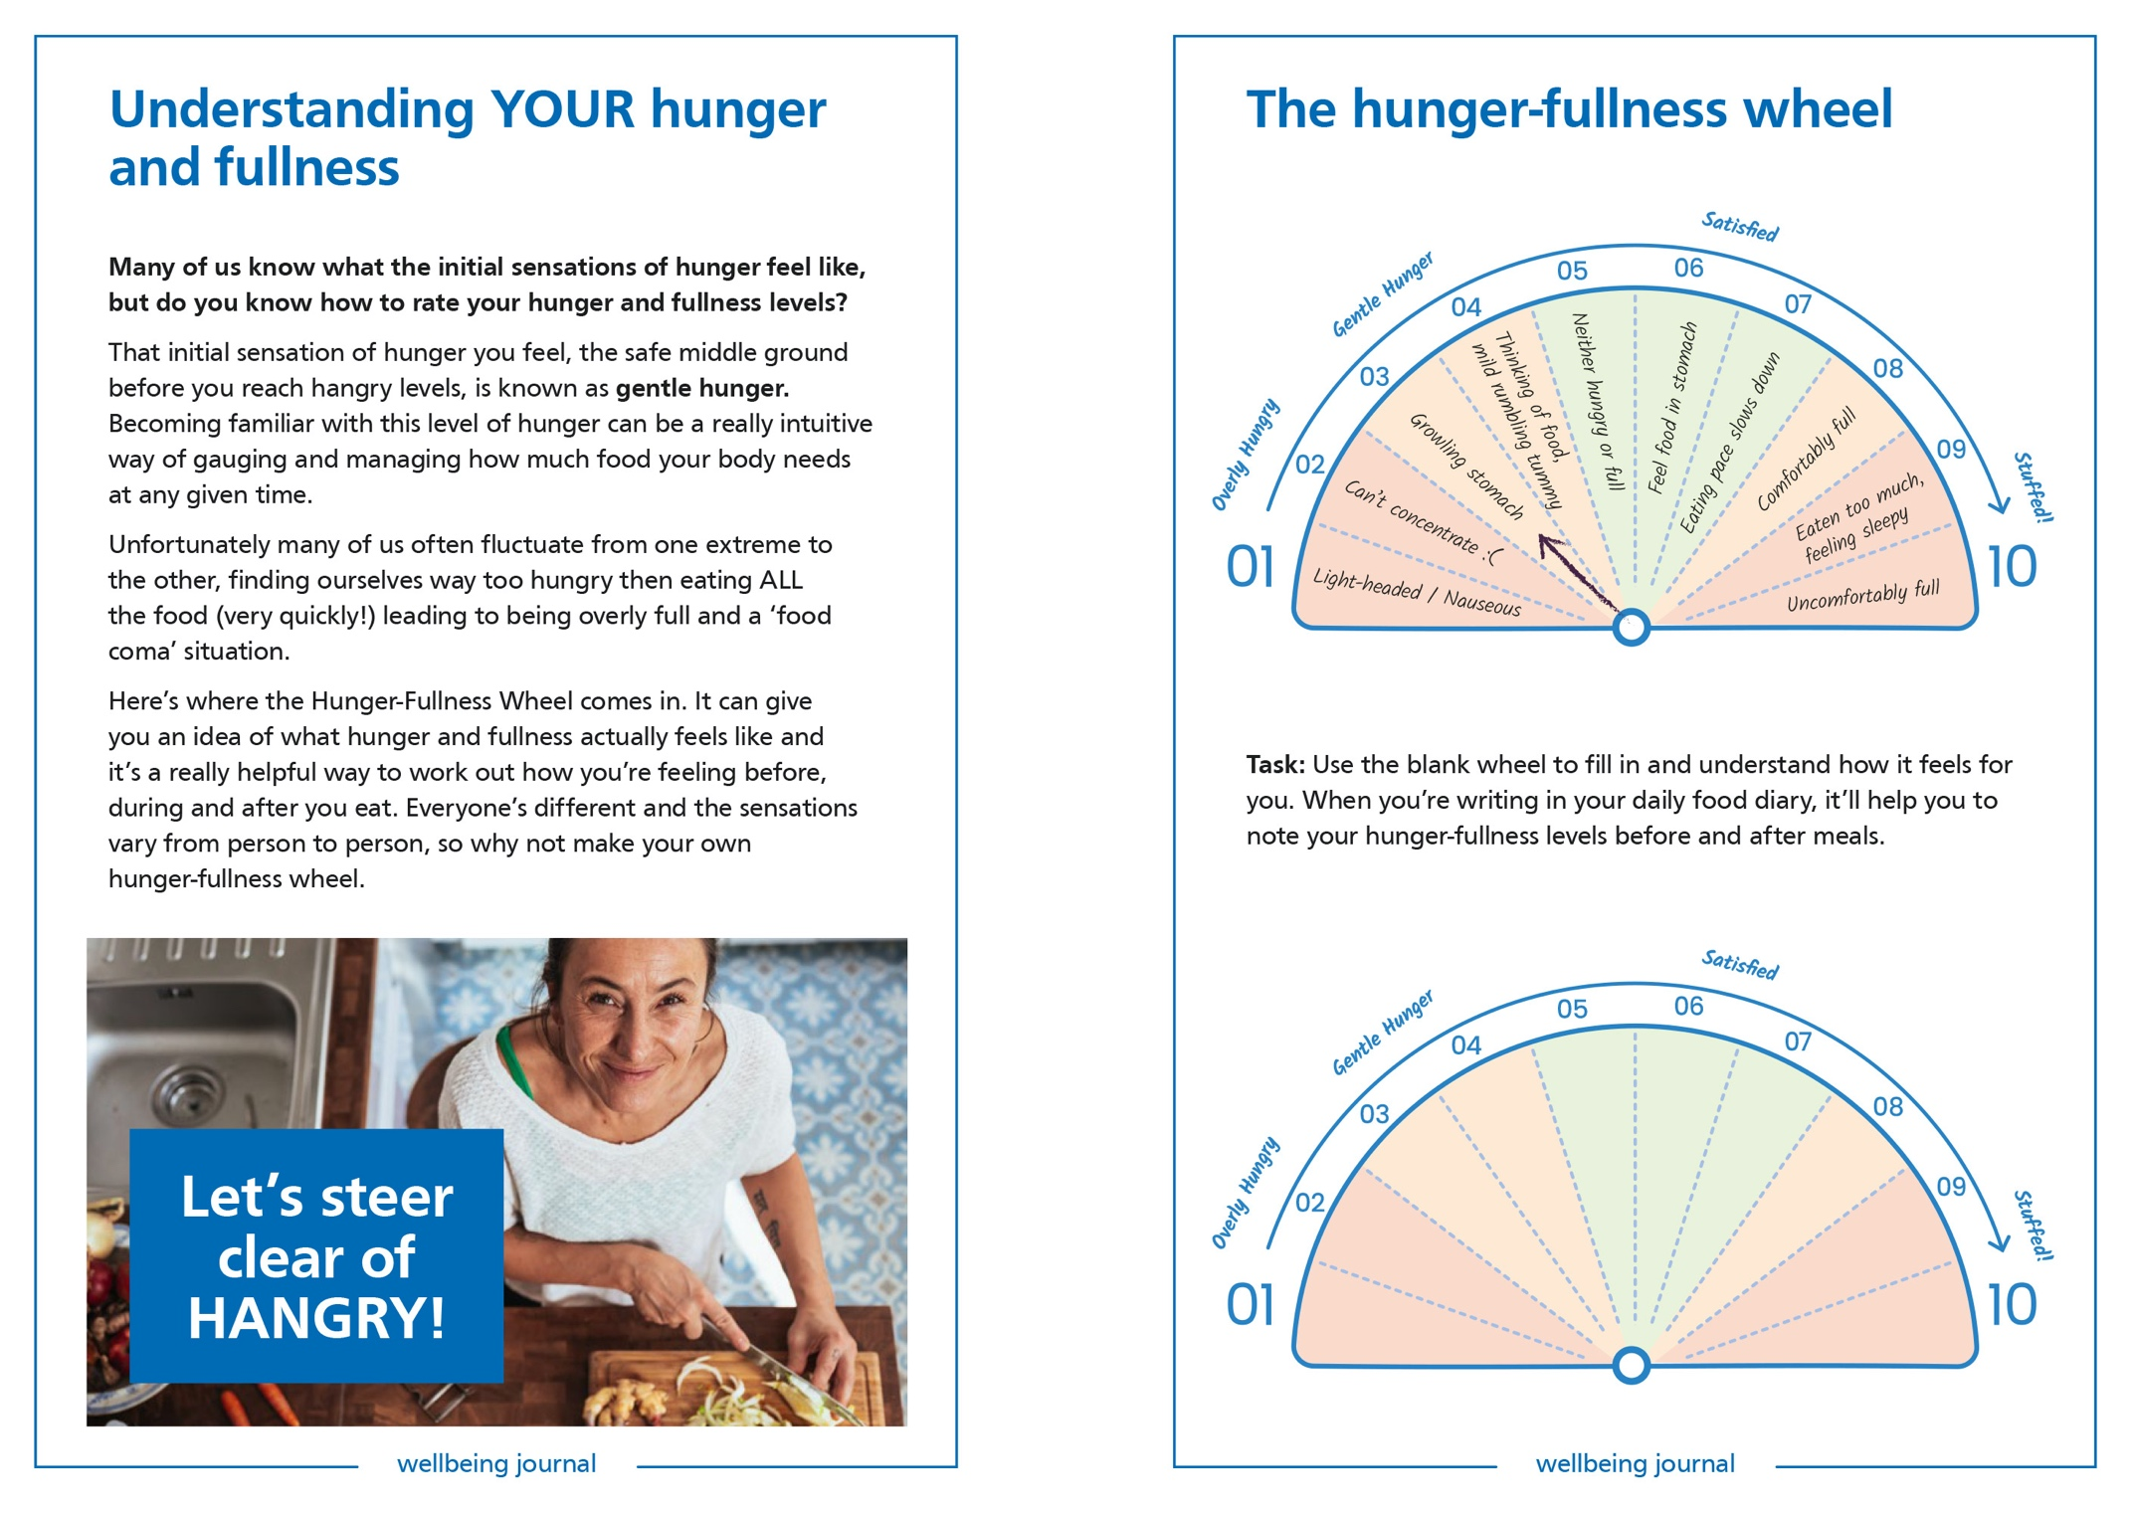
Our Programme – Group Programme
13 sessions/ 9-month programme
1% experiments
Long term sustainable changes​
F2F group session – maximum of 20 people
Initial 'getting to know you' session
Support for clients between group sessions
If a client misses a session, they can have an hour 1:1 to catch up
Aims to address all aspects of lifestyle
One of the aims is for clients to reduce their body weight by 5%
High quality resources to go alongside programme
Interactive videos and activities to support learning
Notes:
13 sessions over 9 months
1st four sessions are fortnightly and then monthly
It is based on 1 % experiments – where patients are encouraged to do small changes that lead to a bigger sustainable change at the end
Those group sessions are F2F with maximum of 20 people (usually those groups are much smaller)
There is an initial ‘getting to know you’ session – over the phone, where the triage team can find out what type of programme would be the patient interested in
There is support for clients between the session – they will receive an email after each session summarizing the session
If client misses a session – they are required to have a catch-up session before the next one
One of the aims is for clients to reduce their body weight by 5%
There are resources available such as online gym and recipe book
5 pillar of health – physical activity (movement), nutrition, mindset, alcohol, sleep

Slide 5
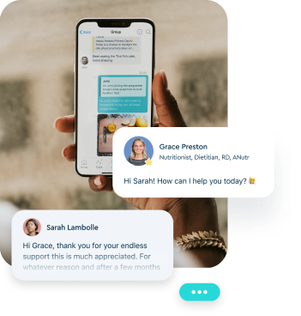
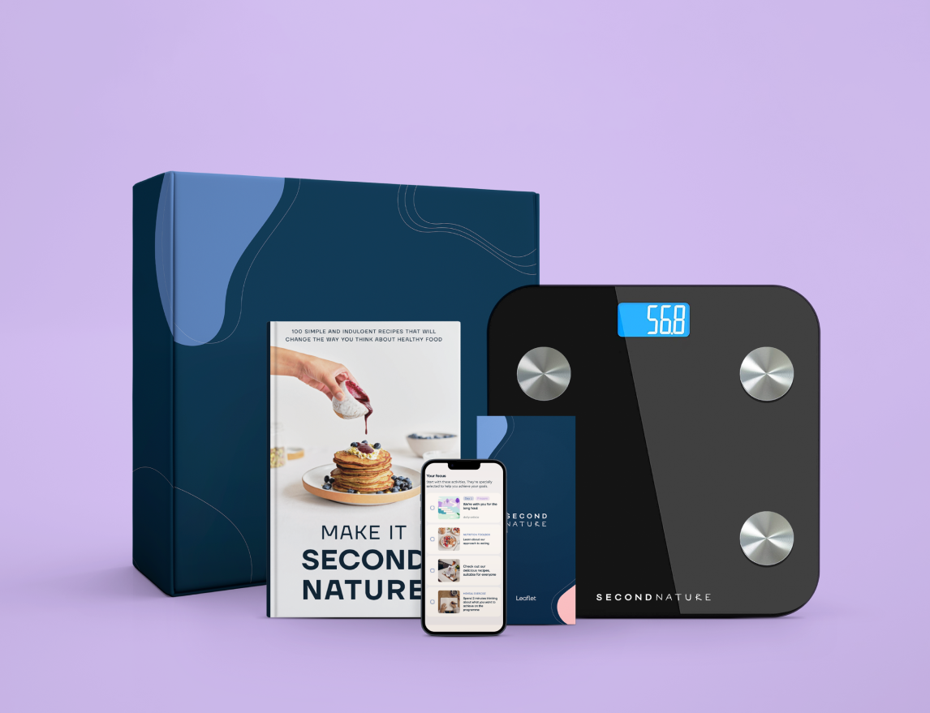
Our Programme – Digital Programme
9-month programme
Second Nature
10 -15minutes a day via a mobile app
1-1 support from a registered nutritionist
Online group support
Printed handbook, recipe book & digital weighing scales
Languages include: English Urdu Hindi Arabic Gujarati Bengali Tamil Polish Chinese Punjabi
Welsh
Notes:
9-month programme
The programme is provided by Second Nature
This programme is completely phone based – patients are encouraged to engage with the app daily for 10-15 mins
There is also 1-1 support session from a registered nutritionist – it’s a free contact, it’s not at scheduled time
Patients are provided with resources – such as printed handbook, recipe book, digital weighting scales – is connected to the app where it tracks the progress
The article content can currently be set to 11 different languages, which I've listed below. The Health Coach, peer groups and other in-app functions remain in English”.

Slide 6
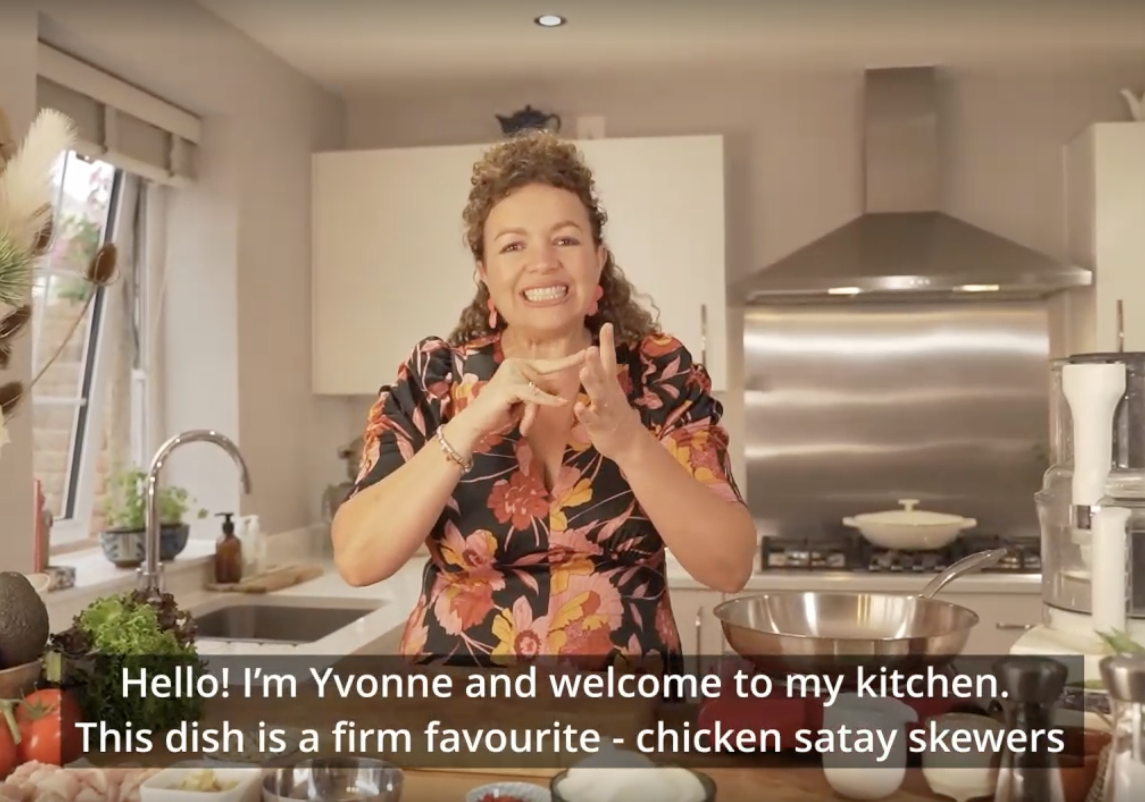
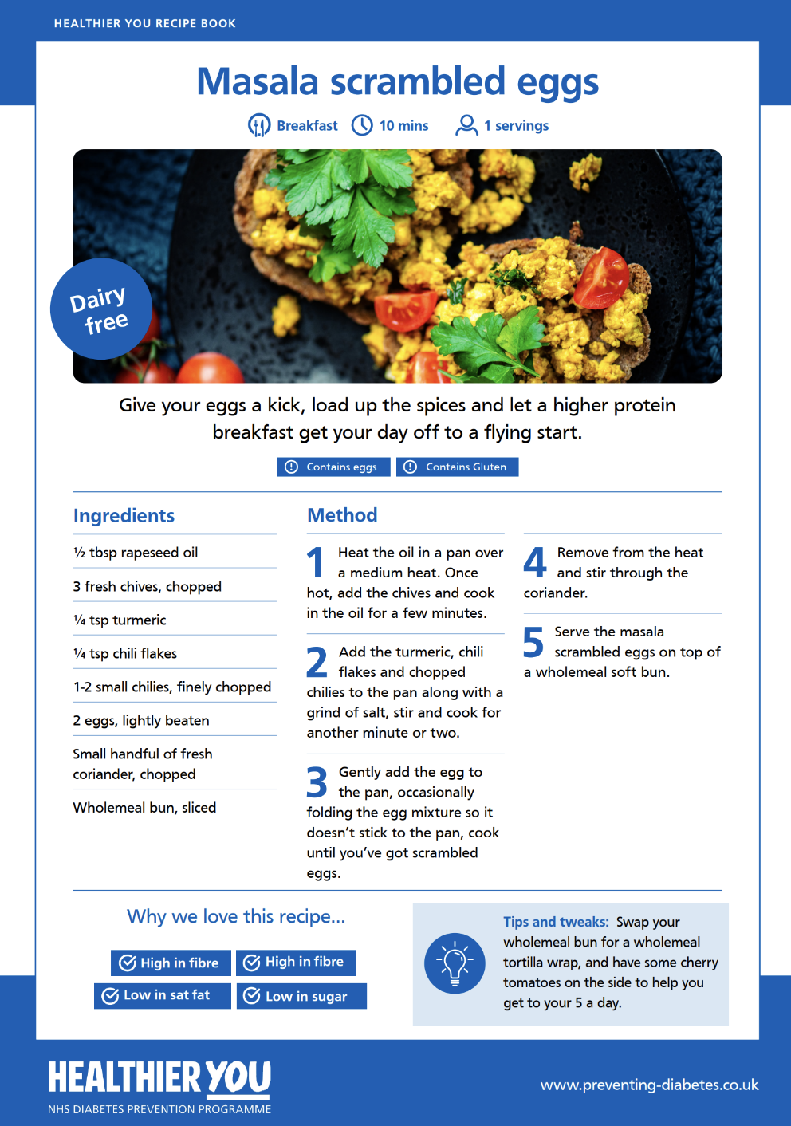
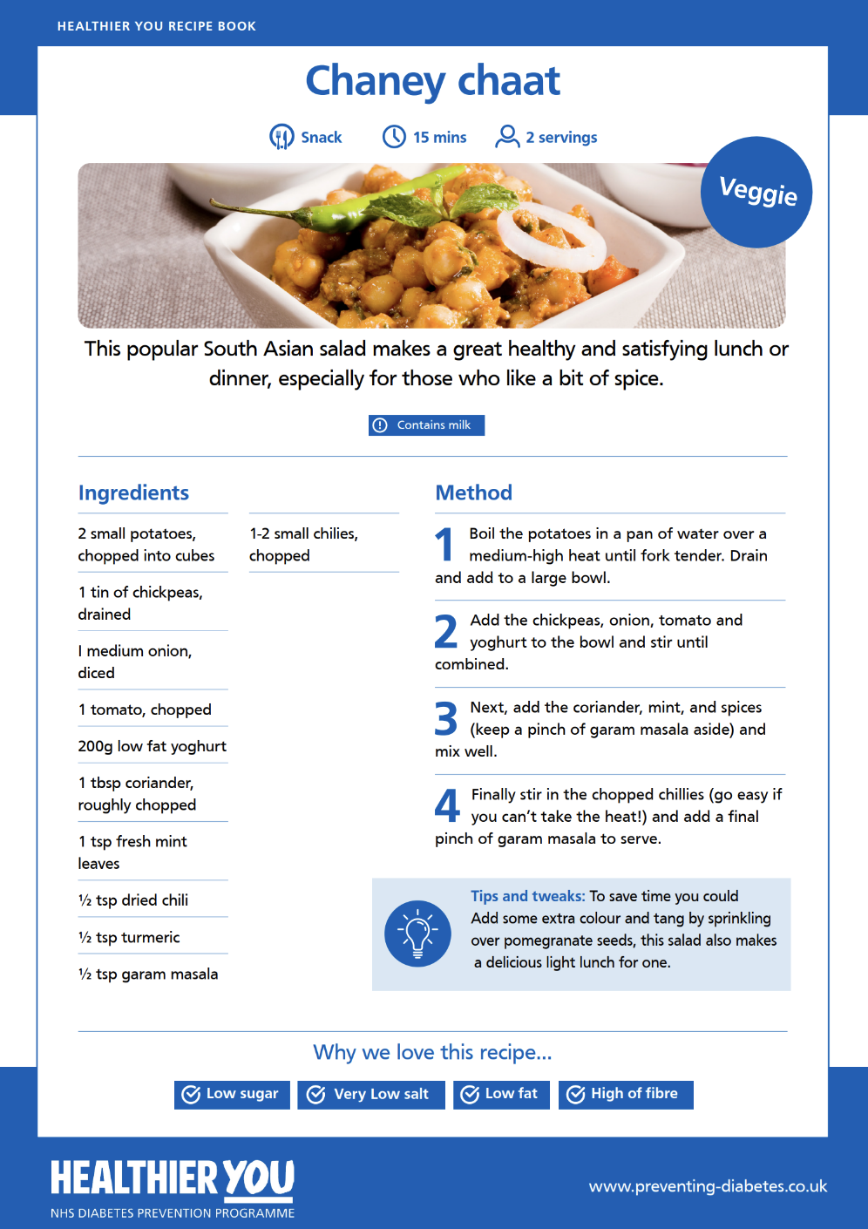
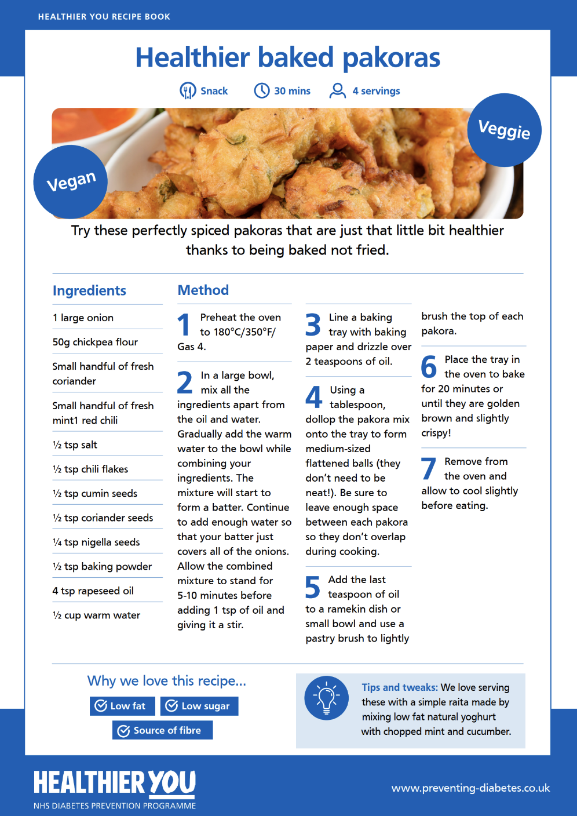
Our Programme – Specialist Remote
Bangladeshi
Or Pakistani Background
Prev. diagnosis of GDM
Impaired vision
Impaired hearing

Slide 7
Our Programme – Specialist Remote GDM
As part of the GDM referral changes we have developed a new referral form which is live on the website as of 28th February that allows those with a history of GDM to self-refer.
Previously, patients with GDM were required to have a blood test result within the previous 12 months. Now, anyone with a history of GDM can self-register or be referred to the NHS DPP without a blood test.
Gestational Diabetes | NHS Diabetes Prevention Programme (healthieryou.org.uk)

Slide 8
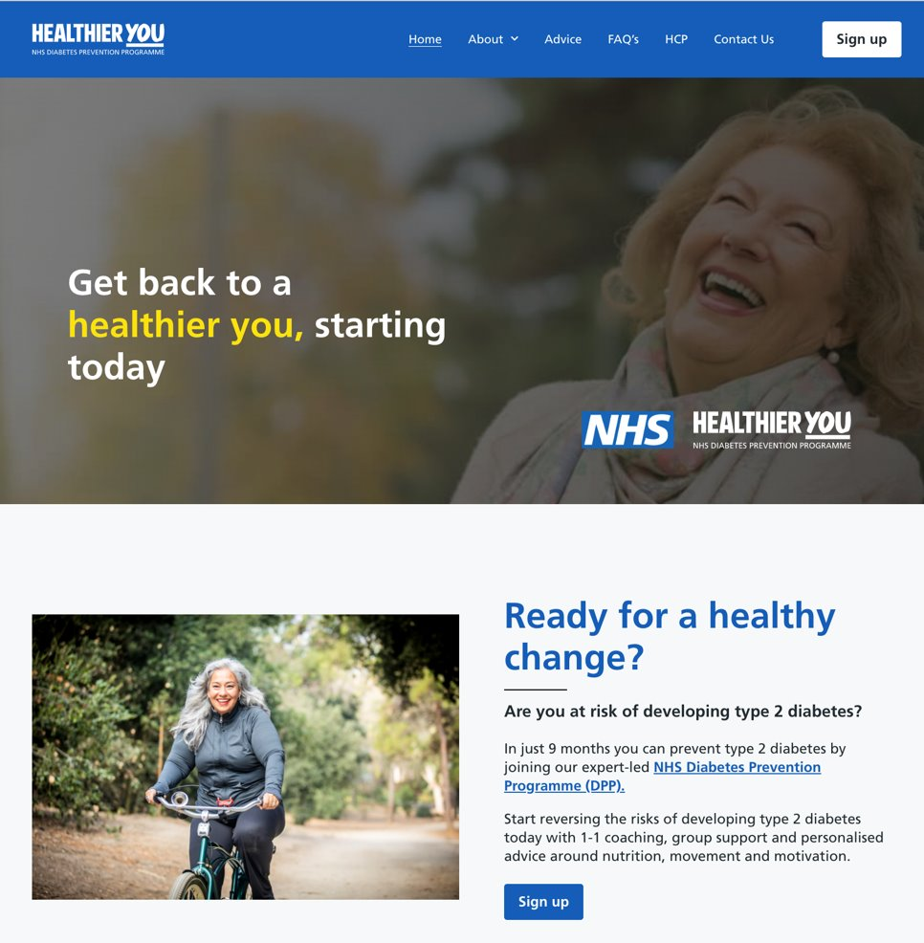
Self-registration
Self Registration -www.healthieryou.org.uk Patients must have the following information to self register:
NHS Number
Blood Test Result (either a HbA1c or FPG reading)
Date of Blood Test (must be within the past 12 months)
www.healthieryou.org.uk
Or call 0333 047 9999
Notes:
Patients are now able to self-register for the programme if they have been supplied the following information by their GP either through an appointment, letter or SMS etc.
NHS Number
Blood Test Result (either your HbA1c or FPG reading)
Date of Blood Test (must be within the past 12 months)
If your patient would like to find out about the program before signing up simply send them to our website www.healthieryou.org.uk where they can learn more about Type 2 diabetes, our NHS diabetes prevention program and most importantly can self refer through our simple form.

Slide 9
How to refer – Eligibility​
Eligibility Criteria​
Be aged 18 or over.​
Has ‘non-diabetic hyperglycaemia’ (NDH) identified by blood test within the last 12 months.​
​HbA1c of 42-47.9 mmol/mol (6.0%-6.4%),​
Fasting Plasma Glucose (FPG) of 5.5-6.9mmol/l
If the patient has a history of Gestational Diabetes Mellitus (GDM) then HbA1c can be below 42 or FPG below 5.5
47.9
42
Notes:
​NDH Identified blood test within the last 12 months ​
FPG - by taking a blood sample from participants who have fasted for at least 8 hours and taken via a vein in your arm.
Blood test within 12 months even for GDM – can be below 42
Mmol – milimoles per mole

Slide 10
How to refer – Eligibility​
Exclusion Criteria​
Pregnancy​
Has blood results suggesting Type 2 diabetes.​
Anyone aged over 80 without prior consideration for the risks and benefits of a programme, likely to result in weight loss for those individuals.​
Bariatric Surgery within the last 2 years.​
Active Eating Disorder.​
Notes:
Eligibility Exclusions - Bariatric surgery (2 years)​ - beriatric surgery
Eligibility Exclusions - Have an Active eating disorder​
People aged over 80 – there needs to be a prior consideration of the risks and benefits done by a GP
Require a written consent from a GP

Slide 11
April
Date commencing | Day of the week | Time | Venue Name | Venue address
9th | Tuesday | 2:00pm - 3:30pm | Belper Community Hall | Bridge Street, Belper, DE56 1BA
10th | Wednesday | 11:00am - 12:30pm | Hillstown Village Hall | 12 Nesbitt Street, Hillstown, Bolsover, S44 6LW
10th | Wednesday | 4:00pm - 5:30pm | Alfreton Community Fire Station | Turnpike Business Park Alfreton Derbyshire DE55 7AD
10th | Wedneday | 1:00pm - 2:30pm | The Arc | The Arc, High St, Clowne, Chesterfield S43 4JY
13th | Saturday | 9.30 - 11.00am | St Thomas Centre, Chesterfield | St Thomas Centre ,Chatsworth Rd, Chesterfield S40 3AW
26th | Friday | 10:30am - 12pm | Buxton Fire & Rescue Centre | Community Room, Staden Lane, Buxton, Derbyshire, SK17 9RZ
26th | Friday | 1:30pm - 3:00pm | Buxton Fire & Rescue Centre | Community Room, Staden Lane, Buxton, Derbyshire, SK17 9RZ
26th | Friday | 11:15am - 12:45pm | Imperial Rooms, Matlock | Imperial Rooms (Riber Room), Imperial Road, Matlock, DE4 3NL
30th | Tuesday | 10 - 11:30 | Infinite Wellbeing | Market Street, Heanor, DE75 7NR
30th | Tuesday | 10 - 11:30am | Chellaston Library | Barley Croft, Chellaston, Derby, DE73 6TU

Slide 12
May
Date commencing | Day of the week | Time | Venue Name | Venue address
8th | Wednesday | 2:15pm - 3:45pm | Bolsover Library | 6 Town End, Bolsover, Derbyshire S44 6DT
13th | Monday | 10:00 - 11:30am | Horizon Healthcare | Building 1 Horizon Healthcare, 3-5 Burton Rd Derby DE1 1TH
14th | Tuesday | 10:00 - 11:30am | Hillstown Village Hall | 12 Nesbitt Street, Hillstown, Bolsover, S44 6LW
20th | Monday | 6:15pm - 7:45pm | Strutts centre - Belper | Derby Road, Belper, DE56 1UU
20th | Monday | 6:15pm - 7:45pm | Bolsover Assembly Hall | George Bratt Room, 1st Floor, Bolsover Assembly Rooms, Hill Top, Bolsover, S44 6NG
20th | Monday | 10 - 11:30am | Loundsley Green Community Centre | Cuttholme Road, Chesterfield, S40 4QU

Slide 13
June
Date commencing | Day of the week | Time | Venue Name | Venue address
5th | Wednesday | 10 - 11:30am | Brimington Community Centre | Heywood Street, Chesterfield, S43 1DB
7th | Friday | 9:30am - 11:00am | The Arc | The Arc, High St, Clowne, Chesterfield S43 4JY

Slide 14
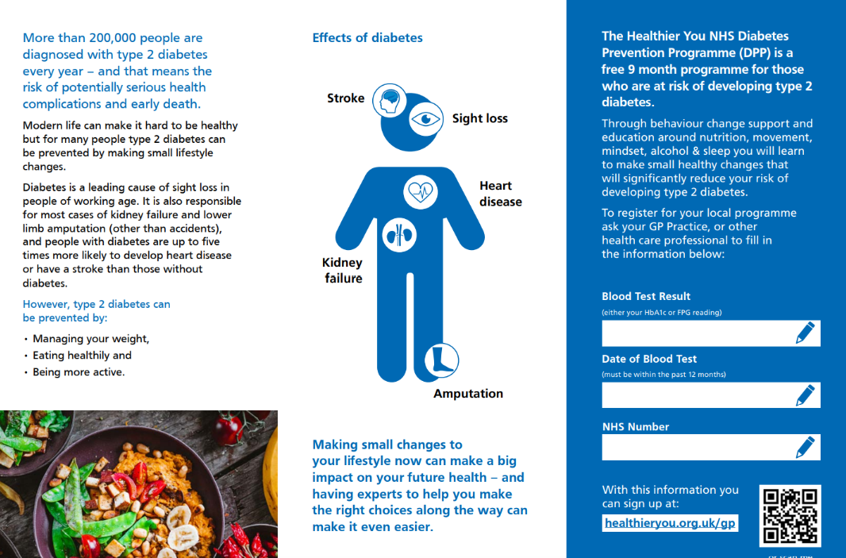
Marketing Material

Slide 15
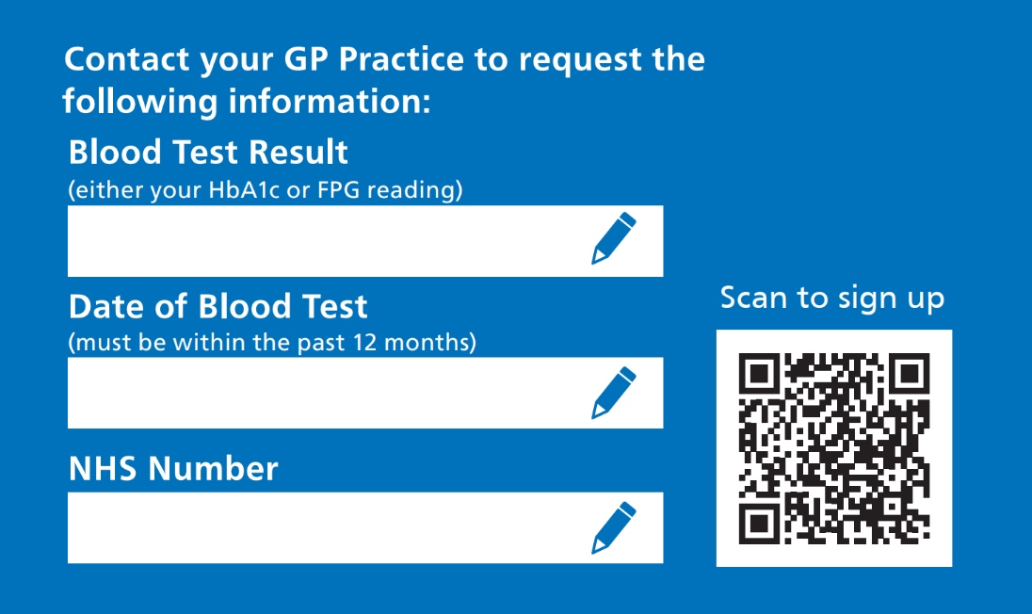
Marketing Material

Slide 16
Thank you​
Get in touch anytime at:​
www.healthieryou.org.uk​
​0161 605 6616
hello@healthieryou.org.uk​ Sandra Havelkova
sandra.havelkova@healthieryou.org.uk
Notes:
Thank you so much, do you have any questions?

