Slide 1



The Derby and Derbyshire
Equality Delivery System
2023-2024

Slide 2
Introduction
Welcome- Claire Warner, Senior Public Equality and Diversity Manager, NHS Derby and Derbyshire Integrated Care Board
What is EDS?
Reporting process- 3 areas linked to CORE20Plus5- approach to reducing Health Inequalities
Agenda

Slide 3
Agenda
2.05pm | Derbyshire Community Health Services Weight management inequalities | Caitlin Sorrell
2.10pm | Scoring
2.15pm | Derbyshire Community Health Services Community Podiatry Inequalities Evaluation | Danny Connor
2.20pm | Scoring
2.25pm | Chesterfield Royal Hospital Maternity Services - The Provision of Safe and Personalised Care: Achieving Equity and Reducing Health Inequalities | Julie Mycock
2.35pm | Scoring
2.45pm | Chesterfield Royal Hospital Early Diagnosis for Bowel Cancer: Reducing Inequalities for those who are living with a learning disability | Luke Jenkinson – MacMillan Programme Lead Netty Richards – Bowel Cancer Screening Lead
2.55pm | Scoring
3.05pm | Derbyshire Healthcare NHS Foundation Trust Derbyshire Perinatal Community Mental Health Service | Kerby Walker Anita Patel
3.15pm | Scoring
3.25pm | Catch up time if needed
3.35pm | Short break
3.45pm | Derby and Derbyshire ICB/Joined up Care Derbyshire A collaborative approach to Hypertension | Claire Warner Senior Public Equality and Diversity Manager
3.55pm | Scoring
4.05pm | University Hospitals of Derby and Burton NHS Foundation Trust Alcohol Care | Denise Garton/Dr Kaanthan Jawahar
4.15pm | Scoring
4.25pm | University Hospitals of Derby and Burton NHS Foundation Trust Tobacco Dependency | Gill Lowery
4.35pm | Scoring
4.45pm | Event close and next steps | Claire Warner-Senior Public Equality and Diversity Manager

Slide 4
DCHS
Specialist Weight Management
Inequalities Evaluation

Slide 5
Who are we?
  Tier 3 Specialist Weight Management
  Support individuals who are living with obesity
  Access only through referral (GP / Health professional)
  Psychology-led service with focus on behaviour change
  Onward referral to bariatric surgery

Slide 6
Why did we do the evaluation?
  To ensure that our service is doing all it can to reduce inequalities for people living with obesity
  Understand who is and isn’t accessing the service
  How we can adapt to support access and outcomes
  Funding from NHS England (Jan 2022- March 2023)

Slide 7
What did we do?
  Quantitative Analysis
    Data on referrals and starters in our service
    Pathways & outcomes
    Focus on 4 protected characteristics & IMD
  Literature Review
  Staff interviews
  Focus group with patients
  GP survey

Slide 8
What did we learn?
  Weight stigma as a key barrier
    Society, health professionals, internalised
    Impact on quality of life
  Gender, Age and Deprivation affect access
  Structural forces generate inequalities
  Importance of person-centred, empathetic service
  Adaptations & training would enhance service

Slide 9
Men are under-represented
  Less likely to be referred & less likely to opt-in (particularly young men)
  Underestimate their weight & its health impact
  Perceive weight management as a female activity
  Just as successful when they do engage

Slide 10
Older adults are under-represented
  Less likely to be referred
  Affects gender differently
  GP perceptions around weight loss & frailty
  Perceived as inevitable/ acceptable?
  Belief that service cannot help OAs? (GPs & patients)
  Above average BMI reduction in service

Slide 11
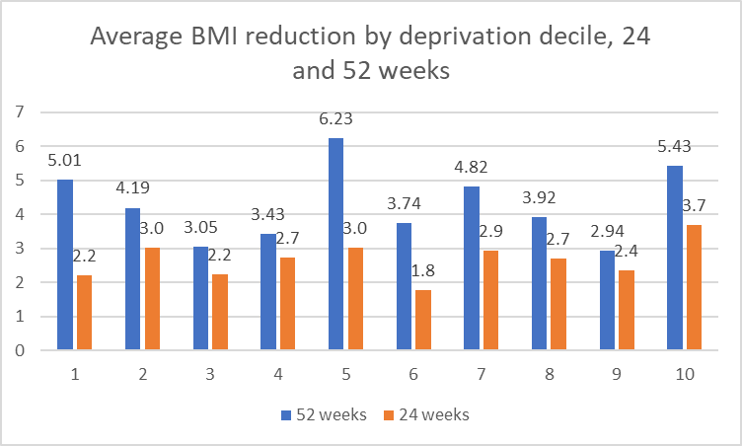
Impact of deprivation
  Over-representation of lower deciles (1&2) at referral, less likely to opt-in
  Lower deciles (1&2) have a BMI reduction below average at 24wks but above at 52
  Greater barriers & complexity that are overcome in time (reflected in mental health and wellbeing scores)

Slide 12
Disabilities
Physical disabilities
Adaptations are made on an individual basis
Learning Disabilities appear under-represented in our service
Lower referrals of people with LD (GP perceptions / Tier 2 service)
Challenges of working through carers highlighted in both literature and staff interviews

Slide 13
Ethnicity
Service is predominantly White (as is local population)
Potentially a slight under-representation of people of Asian ethnicity (not statistically significant)
Literature indicates that medical mistrust could be a barrier for ethnic minorities
Evidence to indicate that ethnic minorities would benefit from adaptations to service (e.g., interpreters)

Slide 14
Actions taken
Increased awareness of inequalities within team
Significant work on health literacy (website & materials)
Training on working with interpreters for Tier 3 staff
Training on working with people with LD / Autism
Trialled induction for people who are under-represented in our service

Slide 15
Next Steps…
Service review due to recent NICE guidance
Opportunity to design with inequalities in mind
Future work could involve
  Reaching out to GPs
  Reaching out to specific populations
  Collaborative working (e.g. Tier 2, CAB, Welfare Rights)

Slide 16
DCHS Community Podiatry
Inequalities Evaluation

Slide 17
About the Community Podiatry service
  The provides assessment, diagnosis and treatment to a range of patients with lower limb and foot problems, including people:
  with long term conditions such as diabetes, vascular disease, amputees, connective tissue disorders, stroke, Parkinson's disease
  with multiple and complex needs e.g. dementia, falls
  with biomechanical problems e.g. gait /postural problems
  requiring wound care to the foot
  requiring nail surgery
  with severe foot and ankle problems and conditions.

Slide 18
Aims of this work
  During 2023-24 the service was identified as an outlier in terms of:
    the volume of people waiting overall
    Variation in average waiting times between ethnicities
    Therefore the focus was on access into the service for this work.
  A subsequent deep dive analysis took place to support the team to identify possible patient groups to prioritise, that could improve the position in relation to current inequalities on the waiting list.
  This work considered looked at both closed and open waits by the following demographic characteristics:
    Geography
    Deprivation
    Gender
    Ethnicity
    Disability
    Age
  patient experience (Friends and Family Test) data was analysed by demography
  A Health Equity Audit was undertaken by ethnicity, age, deprivation, and gender

Slide 19
Health Equity Audit findings, compared to the Derbyshire population:
Gender, compared to the population and by referral reason:
Significant gender differences exist for the following referral reasons:
Rheumatology - highest gender imbalance, with >70% female.
Statistically greater proportion of female patients presenting for Biomechanics and General Care.
Analysis of waiting times by Gender
The distribution of patients waiting by gender is consistent across open and closed waits (see chart)

Slide 20
Health Equity Audit findings, compared to the Derbyshire population:
Age:
Except for nail surgery, the service sees a significantly greater proportion of people in the 69–85-year-old age groups, compared to the population, for all referral reasons.
A significantly greater proportion are seen in the 52-68 age group for wound care, diabetes, and biomechanics related referral reasons.
The opposite is true for Nail Surgery. A significantly greater proportion of patients referred to the service for Nail Surgery are aged 1-34 compared to the population.

Slide 21
Health Equity Audit findings, compared to the Derbyshire population:
Deprivation:
the distribution of waiting times between deprivation quintiles was broadly consistent.
Considering referral reason and deprivation, significantly greater proportion of:
Diabetes referrals in the most deprived 30% vs. population
Nail Surgery referrals in the most deprived 20% vs. population

Slide 22
Health Equity Audit findings, compared to the Derbyshire population:
Ethnicity, when compared to the population:
greater proportion of patients from white ethnicities and fewer patients from Asian or Asian British, and Mixed or Multiple ethnic groups, presenting for all referral reasons except nail surgery and biomechanics.
General care and Nail surgery saw significantly fewer patients presenting from black, or black British, Caribbean or African ethnicities.
Comparing average waiting times between ethnicities:
all ethnicities have a right-skewed distribution except “Black or Black British” which shows a left-skew
This means the majority of Black or Black British people have longer waiting times, compared to other ethnicities present in the data

Slide 23
Analysis of waiting times by demographics
Analysing closed waiting times by geographic area:
The South/City locality had longer waiting times, generally (based on mean closed waiting times)
the darker shaded areas that are present in both maps, regardless of locality (this is because in this scenario it suggests waiting times are longer and less variable).

Slide 24
Patient experience findings (FFT):
Of those patients completing Friends and Family feedback, patients aged 20-29 are less likely than all other patients to report positive feedback.
It was unknown what was driving this finding
Future work could involve patient engagement activity with this cohort to gain insight as to what may be driving this finding.
No other significant variance in reported experience by demographic group was identified.

Slide 25
Actions taken
Developing an inclusive website - So that its appearance, layout, and resources are friendly to all users, regardless of location, language, education level, background, beliefs, or abilities.
Sprint initiative - To manage the Community Podiatry waiting list to enable high risk patients to receive timely care by offering alternative care solutions to lower risk patients. Class / group settings and service model changes

Slide 26
Next Steps…
Consolidation of clinic sites – to focus resources to provide greater access and expertise to patients and improve overall costs directed by the incorporation of geographical accessibility into the decision – making process
Patient engagement planning now commencing - to gain patient insight as to possible barriers experienced / service improvement opportunities from a patient’s perspective (supported by the analysis from deep dive & health equity audit work)

Slide 27



Maternity Services
The Provision of Safe and Personalised Care: Achieving Equity and Reducing Health Inequalities

Slide 28

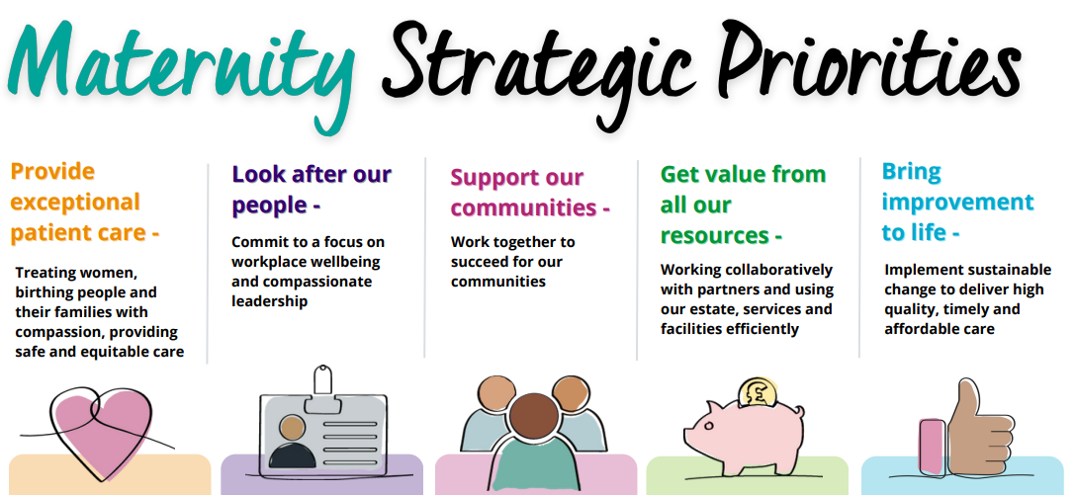
Maternity Services
2,738 births at Chesterfield Royal in 2023
5.2% of births in Derbyshire County to people from a black, Asian or mixed ethnicity¹
4.5% of areas in Derbyshire County within the 10% most deprived in England²
1: 2021 Census
2: 2019 Index of Multiple Deprivation

Slide 29
Defining the Problem
At least 90% of women and birthing people will have their communication needs met by 2025
Provide Exceptional Patient Care
Support our Communities
Bring Improvement to Life
What do we need to do better?
Choice and personalisation
Communication
Cultural Sensitivity
Equal Access
Information and explanations
Improved experience of choice and personalised care

Slide 30
Maternity Equity Driver Diagram
90% of women and birthing people will have their communication needs met
Cultural understanding
Cultural Awareness training
15 Steps
Interpreting process
Education and promotion
Information, communication and informed consent
Deaf Awareness training
15 Steps
Engagement and Co-production – Improvement project(s)
Engagement and Co-production – Improvement project(s)
Interpreting and Translation improvement project
Derbyshire Maternity and Neonatal Voices Partnership (DMNVP)
Engagement and meaningful co-design with community groups to avoid ‘one size fits all’ solutions
Induction of Labour Pathway
15 Steps Action Plan
Co-produced Information
Lenny’s Legacy

Slide 31
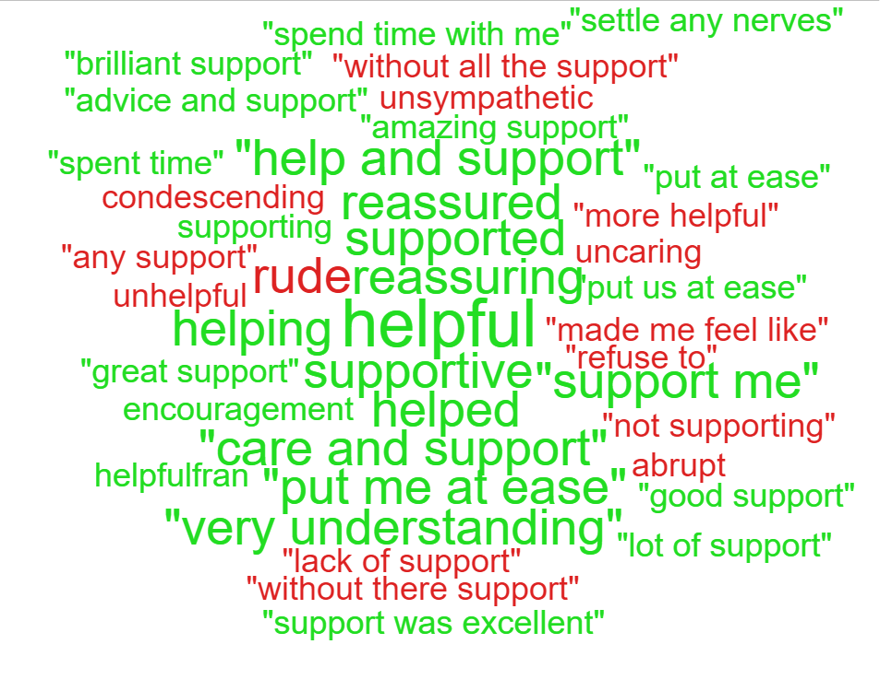
Service User Insight
National Maternity Survey 2023, Trust ranked among the top trusts for 5 of the 8 sections; the Trust also scored the highest compared with other trusts in the region for 4 sections.
92% of FFT respondents reported a positive experience of maternity services. For protected characteristics it was 93%
12% of Trust interpreting bookings were for maternity in 2023
99.6% of respondents from protected characteristic groups said staff spoke in a clear and understandable way
(FFT 2023)
National Maternity Survey 2023: 26 questions scored better than expected
15 recorded compliments, 12 complaints and 29 concerns

Slide 32

Reflections
Plan
Use available information to start
SMART
Listen to the community and service users
Involve influential staff and public representatives early
Time!
Listen to staff
Communicate
Build relationships and trust
Measure

Slide 33
What next?
Improve efficient discharge for all service users
Strengthen experience of informed consent and personalised care
Develop transitional care
Work with Deaf-Initely Women to develop BSL information videos and deliver staff training
Review DMNVP birth debrief feedback to identify improvements
Focused engagement with community groups to explore equity and equality in maternity services
Continued collaboration with DMNVP and Healthwatch Derbyshire to ensure women and birthing peoples’ experiences are at the heart of everything we do

Slide 34


Early Diagnosis for Bowel Cancer
Reducing Inequalities for those who are living with a learning disability
Luke Jenkinson – MacMillan Programme Lead
Netty Richards – Bowel Cancer Screening Lead

Slide 35
Service and Demographics
The below process map demonstrates the high-level pathway
Patients of eligible age (60-74y) but expanding to 50y. Over 74 able to request kit
  North Derbyshire now live for patients aged 54. After April 2024, plan to reduce to age of 52. By end of 2025, plan to reduce to age of 50
Patients invited to participate in screening every 2 years.
Jointly delivered by CRH and Regional Bowel Screening Hub at Nottingham (QMC)
+ve
+ve
+ve or -ve
+ve or -ve
Treatment discussion
Invitation and kit sent
Sample obtained and returned
Colonoscopy
Discharged
Invited for bowel screening in 2 years
-ve
-ve

Slide 36
Problem Identified
General observation that patients living with a learning disability do not regularly access the service
  Is this due to life expectancy or is this due to other factors?
There is a lack of support and personalisation for those patients who may require additional support
Is there thorough understanding of the consent process and best interest decision making?
The pathway is delivered by the national programme and Chesterfield Royal Hospital
Most frequently reported cancerous cause of death for people with a learning disability is Bowel (15.8% in 2022, general population 10%; LeDeR 2022)
“To identify those who are living with a learning disability and who are eligible for bowel cancer screening, to allow for an additional personalised approach where required. Aiming to Implement the identification and 6-week targeted support offer by August 2024 across the catchment for Chesterfield Royal Hospital.”

Slide 37
Future Service Model
+ve
+ve
+ve or -ve
+ve or -ve
Treatment discussion
Invitation and kit sent
Sample obtained and returned
Colonoscopy
Discharged
Invited for bowel screening in 2 years
-ve
-ve
Patients living with LD are identified and prompted 6 weeks after invitation. Discussion offered to understand why patient is not returning sample. Best interest guidance and assistance offered plus advice on personalised appointments.
Personalised appointment offered and alternative investigations discussed

Slide 38
Improvement Methodology
Plan, Do, Study Act
Co-designed services with patient/carer experts
  Engagement sessions online and face to face in community centres
Data Protection Impact Assessment and Quality & Equality Impact Assessment
Key measures:
  Uptake of bowel cancer screening (patients living with learning disabilities) at GP level
  Number of bowel cancers identified (patients living with learning disabilities)
  Patient, carer & staff experience

Slide 39
Reflections so far
Initial aim is to pilot across Royal Primary Care due to additional data sharing requirements across other GPs
If successful, can be expanded across the ICS
Potential to address other healthcare inequalities
Positive appetite for this work across bowel cancer screening service and staff working with learning disability patients
Aligned to (draft) cancer planning guidance 2024-25
? Possibility to explore efficiencies from the pilot

Slide 40
Perinatal Community Mental Health Service
EDS – February 2024
Domain 1

Slide 41


Derbyshire Perinatal Community Mental Health Service
The Derbyshire Perinatal Community Mental Health Service provides treatment and care to support women and birthing people who are experiencing moderate to severe and complex mental health difficulties associated with pregnancy and the postnatal period.
Care for women and birthing people from 12 weeks of pregnancy up until 24 months postpartum.
Working towards NHS Long Term Plan ambition- by 2023/24, at least 66,000 women with moderate/complex to severe PMH difficulties can access care and support in the community.
NB: The perinatal period includes preconception, antenatal and postnatal.

Slide 42
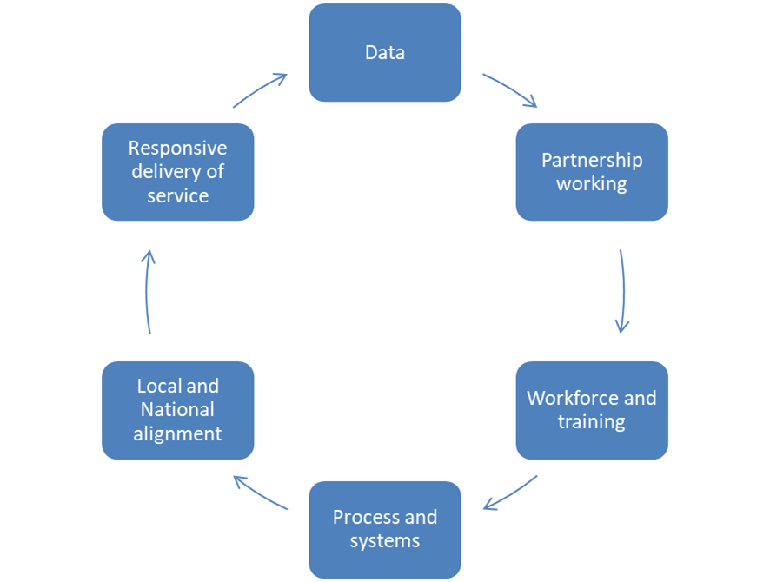

Local Strategy

Slide 43
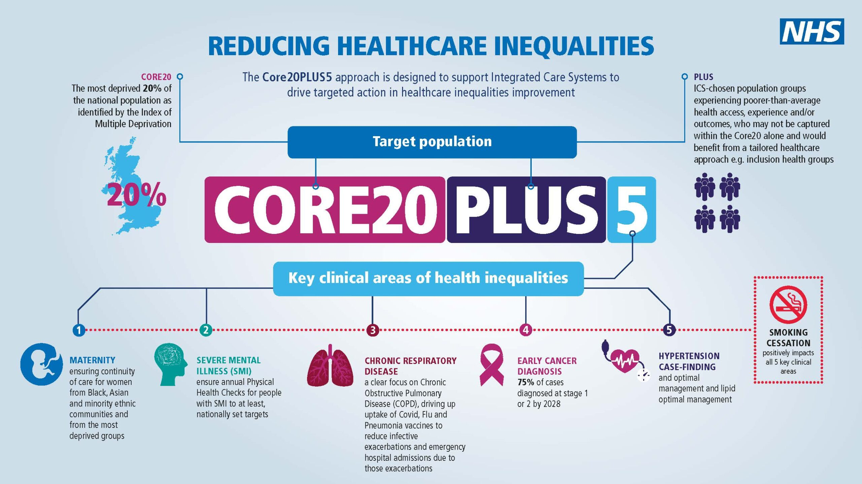

Slide 44
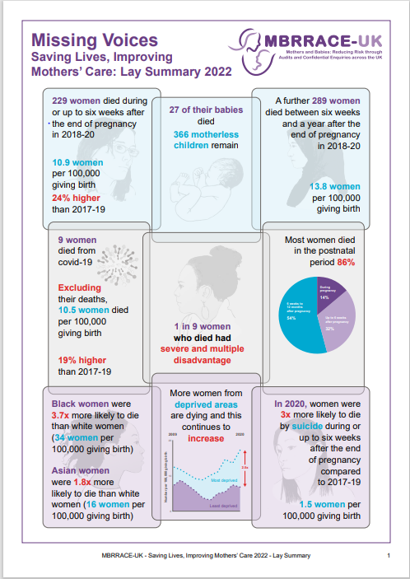
Groups at Risk of Experiencing Healthcare Inequalities and some Barriers to Accessing the Service
Women from ethnic minority groups are:
Service Design
*Service accessibility
*Service provision
Individual
*Fear of baby being removed
*Finances/travel
*Digital poverty
Socio-cultural Factors
*Stigma surrounding mental health
*Cultural differences & Linguistic barriers
Barriers
At greater risk of developing mental health problems (Watson et al, 2019)
Likely to have lower access rates to community mental health services and higher percentages of involuntary admissions than White British women (Jankovic et al., 2020)
Women aged 25 years and younger are:
More likely to experience a significantly higher burden of mental health issues compared with women aged 25 years and older (Estrin et al, 2019).
Women living in more deprived areas are:
At greater risk of experiencing poor mental health during the perinatal period. This risk is increased for those living in the most deprived areas compared to those in the least deprived areas (Ban et al, 2012).

Slide 45

1a Patients have required levels of access to the service
13% were from a minority ethnic background
&
85% had a white ethnic background
29% were young mums (<25 years)
&
71% from other age groups
More than a quarter (25.9%) were living within 20% of the most deprived areas locally
3.77% of individuals are accessing the service relative to our local birth rate
Who was accessing the service and what did this mean?
April 2021 – Mar 2022

Slide 46
Improving access to the service
What actions have been taken?
Assessment-led clinic. A change to the model of working. Focused assessments to enable assessments to be offered for almost all women referred.
Joint Antenatal Clinics
Pilot self-referrals into the service June 23-June 24
Outreach posts and partnership working with Derby City Family Hubs
Community Outreach Group- professionals from Community and MBU coming together monthly, utilising HEAT tools to systematically assess health inequalities and formulate actions.
Communication Officer recruited on a fixed term basis to support with meeting NHS LTP ambitions.
Building strong connections with the community- VCSE, faith leaders, GP
Community Engagement Event- held in Derbion shopping centre.
Annual stakeholder event

Slide 47
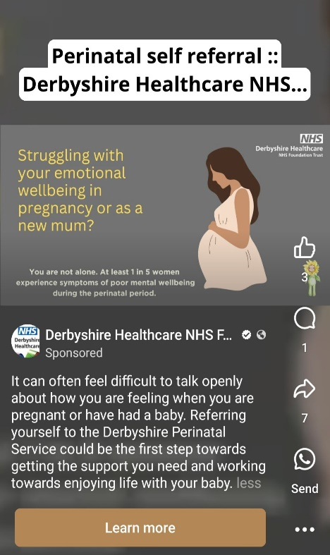
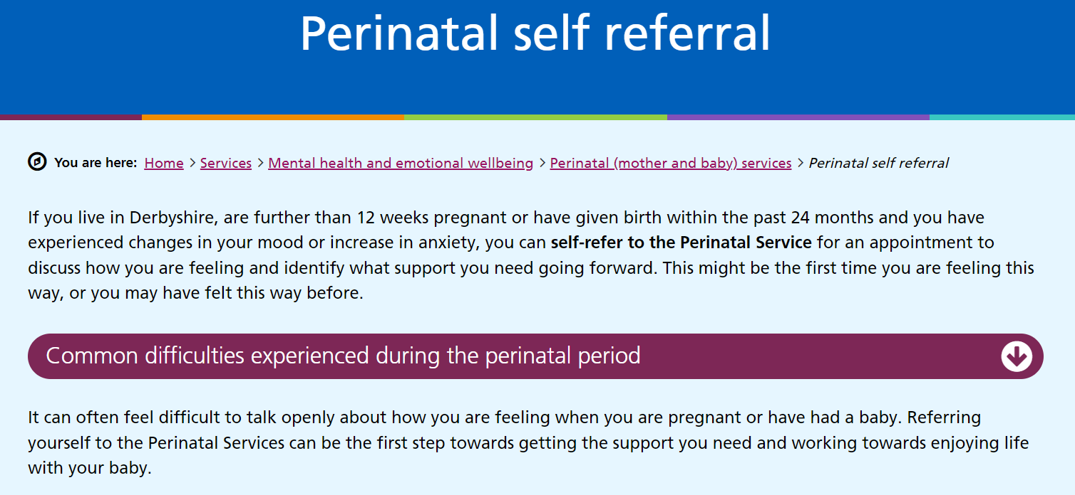

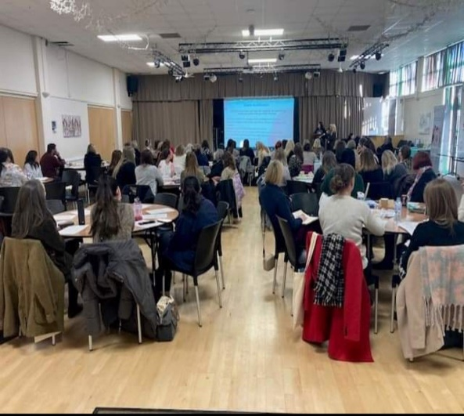
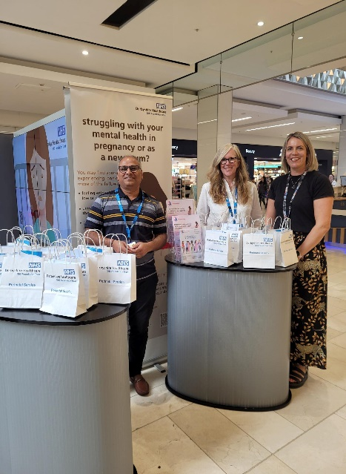


Raising Awareness & Increasing Access

Slide 48

1a patients have required levels of access to the service
More than 1 in 5 (>20%) were from a minority ethnic background
Over a third (31%) were young mums (<25 years)
9.35% of individuals are accessing the service (relative to our local birth rate)
More than a quarter (26%) were living within 20% of the most deprived areas locally
Who is accessing the service now?
April 2023- Jan 2024

Slide 49
1b individuals’ health needs are met
Satellite clinics
Focused assessments to identify most appropriate pathway of care and for signposting
Partners self-assessment and signposting
Peer Support Worker roles and Experts by Experience Group embedded across the Service
Therapeutic groups developed from patient need- Mums group, Sunshine, Discharge Group
Understanding and responding to needs through partnership working. Strong connections with Connected and Family Hubs and developing relationships with other services.
Inhouse training- Cultural Competence, LGBT Mummies, PSW, Young Mums
DNA pilot to understand reasons for not attending appointments and how we can support women and birthing people to attend future appointments

Slide 50
How are we checking that health needs are being met?
Perinatal CMHT- Patient-Rated Outcome Measure Scores 22/23 | Young Mums | Individuals from a Minority Ethnic Background
CORE-10 (Timepoint 1) | 19 | 18
CORE-10 (Timepoint 2) | 7 | 6

Slide 51
1c When patients use the service, they are free from harm
A culture of continuous quality improvement
Accredited by the Royal College of Psychiatrist Perinatal Quality Network ‘The team are clearly committed to Quality Improvement, and it is very impressive that there is a Research Fellow who is part of the team. Ongoing projects include considering local population statistics compared to the demographic information of those who have been referred to the service, and another focusing on improving access to CMHTs.’
Inhouse Training programme- Cultural competence, deaf awareness, LGBT mummies, additional safeguarding.
Derbyshire Safeguarding Childrens Partnership Training
Datix Risk Management and Information System
Triage service to ensure referrals are prioritised based on clinical need and risk
Exemption reporting on waiting lists, waiting well and actions to reduce waiting times including Saturday clinics
Robust supervision for all clinical staff including cascade model for safeguarding supervision

Slide 52
1d When patients use the service, they report positive experience of the service
Patient Rated Experience Measures (POEM)
DATIX Compliments
Friends and Family Test Feedback
100% of respondents rated the service ‘Very Good’ or ‘Good’.
(82.4% Very good and 17.6% Good.)
The support I received from the service was outstanding, I don’t think I would have been able to recover without it. It helped me to understand what was happening to me and eventually allowed me to get better.
POEM Feedback, Jan 2024
Thank you for everything you have done for me over the last two years! Youve guided me and supported me and helped me see the light in the most dark of places.
Compliment January 2024
Demographics of Respondents (n=36) (Feb 23 – Jan 24)
5.9% minority ethnic backgrounds
Female
11.8% young mums
62.1% North & 37.9% South
I have really enjoyed attending MUMS group, it has helped me understand my anxiety and managing it. It has also helped me feel less anxious about attending groups. I looked forward to group because I feel able to share my thoughts and feelings I have formed relationships that have helped me feel less isolated and I feel I have the skills to manage emotions when I do feel like this.
Compliment Sept 2023
Demographics of Respondents (n=6) (July 23 – Jan 24)
White British
Female
Heterosexual
No religion
Incredibly compassionate and supportive staff. Feel that I am listened to but also that support is offered and available when needed urgently. Really varied service that caters for really broad spectrum of different needs
Friends and Family Test Feedback, Nov 2023
Young Mums Focus Group
Feedback due
March 2024

Slide 53

PQN Accreditation-
Patient Feedback
Reviewers were thoroughly impressed by the team’s drive and dedication in their third PQN accreditation review. A number of areas of good practice were highlighted on the review day and within this report. The mothers and staff we spoke to provided very positive feedback about the service
Mothers and partners/chosen others praised how quickly they were seen by the service. One mother said ‘the referral process was very very quick’, another ‘I didn’t have to wait at all’. They also felt that useful information was provided about the perinatal service, with one saying ‘someone from the team explained over the phone about the help they can offer’.

Slide 54
Challenges
Disparity of services across North and South of Derbyshire
Funding
Workforce
Commissioning not including work with non-birthing parent

Slide 55
Thank you

Slide 56
Short break

Slide 57
Hypertension
Claire Warner
Senior Public Equality and Diversity Manager

Slide 58
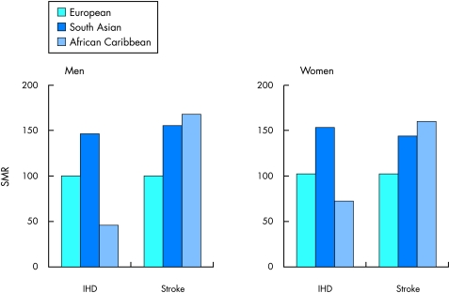
Background
Hypertension is often referred to as high blood pressure. This health condition affects just over a quarter of adults in the UK, around 14.4 million people have high blood pressure (British Heart Foundation, 2019).
People of non-European origin form around 7% of the total UK population. Most of these are of South Asian (that is, from the Indian subcontinent) or Black African (that is, from the Caribbean and West Africa) descent.
In the UK, mortality from Heart Disease in both South Asian men and women is 1.5 times that of the general population
The Ethnic differences in Heart Disease are greatest in the lower age groups

Slide 59
What does this mean?
Risk of High Blood Pressure and Heart Disease problem in UK 1 in 4
1 in 2 adults with high blood pressure don't know they have it or aren't receiving treatment
If Hypertension is left untreated it can be severe and increase the risk of strokes and heart attacks.
Significant difference in Heart Disease risks in different ethnic groups- Health Inequality
Different signs and symptoms for disease in different Ethnic groups- unknown

Slide 60
What did we do- Engagement
Assess people's knowledge and awareness of high blood pressure and its associated risks.
• Better understand what people know about the services and support available at community pharmacies
• Determine the most effective methods and platforms for disseminating health information to the community
• Identify the best places within the community to communicate health information effectively

Slide 61
Target
People over 40
• Residents of high deprivation areas
• Individuals from Black and Asian communities
• Seldom heard groups
How?
Survey: A comprehensive survey was disseminated to communities to collect individual responses on awareness, knowledge and experiences relating to high blood pressure.
Community-Led Workshops: Engaging with local community groups through workshops provided a platform for open discussions, idea sharing and gathering qualitative data.
Case Study: An in-depth case study allows us to explore a personalised viewpoint and experience of a local individual, shedding light on the human stories behind the statistics.

Slide 62
Engagement?
We had a target of around 100 people to complete the survey. The survey was completed by 265 people over a 5-week period, from 27 July to 31 August 2023.
11 different community groups took part in the engagement workshops during September and October 2023 which involved 409 people across different community groups in Derby.

Slide 63
What did we find out?
Awareness and understanding of Hypertention- over 80%
56% knew where to get blood pressure check
Less than 20% knew that pharmacy did blood pressure checks
Current experience and barriers- experience at Pharmacy good
Number of barriers including lack of awareness of services
Communication preferences- not written info or web based
Different formats of information- where English not preferred

Slide 64
Reflections?
True joined up working with communities, Voluntary and Community Sector and NHS and Council- essential
General understanding but communication needs to be better and informed by communities
Opportunity to improve health literacy- NHS do much better and be more accessible
Blueprint for more work

Slide 65
Contact Details
For more information on this work:
Name: Claire Warner
Title: Senior Public Equality and Diversity Manager
Email: Claire.Warner18@nhs.net
Web: https://joinedupcarederbyshire.co.uk

Slide 66

ALCOHOL CARE TEAM (ACT)
EDS February 2024 presentation
Domain 1: commissioned or provided

Slide 67
Overview of Service
Alcohol Care Teams (ACTs) are teams based within acute hospitals, delivered by alcohol specialist clinicians, who aim to:
Provide timely assessment, management, education and referrals to those drinking harmful levels of alcohol attending acute hospitals (this includes psychoeducation, psychosocial intervention, medically-assisted withdrawal, and integration with community substance misuse teams)
Provide education and training to acute hospital colleagues, including relevant training and guideline development
Improve data quality and collection with respect to alcohol use disorders
Aim to reduce acute hospital alcohol-related admissions, re-admissions and length of stay
The Royal Derby Hospital (RDH) site within the University Hospitals of Derby and Burton NHS Foundation Trust (UHDB) was successful in their bid with the RDH psychiatric liaison team (Liaison Team South within Urgent Assessment Services) at Derbyshire Healthcare NHS Foundation Trust (DHCFT) to be a ‘wave 2’ ACT site in Summer 2021. Wave 2 sites were selected owing to geographical distributions of alcohol-related harm. Key figures from Derby City’s data are as follows:
40% higher rate for broad alcohol-related conditions compared to the national average (cardiovascular 38% worse, alcoholic liver disease 111% worse, co-occurring mental health problems 80% worse)
Combined years of life lost in Derby City due to alcohol-related conditions was 1979 in 2018 (national average 1279)
Alcohol-related mortality in Derby City was 74% higher than the national average in 2019
Estimates suggest 3177 people in Derby City are dependent drinkers requiring treatment, but only 23% are in structured treatment
A recognition that the community substance misuse provision is under-resourced.
Notes:
There are currently 146 SAS Doctors who work at UHDB across a large number of specialties

Slide 68
EDS Domain 1:Commissioned or Provided Services
1a. Patients (Service Users) have required levels of access to the service

Slide 69
1a. Patients (Service Users) have required levels of access to the service
At risk population:
No readily available expected rate of attendance or presentation, however the Trust has implemented this service for all inpatient areas and ED. Protected characteristics that are recorded within the Trust Patient Administration Systems (PAS) allows the capture of accessible information standards as well as the following protected characteristics:
• Age
• Ethnicity
• Sex
• Sexual Orientation
• Disability
• Pregnancy
• Religion

Slide 70
1a. Patients (Service Users) have required levels of access to the service
An evaluation of the data 1 year post implementation of the ACT team showed 1631 patients were referred in the first 12 months, with 788 patients seen and a further 594 patients provided with advice & guidance (usually to referring staff). This is a 70% increase in patients seen compared to the year previous by RDH psychiatric liaison, and a 28% increase in patients provided with advice and guidance.
In the year following the introduction of the ACT, there was a 23% reduction in the readmission rates of patients admitted to the general hospital for alcohol-related reasons. This is despite a 26% increase of patients admitted for alcohol-related reasons. Readmission rates for all patients across the hospital within the same timeframes remained stable, indicating the reduction in alcohol related readmissions is due to the intervention provided by the ACT.
Length of stay for this same cohort increased marginally from an average of 6.56 days to 7.39 days However, this is likely due to improved care during their admission and putting in place appropriate post-discharge care, leading to a reduced likelihood of readmission as demonstrated in the above figures.

Slide 71
EDS Domain 1:Commissioned or Provided Services
1b. Individual patients’ (service users’) health needs are met

Slide 72
1b. Individual patients’ (service users’) health needs are met
The (ACT) offers:
- case identification/alcohol identification and brief advice (IBA)
- comprehensive alcohol assessment
- specialist nursing and medical care planning
- management of medically assisted alcohol withdrawal (MAW)
- provision of psychosocial interventions for people with mental health difficulties and/or complex needs
- planning safe discharge, including onward referral to community alcohol services
Its aspiration is to reduce alcohol related harm across the Integrated Care System (ICS).

Slide 73
1b. Individual patients’ (service users’) health needs are met
Referrals:
The ACT will offer an assessment to anyone that scores 5 or above on the AUDIT-C. The AUDIT-C will be completed in the ED’s pit stop as well as on inpatient wards and will be available on the electronic patient record system (Lorenzo). Once completed, a referral is sent (assuming the score is 5 or higher) by a secure e-mail to the ACT, who then contact the patient (see Flow Diagram) to offer an assessment. The referral is also registered onto Derbyshire Healthcare NHS Foundation Trust’s (DHCFT) electronic patient record (SystmOne).
Once the ACT receives the referral, clinical triage takes place, utilising the AUDIT-C score as a guide. The lower scoring referral forms can be allocated to the Band 3 team member (ACT Support Worker) and the patient will be typically offered brief advice. The score that is more likely to indicate non-dependence or lower risk will be determined by the ACT and will be reviewed on an iterative basis.

Slide 74
1b. Individual patients’ (service users’) health needs are met
Response times may vary depending on when the referral is made and will be more clearly delineated as this new service matures. During operating hours, referrals should be actioned on the same or next day. To minimise admissions that are not clinically indicated, the aspiration is for all referrals from ED to be seen on the same day, where patients may be offered an assessment/advice or discharged.
Where patients attend ED outside of the ACT’s operating hours, and the referral form completed at Pit Stop generates an ACT referral, they will be contacted by telephone the following day by the ACT, and community links will be utilised where indicated.
The referral form is mandatory for those admitted to inpatient settings, and will generate an ACT referral where the score is 5 or higher on the AUDIT-C.
Hepatology Outpatients – the aspiration is to provide an in-reach service to hepatology outpatients in due course.

Slide 75
EDS Domain 1:Commissioned or Provided Services
1c. When patients (service users) use the service, they are free from harm

Slide 76
1c. When patients (service users) use the service, they are free from harm
Sadly the fragmentation between addiction and mental health over the last decade has led to increases in both drug and alcohol-related harms. Psychiatric liaison at the RDH has guarded against this, initially by keeping addictions within their remit (many services nationally do not) and now fully integrating the ACT into what it delivers.
This allows full access to the psychiatric liaison MDT, and draws on the experience and expertise of the substance misuse clinical lead, and the liaison/neuropsychiatry consultant who provides medical leadership. For the latter, there is a specific expertise around alcohol-related brain damage (ARBD), with an embedded diagnostic pathway at RDH.
The ACT has moved beyond its minimum service descriptor to deliver a full addictions service (i.e. not solely alcohol), including opioid substitution therapies (e.g. methadone), in-reach work from community substance misuse teams, and liver health, with a weekly ‘Fibroscan’ clinic – an intervention that is increasingly showing itself to alter behaviours in alcohol-use disorders, and ultimately improve liver health and its related morbidity and mortality.

Slide 77
1c. When patients (service users) use the service, they are free from harm
All work is currently undertaken in inpatient areas where access to any emergency equipment is available
The ACT also accepts referrals from the pre-op assessment clinic at RDH. The hope here is that planned surgical procedures a way off in people with alcohol use disorders can be supported to access community substance misuse teams to optimise their surgical outcomes. In addition, where the procedure cannot wait, the ACT are able to advise the surgical/anaesthetic teams on pre-admission plans/medically assisted withdrawal to ensure the surgical procedure is not cancelled. ‘
The ACT is also in the process of producing guidelines for ‘take home’ Naloxone to be available for opioid dependent patients attending the Emergency Department or inpatients on wards. This will come under the remit of the ACT to ensure full training is given to the patients, and the medication is available quickly (DHSC 2023).

Slide 78
1c. When patients (service users) use the service, they are free from harm
Education is key function of the ACT, training ward staff in substances of misuse and alcohol withdrawal syndrome, and are currently engaged in updating relevant UHDB guidelines for the RDH site, as well as supporting hepatology with a move towards ‘symptom triggered detox’ – an approach that reduces the medication need and time to detox a dependent drinker.
Finally, it must be noted that the work of the ACT is integrated into the local health/social care system in addressing health inequalities. The clinical lead is engaged and embedded within high impact user and homelessness MDTs, has strong links with the community substance misuse teams, and also secondary mental health services. We have been able to be ‘creative’ with patients with complex needs, and tailor pre-existing pathways to what is needed (e.g. an elective detox to a planned psychiatric admission). Previously, these patients would have fallen through ‘commissioning gaps’.

Slide 79
EDS Domain 1:Commissioned or Provided Services
1d. Patients (service users) report positive experiences of the service

Slide 80
1d. Patients (service users) report positive experiences of the service
We have a patient feedback form but this does appear to be under utilised. Our research department is in the process of collating the results and this information will be used to shape service provision going forward.
We are utilising a new automated system that sends patients a text or email when they are discharged from the team asking them to provide feedback by following the link. This started in December 2022. Responses are viewed monthly, as more feedback is received and areas for improvement identified, we will ensure that the feedback is being utilised to shape ongoing service provision.
All patients who are seen by the alcohol care team automatically receive a text or email upon discharge from the team. The text contains a link that asks them to provide feedback on their experience with the service.

Slide 81
1d. Patients (service users) report positive experiences of the service
36 responses from December 2022 to September 2023.
  94% of people who received an information leaflet found it useful.
  53% of people rated their overall experience as good or very good (with a further 41% saying 'don't know' or 'neither good nor poor').
Some comments:
  "Very understanding and reassuring, non-judgemental"
  "The lady I saw was incredibly kind and it was good to talk with her"
  "Very thorough in laying the facts on the table"
  "It caused me to stop and think.....I was already considering cutting down a bit"

Slide 82
1d. Patients (service users) report positive experiences of the service
There is also a paper version available
This feedback is then reviewed by the team monthly where they review the quantitative and qualitative results.

Slide 83
TOBACCO DEPDENDENCY TREATMENT
EDS February 2024 presentation
Domain 1: commissioned or provided

Slide 84

Overview of Service
Notes:
There are currently 146 SAS Doctors who work at UHDB across a large number of specialties

Slide 85
Overview of Service
The NHS long term plan target was to rollout tobacco dependence treatment services in all inpatient, mental health and maternity settings by the end of 2023/24.
The Tobacco Dependency Treatment Service at UHDB went live on 5th September 2022 across RDH and QHB covering acute inpatients and maternity.
The UHDB model is an “in-reach” model working with our partners in the local authority service Live Life Better Derbyshire and Everyone Health Staffordshire, who are directly funded by the ICB to deliver TDT within the Trust.
Notes:
There are currently 146 SAS Doctors who work at UHDB across a large number of specialties

Slide 86
Overview of Service: Inpatients
During Admission
Discharge
Ongoing care from tobacco dependency team arranged
2 weeks of NRT prescribed
Post-discharge
12 weeks further NRT and support given
4 week and 12 week quit rate reported
Patient admitted
Tobacco addiction assessment completed
NRT prescribed and delivered to patient within 2 hours
Referral made to Tobacco Dependency Team
EXPERT review by tobacco dependency team
Continue NRT
Notes:
There are currently 146 SAS Doctors who work at UHDB across a large number of specialties

Slide 87
Overview of Service Cont………
Adult inpatients
  The service is being referred about 200 patients each month.
  Year to date around 80% opt into the service and make a quit attempt.
  Current 4 week quit rate is around 50% and 12 week rate is 30%.
  % smoking status screening:
    Has risen from 20.2% in Sept 2022 to a peak of 42.4% in August 2023.
    Current screening rate has dropped to 38% (Jan 2024).
    There is variation between sites (QHB 18.6% and RDH 47%).

Slide 88
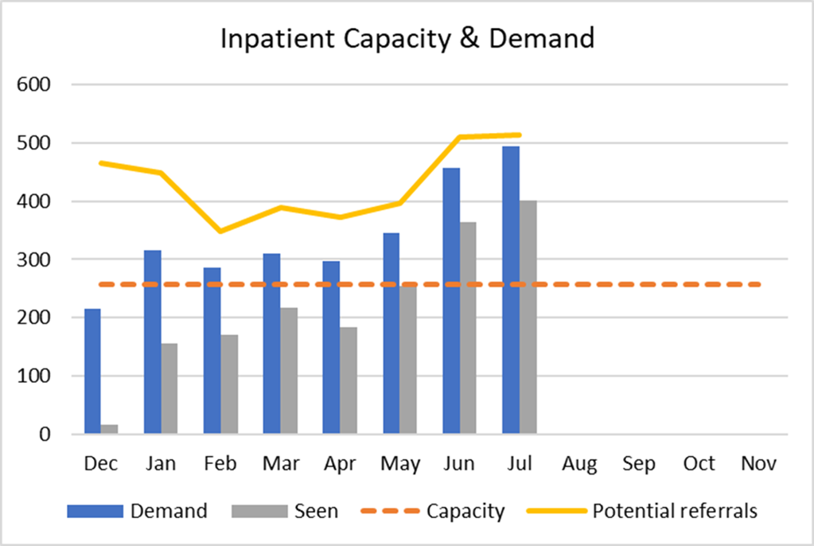
Overview of Service Cont………

Slide 89
Overview of Service Cont………
Maternity Pathway
  UHDB Champion Midwife appointed
  Work has been carried out around aligning pathways and ensuring robust data collection
  Currently 72% of women smoking at booking are referred to the service, but 21% currently seen.
  Staffing to deliver the service is currently inadequate.
    Tobacco Dependency Advisor at RDH but not at QHB
  Lack of maternity advisors is preventing the service from reaching its targets.
  Smoking rates at time of delivery remain higher than the national average (7.5%) across Derbyshire (9.3%) and (8.9%) across Staffordshire.
  Smoking remains the biggest avoidable risk factor associated with a range of poor birth outcomes.

Slide 90
EDS Domain 1:Commissioned or Provided Services
1a. Patients (Service Users) have required levels of access to the service

Slide 91
1a. Patients (Service Users) have required levels of access to the service
At risk population:
No readily available expected rate of attendance or presentation, however the Trust has implemented this service for all inpatient areas and those pregnant ladies using the Trusts maternity services.
Protected characteristics that are recorded within the Trust Patient Administration Systems (PAS) allows the capture of accessible information standards as well as the following protected characteristics:
      Age
      Ethnicity
      Sex
      Sexual Orientation
      Disability
      Pregnancy
      Religion

Slide 92
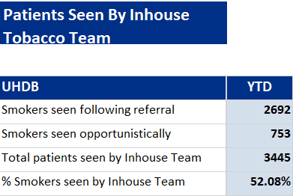
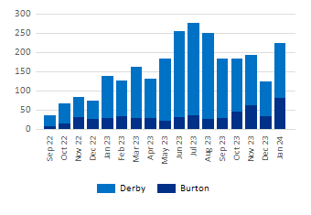
1a. Patients (Service Users) have required levels of access to the service – Business Intelligence Portal (BIP) Inpatients Smoking Summary Report 01/09/2022-26/02/2024

Slide 93
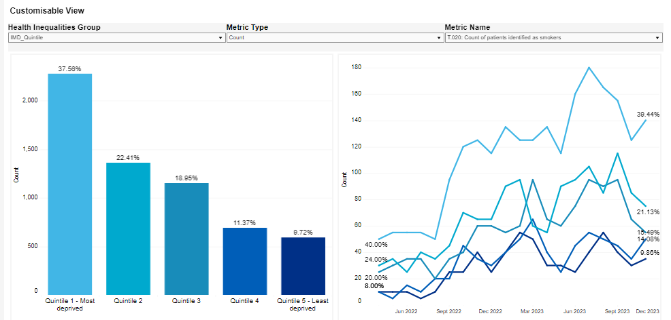
UHDB data from NHS Futures Tobacco Dependency Dashboard. Tobacco Dependence Services Dashboard LIVE: Health Inequalities - Tableau Server (england.nhs.uk)

Slide 94
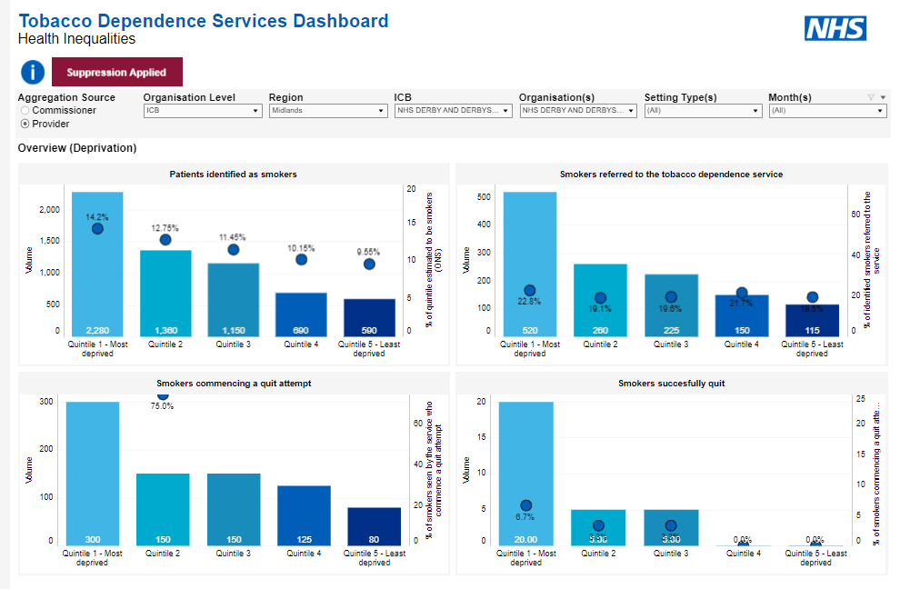
UHDB data from NHS Futures Tobacco Dependency Dashboard. Tobacco Dependence Services Dashboard LIVE: Health Inequalities - Tableau Server (england.nhs.uk)

Slide 95
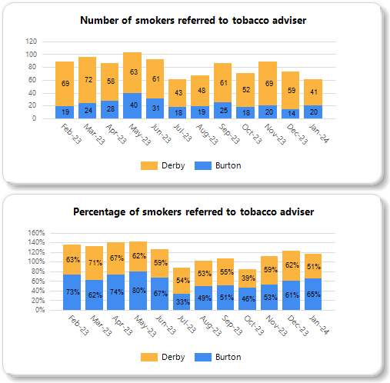
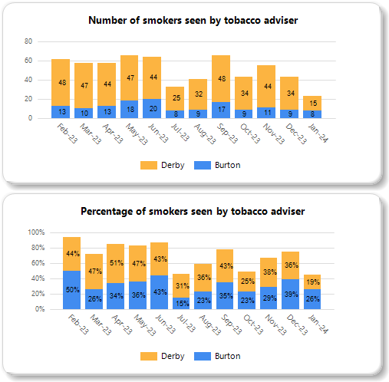
1a. Patients (Service Users) have required levels of access to the service – Business Intelligence Portal (BIP) Maternity Smoking Summary Report 01/09/2022-26/02/2024

Slide 96
EDS Domain 1:Commissioned or Provided Services
1b. Individual patients’ (service users’) health needs are met

Slide 97
1b. Individual patients’ (service users’) health needs are met
Undertake a comprehensive initial assessment to understand their health needs and goals irrespective of any protected characteristic.
All inpatient areas of covered.
The need for a translator is asked at the point of assessment and on further ongoing referral forms post discharge.
TDT treatment commenced at initial assessment.
Only RDH maternity patients covered by in-reach/in house model

Slide 98
1b. Individual patients’ (service users’) health needs are met – risks to TDT
Funding
  Awaiting confirmation of funding package from the ICBs for 24/25.
  Ringfenced funding from NHS England for the LTP finishes 24/25.
  Increase in funding unlikely.
Pathways
  In reach-model is in partnership with local authority means that the money doesn’t come directly to the Trust – ICB currently reviewing this model.
  Pathway variation across RDH and QHB sites
Maternity Service
  The TDT Maternity Service is not compliant with SBLV3, with significant understaffing.

Slide 99
1b. Individual patients’ (service users’) health needs are met – risks to TDT
Internal Risks
  Lack of resilience in project team structure.
  High staff turnover in acute outpatients and maternity with home office visa renewal.
  Lack of workspace at RDH – team previously displaced.
  IT systems – there needs to be a priority for mandating the smoking screening in the new EPR systems.
Inpatient Service
  Latest demand and capacity modelling by Derbyshire ICB shows service currently. running at 30% over capacity for the currently employed workforce.
  Limited onsite capacity due to system financial funding.
  Increase in screening levels have the potential to swamp the existing service.

Slide 100
1b. Individual patients’ (service users’) health needs are met – future opportunities
Cytisine pilot – acute inpatients
Community pharmacy offer
Development of healthcare support workers – secondment role in TDT
Maternity - National incentive scheme being developed and rolled out from April 2024, accompanied by national awareness.
Wider HI agenda: weight management, smoking, housing, exercise
  Portal under development to refer patients to a range of community services

Slide 101
EDS Domain 1:Commissioned or Provided Services
1c. When patients (service users) use the service, they are free from harm

Slide 102
1c. When patients (service users) use the service, they are free from harm
To prepare for these changes, we have been working closely with Integrated Care System (ICS) and Local Authority (LA) partners who currently provide tobacco dependency treatment services within the wider population (Livewell and Live Life Better Derbyshire and Everyone Health Staffordshire) so that they provide an on-site in-reach service across our sites. This is a new, integrated way of working for UHDB.
Each person is also offered in depth support from an on-site tobacco dependency advisor and supported for up to 12 weeks in their quit attempt and provide important continuity post discharge. We have made changes within our clinical systems to ensure a straightforward referral process and to track the success of the change as it is embedded.
Respiratory Consultant available for any staff member if they need any urgent advice or support with more complex patients to facilitate supportive conversations with colleagues.

Slide 103
1c. When patients (service users) use the service, they are free from harm
All work is currently undertaken in inpatient areas where access to any emergency equipment is available
Training package is available on My Learning Passport and is also accessible to clinicians via their ward representatives. Further work to be undertaken around roll out
A very brief advice (VBA) video has been produced to further support awareness of the service amongst UHDB staff
Adjustments are made when patients need them
All required staff safeguarding trained and safeguarding team available should they be required
Datix process to record any incidents

Slide 104
1c. When patients (service users) use the service, they are free from harm
Staff have received diversity and inclusivity training
Use and development of Business Intelligence dashboards to support
Regular mentoring sessions for the TDT advisors with Lead Respiratory Consultant

Slide 105
EDS Domain 1:Commissioned or Provided Services
1d. Patients (service users) report positive experiences of the service

Slide 106
1d. Patients (service users) report positive experiences of the service
The TDT programme is currently reporting a 50% 4 week and a 30% 12 week QUIT rate across both acute sites of UHDB.
A process to obtain patient feedback is due to be implemented as part of this process to inform future work.
There have been no complaints received to date, however all complaints regarding the service would be processed via the Trusts formal complaints process.
Patients report the service being accessible because of telephone support and NRT being delivered to their homes.
Patients are favourable with the service being free
Bedside consultations are being welcomed: 80% of those referred take up the service.

Slide 107

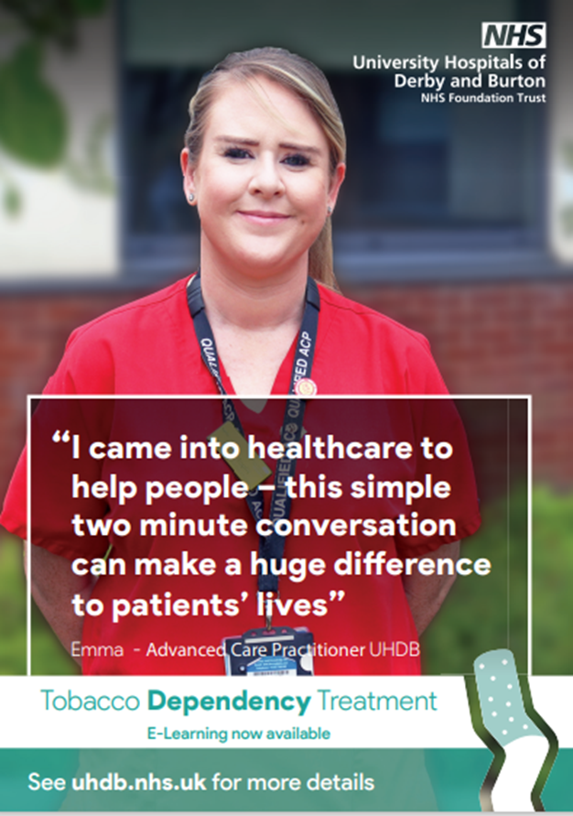
How are we doing? Patient and Staff Feedback
I wish I had known about it the service sooner, would highly recommend the service in the future.
I am better off with my breathing now and can taste my food a lot better.
Found the help and support given by Stop Smoking staff at the hospital very helpful, they were understanding and supportive and non-judgemental. I would highly recommend the service to friends and family.
Notes:
This is one of the most rewarding things I have done in my time as a consultant. I get feedback daily from patients and staff.
The staff love it – at a time when they feel powerless and hopeless this really gives them a sense of purpose
Talk about starting pilot before LTP in COVID on respiratory wards
I’d like to read you the testimony of John – one of your patients
"On January the 16th 2023 I was admitted to QE Burton with a heart attack, I spent the next 5 days receiving various medication and treatments. Having been wired up to the machines and unable to unplug I was not able to smoke however been a smoker for circa 40 years this was not only difficult but looked like a lost cause. It was then I was approached by (I now know as Steve) on the ward at first with his cloth bag thought he was coming to sell me religion only to be surprised that it was to see if I would want to quit smoking, after around 20mins I was clearer of the impact that smoking contributes to my health and now heart attack. Steve then took details and said I would receive some support products and regular calls with the friendly Melanie I am still smoke free and breathing better."

Slide 108


Tobacco Dependency Treatment Programme
JUCD:
Sam Knight
Angela Deakin
Maternity:
Lisa Adams – champion midwife
Tobacco dependency team:
Dee Thornhill – team leader
Steven Tranter
Simon, Tom, Anju, Ani, Sam, Izzy, Natasha
Consultants:
Gillian Lowrey
Jude Hampson
Elspeth Spencer
Junior Doctors:
Chinichem Okoyezu
Wai Lam
Pharmacy:
Paul Thornley and Lauren Docksey
IT:
Tracey Pickles
Health inequalities project manager:
Caroline White, Mic Heaton
ACP:
Emma Toplis
Business Intelligence:
Vicky Proctor

Slide 109
Next steps
Publish results on ICB and provider websites
Update ICB and Provider Governance Committees
Finalise and changes to websites
Set timeline and action plan for the next year
Continue joint working

Slide 110
Contact Details
Name: Claire Haynes
Title: Senior Public Equality and Diversity Manager
Email: Claire.Haynes2@nhs.net
Web: https://joinedupcarederbyshire.co.uk

