Slide 1

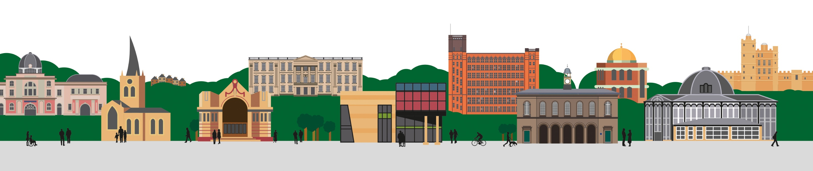

GP Access
Clive Newman, Director of Primary Care
for Derby and Derbyshire ICB

Slide 2
Questions we’ll try and answer
Why is getting a GP appointment so difficult?
How many GPs do we have in Derby and Derbyshire?
Is it getting worse?
Have GPs stopped doing appointments face to face?
Why do GPs tell patients to ring back?
Have we invested in General Practice / Primary Care Networks? What’s happened to that money and those staff?
What’s the national plan (and how are we doing?)
What’s our local plan?
What’s happening with the current GP collective action

Slide 3
Why is getting a GP appointment so difficult?
Too much demand, not enough supply
30% increase in people over 70 since 2010
People living longer in worse health who need increasingly complex care
Number of GPs and practice nurses has remained about the same for the last ten years
Number of staff overall has increased, but they don’t all provide ‘normal’ GP appointments

Slide 4
How many staff do we have? How does it compare to the hospitals?
There are more than twice as many Consultants in hospitals in Derby and Derbyshire than there are GPs
Between 2019-2024 the number of GP Partners (the GPs who own and run the practices) has fallen by 30%, replaced by salaried GPs

Slide 5
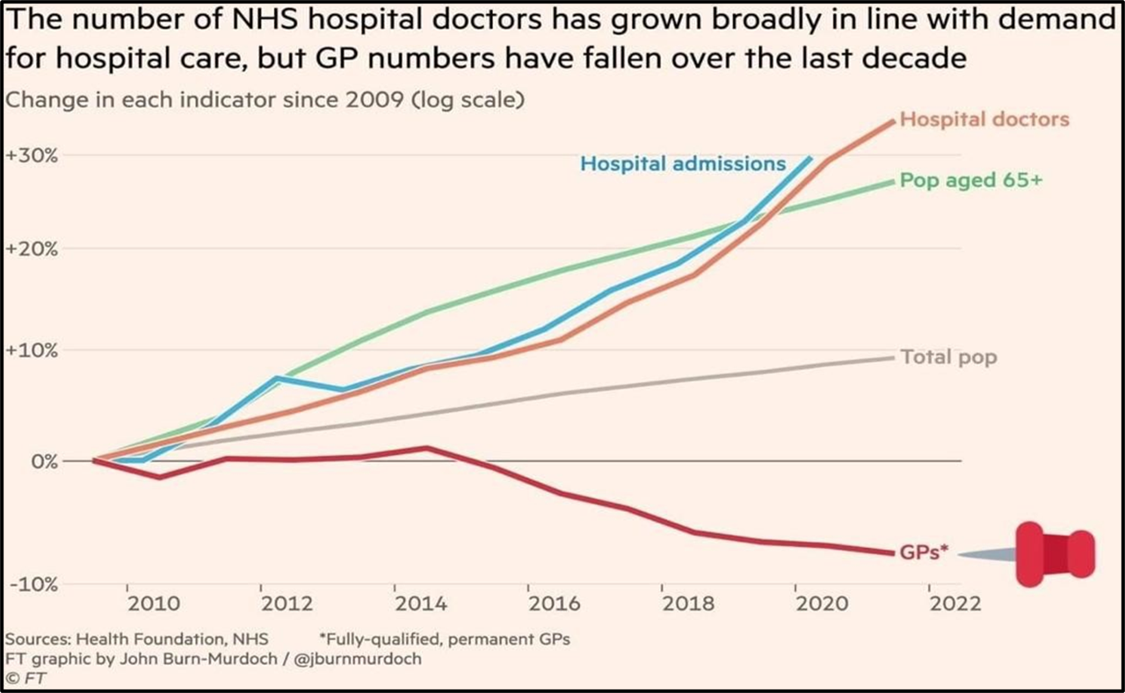
How many staff do we have? How does it compare to the hospitals?
Staff group | Whole Time Equivalent
GPs | 732
Nurses | 344
Staff providing direct patient care | 271
 | 1521

Slide 6



Is it getting worse?
It’s hard to tell
But the number of appointments offered overall has increased – it’s up 12% since 2019 (we offer c570,000 per month in Derby and Derbyshire)
Patient survey information says that patients generally think so

Slide 7
Is face to face access worse?
No – about ¾ of all patients get seen face to face
(slightly down by 4% to 71% since 2019)
Phone appointments have increased since 2019 and now make up 20% of all appointments
About 10% of appointments are online
40% of appointments are offered on the same working day
82% of appointments are offered within 2 weeks

Slide 8
Why do they tell me to ring back?
Too much demand
GP practices are juggling requests for ‘on the day’ and ‘routine’ appointments (which are booked ahead)
Typically, they book up to 60% ahead for routine and hold back the rest for anyone ringing in with something urgent
They won’t book endlessly into the future (like a hospital waiting list) but will release appointments every day
So, unfortunately, if you ring and all the appointments are already booked you have to ring back the next day when they will release more appointments

Slide 9
Haven’t we put a lot of money into General Practice – aren’t there more staff?
Yes, since 2019 we’ve invested nearly £24m in staff in Derby and Derbyshire – 589 new people
The money has been given to groups of GP practices (called Primary Care Networks (PCNs))
It isn’t for doctors or nurses but for other linked staff such as pharmacists, physiotherapists, mental health workers and social prescribers
The staff deliver a wider range of services such as support for care homes, medication reviews, anticipatory care for older people etc

Slide 10
What’s the national plan to improve access?
In 2023 the government launched a national primary care access recovery plan
It aimed to tackle the 8am rush and make sure that patients know when they ring how they will be cared for i.e. same day if urgent, within 2 weeks if not, or signposted to another service
It’s a four-part plan aimed at:
  Empowering patients
  Developing modern General Practice
  Building (staffing) capacity
  Improving the interface between primary care (GPs) and secondary care (hospitals)

Slide 11
National plan #1 ‘Empowering Patients’
Increasing uptake of the NHS App (for online prescriptions, appointments, messages and access to records)
New self-referral pathways
Pharmacy First
Automatic GP registration servicer

Slide 12
National plan #2 ‘Modern General Practice’
New digital telephone systems
More online requests (18% increase in Derby and Derbyshire since April 2023)
Training in ‘care navigation’ (93 /112 practices trained)
A new digital triage tool
A General Practice improvement programme

Slide 13
National plan #3: Building Capacity
Investment in larger multi-disciplinary teams, led by GPs, through investment in Primary Care Networks
Stablise GP numbers (and, since September 2024, allow PCN funding to be used to fund GPs)
Initiatives to encourage the recruitment and retention of GPs and Nurses e.g.
GP fellowships
Counselling, mentorship and support
Local recruitment and retention schemes

Slide 14
National plan #4: Primary / Secondary Care Interface (GP/Hospital Relationship)
Work from hospitals accounts for 20-25% of the total. This includes
Patients seeking advice from GPs because they are on long waiting lists
Hospitals asking GPs to undertake tests or provide elements of care for patients who they are treating
Hospitals asking GPs to re-refer to different departments ‘onward referrals’
Hospitals to work with GPs to:
Eliminate unnecessary ‘re-referrals’
Make sure patients are discharged with ‘fit notes’ and correct discharge information
Call and recall patients to hospital without needing GP input
Provide a clear point of contact for patients / GPs on waiting lists

Slide 15
Our local longer term plans
GPs are working on plans to change how they organise themselves and tailor care to patients depending on need
This would mean working together more and providing some services across more than one practice. The idea is that by pooling their resources they can offer more accessible and resilient services. An example would be the pooled ‘on the day’ appointment service offered by Ilkeston and Long Eaton GPs
We are also reviewing the local funding we give to practices and the services they provide. The aim is to provide accessible, appropriately funded and high quality services close to home

Slide 16
Questions?

Slide 17
Contact Details
Name: Clive Newman
Title: Director of Primary Care for
Derby and Derbyshire ICB
Email: clive.newman3@nhs.net

