Slide 1
Derbyshire Dialogue
How we use your data

Slide 2
Introductions
Ged Connolly-Thompson Head of Digital Development and Information Governance NHS Derby & Derbyshire Integrated Care Board
Lis Ries Head of Business Intelligence NHS Derby & Derbyshire Integrated Care Board
Hils Poole Senior Consultant (Strategic Information Governance) North of England Commissioning Support Unit
Joanne Goodison Senior Commissioning Manager – Strategic Clinical Conditions and Pathways NHS Derby & Derbyshire Integrated Care Board

Slide 3
Topics we will be covering
The use of patient identifiable data (PID) to provide care
How and why the Integrated Care Board (ICB) uses patient data for risk stratification and what this means
Future plans for using patient data for Population Health Management (PHM)

Slide 4
Topics we will not be covering
The awarding of a contract by NHS England to Palantir for the Federated Data Platform (FDP)
Access to Primary Care services
Prospective access for patients to primary care health records

Slide 5
Direct care

Slide 6
Direct care
Each GP Practice has access to a clinical system which they use to record details of your appointments and other interactions on your care record;
If your care plan involves a referral to another organisation, such as a hospital, the GP Practice will share part of your care record with that organisation to provide context to the referral;
A subset of the information in your care record may also be shared with other systems – such as the Derbyshire Shared Care Record or national summary care record;
All of the above is to ensure the appropriate care is provided.

Slide 7
Risk stratification

Slide 8
What is it?
A way of identifying patients who currently carry a high risk, or are likely to be at higher risk, of developing worsening health outcomes;
This could include:
Increased hospital admissions;
Increased risk of falls;
Complications with an existing illness or condition;
Development of a new illness or co-morbidity;
Diminished quality of life;
Shorter life span.

Slide 9
How does it work?
Information from Derbyshire NHS organisations and GP Practices is combined in a secure database by a regional NHS organisation;
Identifiable information is removed from the data, which then feeds into a number of reports and data dashboards;
These are analysed by the Business Intelligence team and other colleagues to look for patterns or trends within a certain diagnosis group and/or geographical area;
Reports and dashboards are discussed with Primary Care
Local GPs can look at the information and re-identify their own patients to provide appropriate care.

Slide 10
Example - Cardiovascular
A recent practical example involves the ICB’s Medicines Management Technicians
This involved the risk stratification and prioritisation of known patients with high-risk cardiovascular disease related conditions, namely Atrial Fibrillation (AF), Hypertension (High Blood Pressure) and Elevated Cholesterol
Searches were undertaken to identify all patients within scope
For Hypertension, for example, patients were divided into priority groups based on the last recorded blood pressure as well as comorbidities and ethnicity
This grouping allows practices to prioritise patients and to safely phase review appointments over time
It also helps match patient care to the workforce requirements

Slide 11
Who is our regional processor?
Except in a handful of specific circumstances, commissioners of services are not permitted to receive identifiable data;
As a result, the ICB uses an NHS Safe Haven to handle all the personal and confidential data on their behalf;
These NHS Safe Havens are called Regional Processors.
They are NHS organisations who have the appropriate approvals in place and adhere to strict security policies and controls.

Slide 12
Key points of Risk Stratification
The NHS Regional Processor removes all identifiable data before sharing the information with the ICB;
No one within the ICB can identify you from the information that we receive;
GP colleagues can identify groups of their patients with the highest need or who are likely to develop the highest need;
They are then able to provide appropriate care and support;
The information is not shared for any other purpose;
This has been approved by the Health Research Authority to access patient data for this purpose.

Slide 13
Population Health Management

Slide 14
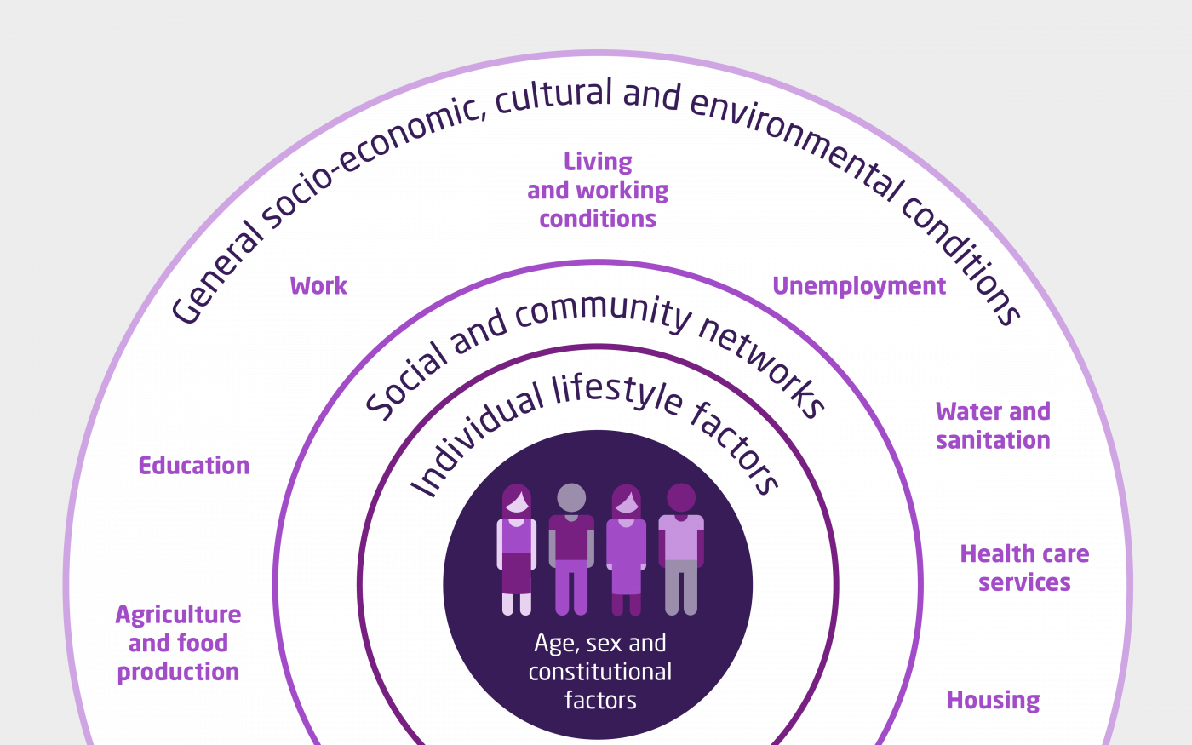
Source: Dahlgren G, Whitehead M 1993

Slide 15
What is it Population Health Management (PHM)?
A way of looking at the overall health of the population;
A focus upon prevention rather than treatment;
Knowing that the health and wellbeing of a population requires input from numerous organisations;
It needs safe sharing of data about individuals held by health and care organisations within a secure system;
It is not possible to identify the individual from the data provided for PHM;
PHM is not quite the same as public health.

Slide 16
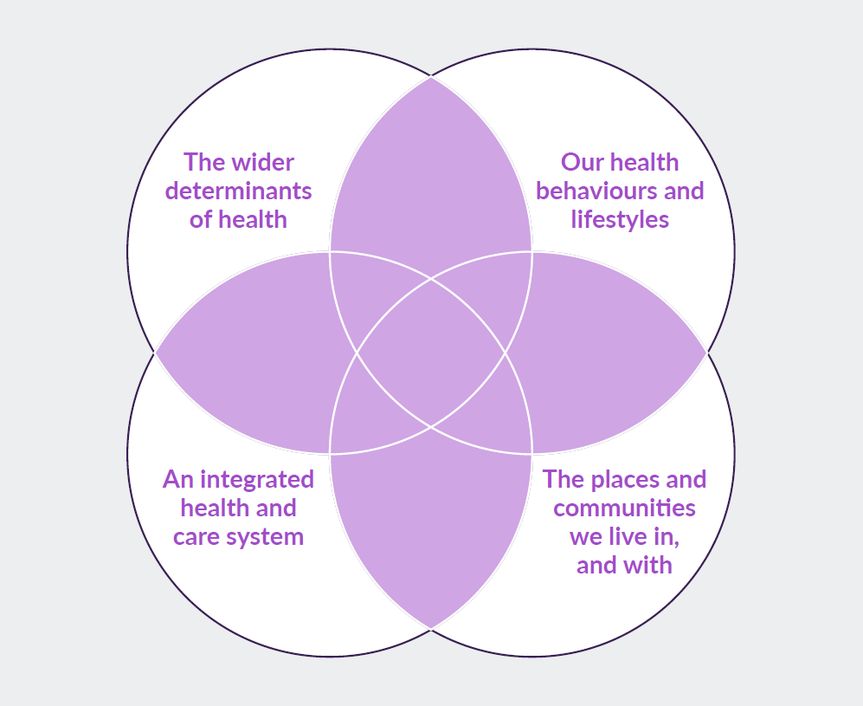
Source: Buck et al 2018

Slide 17
Example – Housing Development
A population health approach to housing development would ensure the following are considered:
Active travel and the promotion of cycling, walking as a preferred choice of travel;
Availability of green space;
The size and design of individual homes within the development;
Ensuring that homes are affordable to all sections of the community;
Actions to allow residents to remain within their homes as they age.

Slide 18
Key points
It is not possible to identify you as an individual from the data shared for Population Health Management
The ICB will be applying to the Health Research Authority in the coming months for permission to use data for Population Health Management

Slide 19
Questions?

