Slide 1
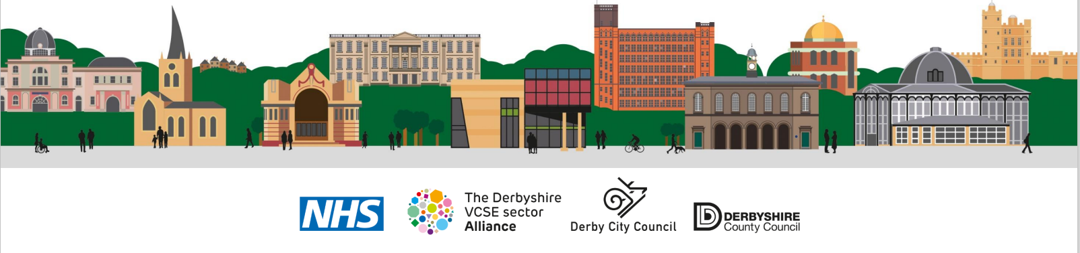
Improving Pain Management
Derbyshire Dialogue - 11 September 2024
Paula Whitehurst
Lead Pharmacy Technician – Strategy Pharmacy Directorate
NHS Derby and Derbyshire Integrated Care Board

Slide 2
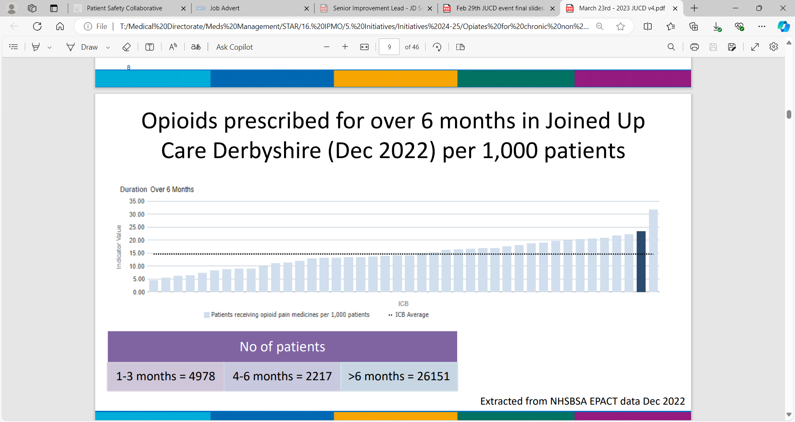
Background
Opioid medication includes medicines such as morphine, fentanyl, tramadol and codeine.
Opioids have a place in the management of acute pain e.g. post-surgery and cancer-related pain but there is no evidence to support the routine use of opioids in chronic, non-cancer pain.
Opioids are classed as a high-risk medicine. The risks and side-effects from opioids are dose related with doses of 120mg per day of morphine (or equivalent) providing no further benefit but an increased risk of harm.
The MedSIP Methodology Report (Dec 2022) states that 'for every 62 people who stop opioids (or do not start) prevent one death'.
Notes:
The graph shows prescribing data from 2022, which highlighted high prescribing of opioids in Derby and Derbyshire.
This programme also ties in with the ‘Optimising Personalised Care for Adults Prescribed Medicines Associated With Dependence or Withdrawal Symptoms Framework’ (March 2023).

Slide 3
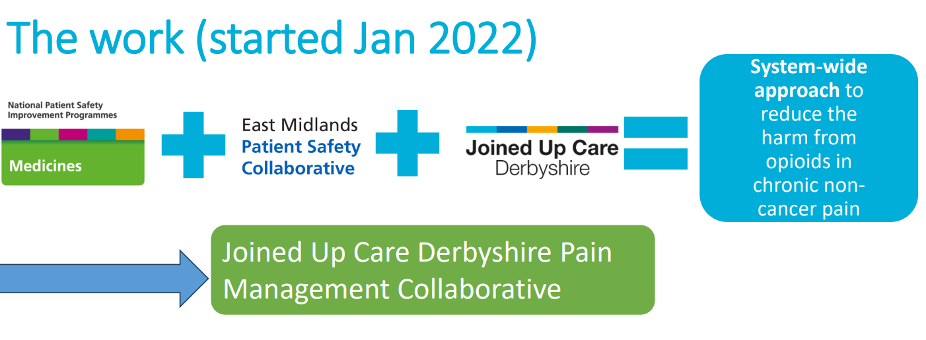
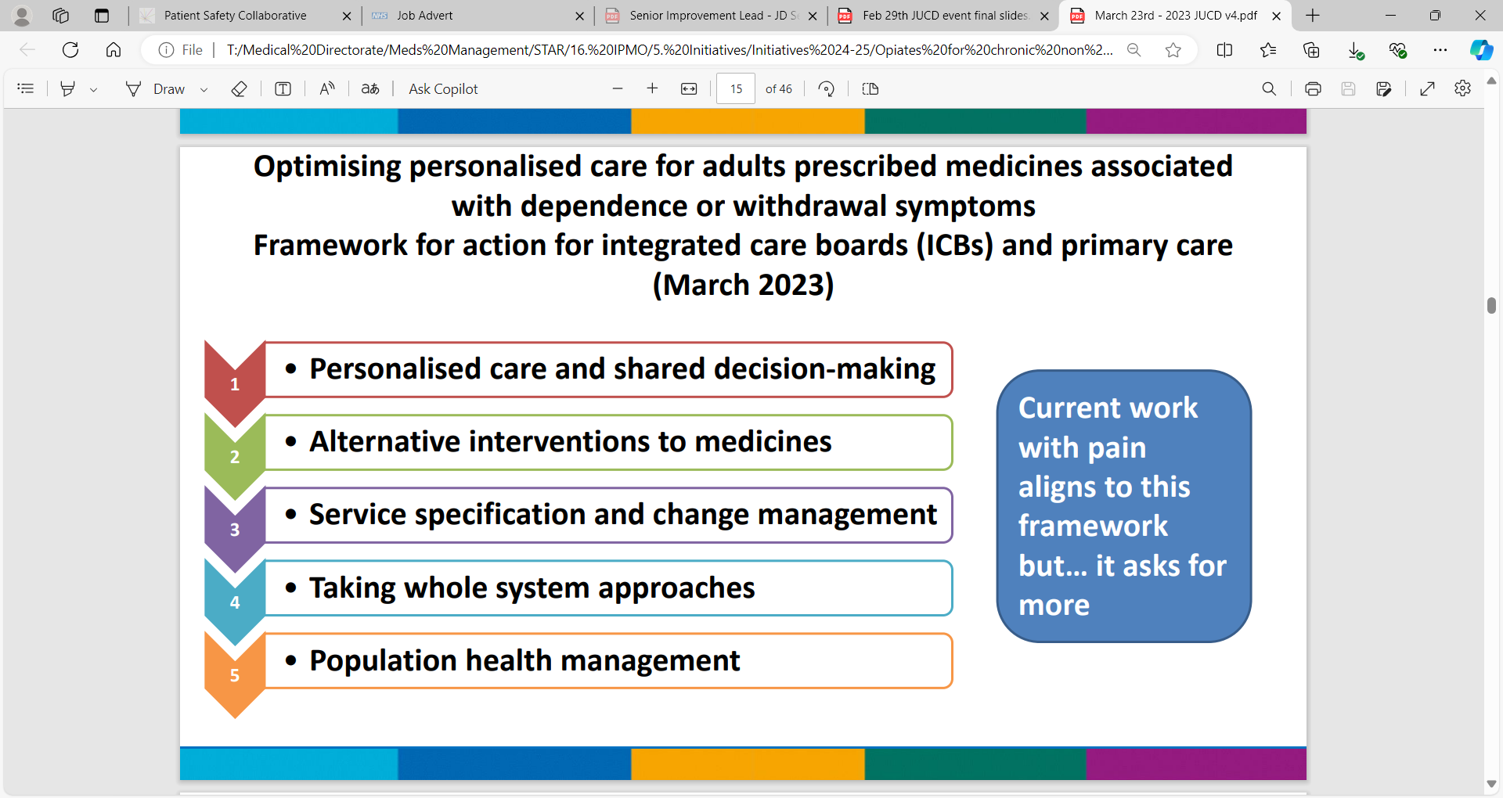
Context
Optimising personalised care for adults prescribed medicines associated with dependence or withdrawal symptoms Framework for action for integrated care boards (ICBs) and primary care (March 2023)
Medicines Safety Improvement Programme
The Medicines Safety Improvement Programme addresses the most important causes of severe harm associated with medicines, most of which have been known about for years, but continue to challenge the health and care systems in England.
The key ambition for the Medicines Safety Improvement Programme is as follows:
Improving care for people with persistent pain by reducing opioid analgesic use.
Notes:
The opioid change management programme is a system wide approach to reduce harm from opioids. JUCD have partnered with Health Innovation East Midlands (previously known as the East Midlands Academic Health Science Network) to deliver this programme.
The programme is a national Medicines Safety Improvement Programme (https://www.england.nhs.uk/patient-safety/patient-safety-improvement-programmes/#MedSIP) with the key ambition of improving care for people with persistent pain by reducing opioid analgesic use.
This programme also ties in with the ‘Optimising Personalised Care for Adults Prescribed Medicines Associated With Dependence or Withdrawal Symptoms Framework’ (March 2023).
Along the way we have partnered with ‘Live Well With Pain’ adopting their ‘Ten Footsteps’ methodology which is advocated to support people in Derby and Derbyshire who live with pain, to live well with their pain.

Slide 4
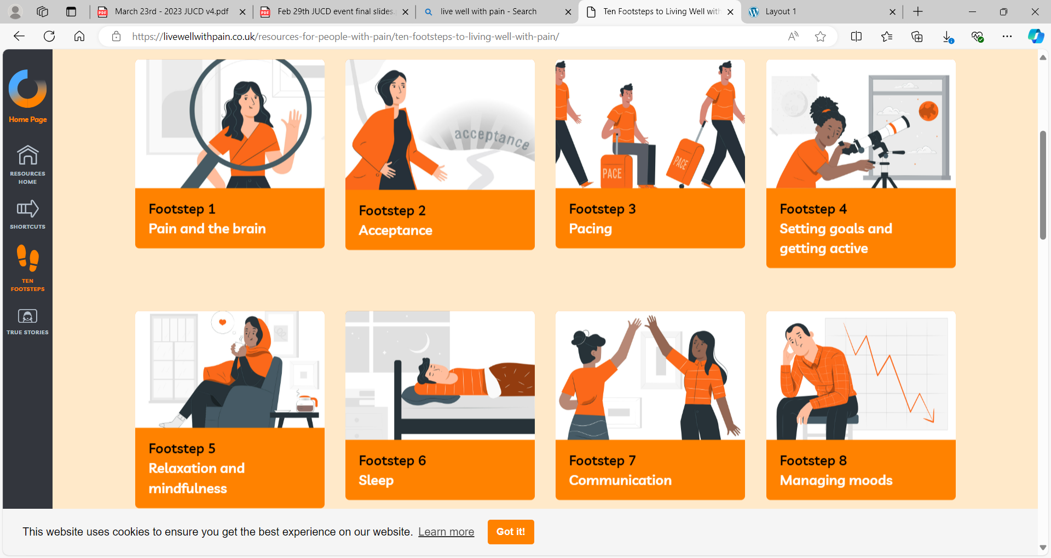
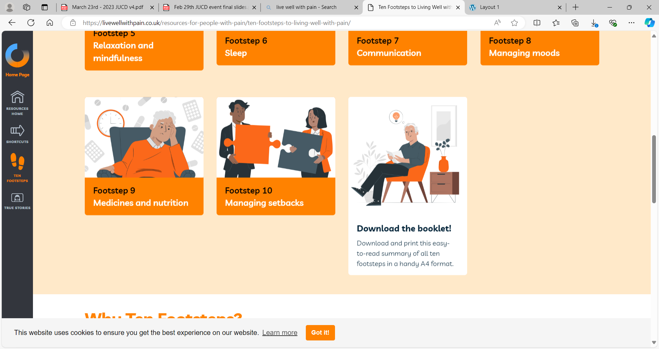
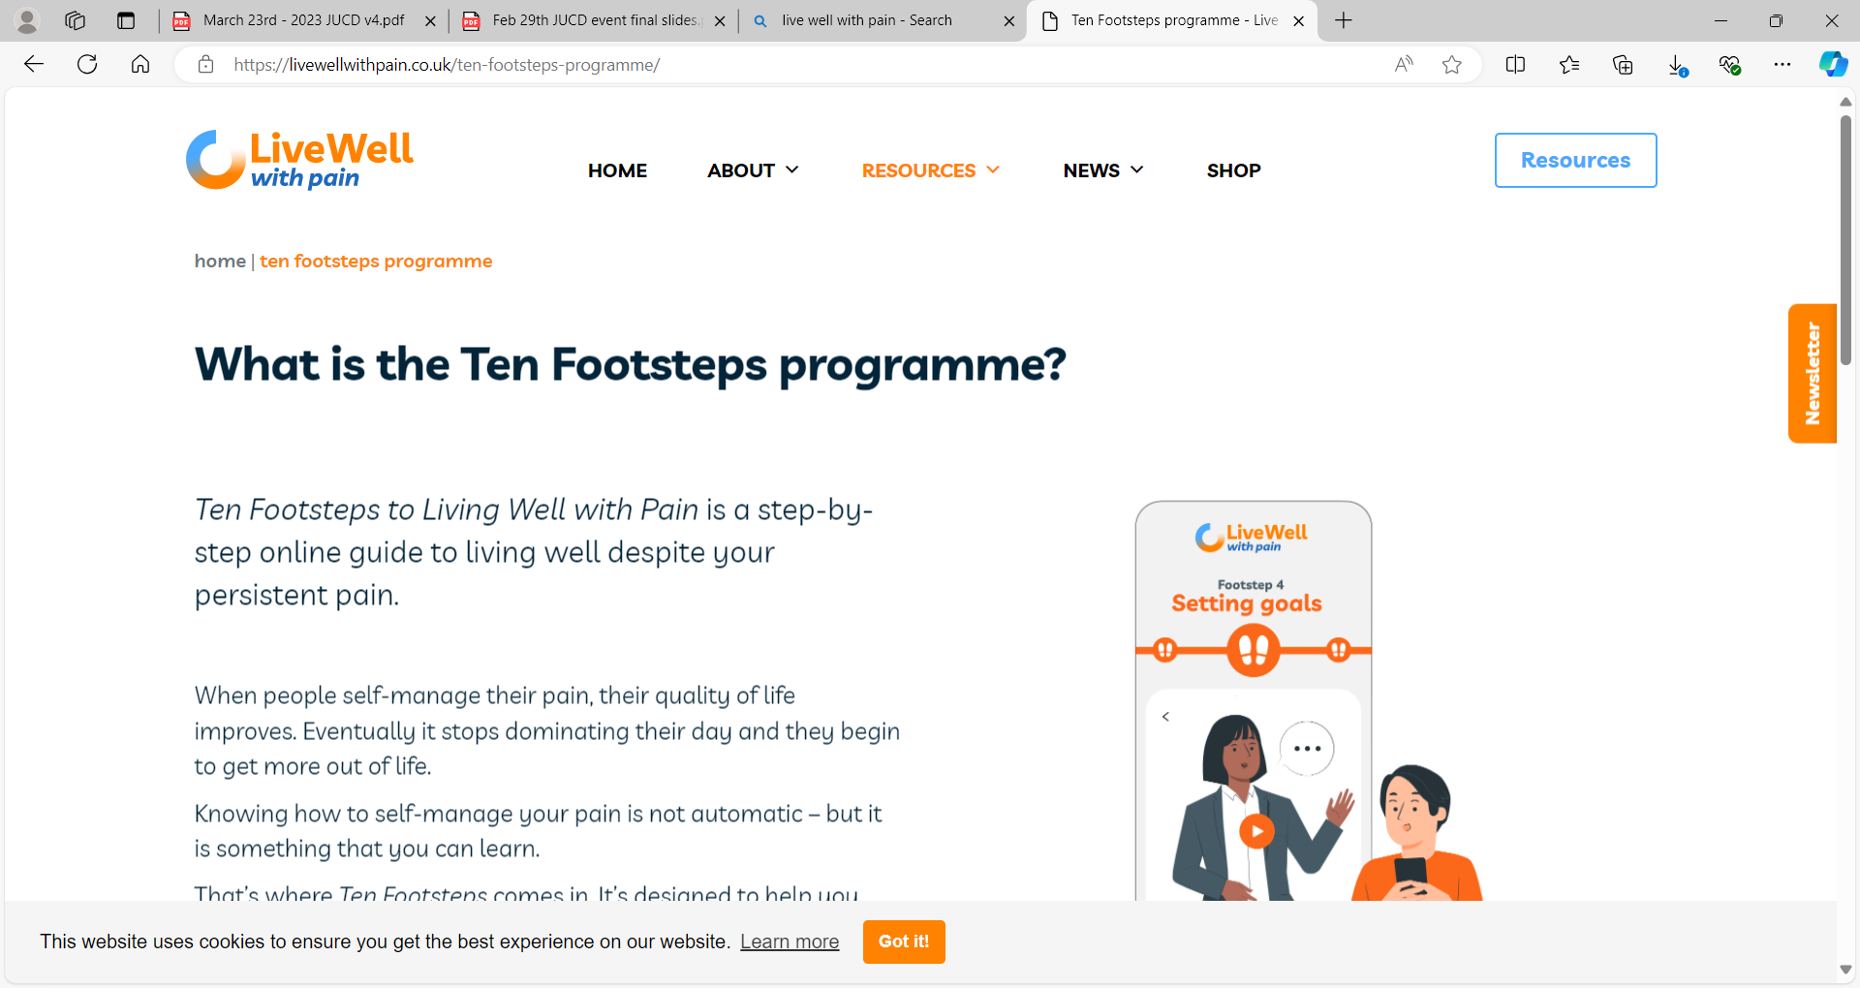
Working In Partnership
Ten Footsteps to Living Well with Pain.
Notes:
The opioid change management programme is a system wide approach to reduce harm from opioids. JUCD have partnered with Health Innovation East Midlands (previously known as the East Midlands Academic Health Science Network) to deliver this programme.
The programme is a national Medicines Safety Improvement Programme (https://www.england.nhs.uk/patient-safety/patient-safety-improvement-programmes/#MedSIP) with the key ambition of improving care for people with persistent pain by reducing opioid analgesic use.
This programme also ties in with the ‘Optimising Personalised Care for Adults Prescribed Medicines Associated With Dependence or Withdrawal Symptoms Framework’ (March 2023).
Along the way we have partnered with ‘Live Well With Pain’ adopting their ‘Ten Footsteps’ methodology which is advocated to support people in Derby and Derbyshire who live with pain, to live well with their pain.

Slide 5
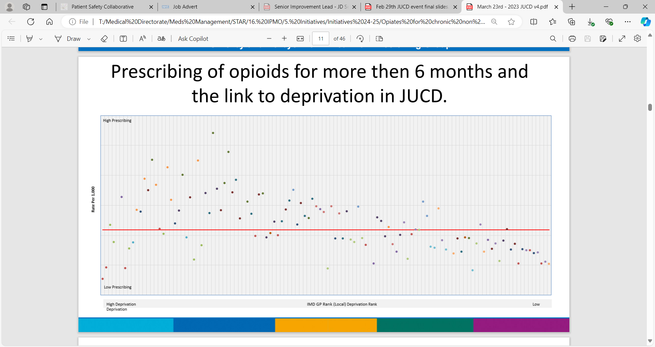
Population Health
Prescribing of opioids for more then 6 months and the link to deprivation in JUCD.

Slide 6
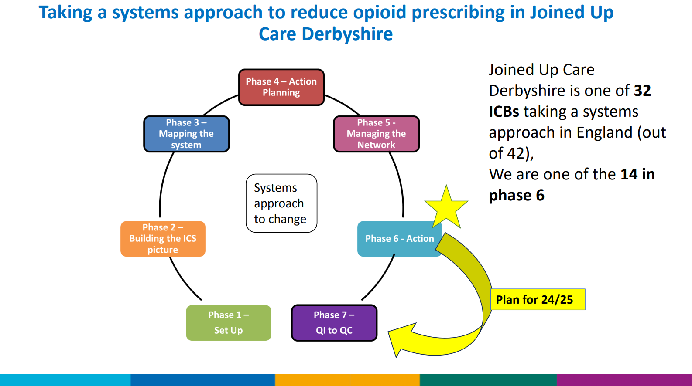
Programme Detail
Annual System Action planning events (March 2023 and February 2024) enable the workplan to be set for each financial year.
Stakeholders are invited to the annual events; with an interest in pain management, including people with lived experience of chronic pain and their carers.

Slide 7
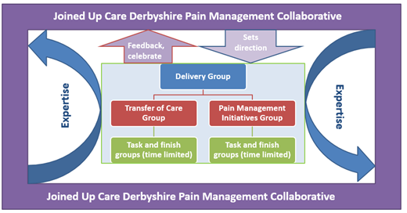
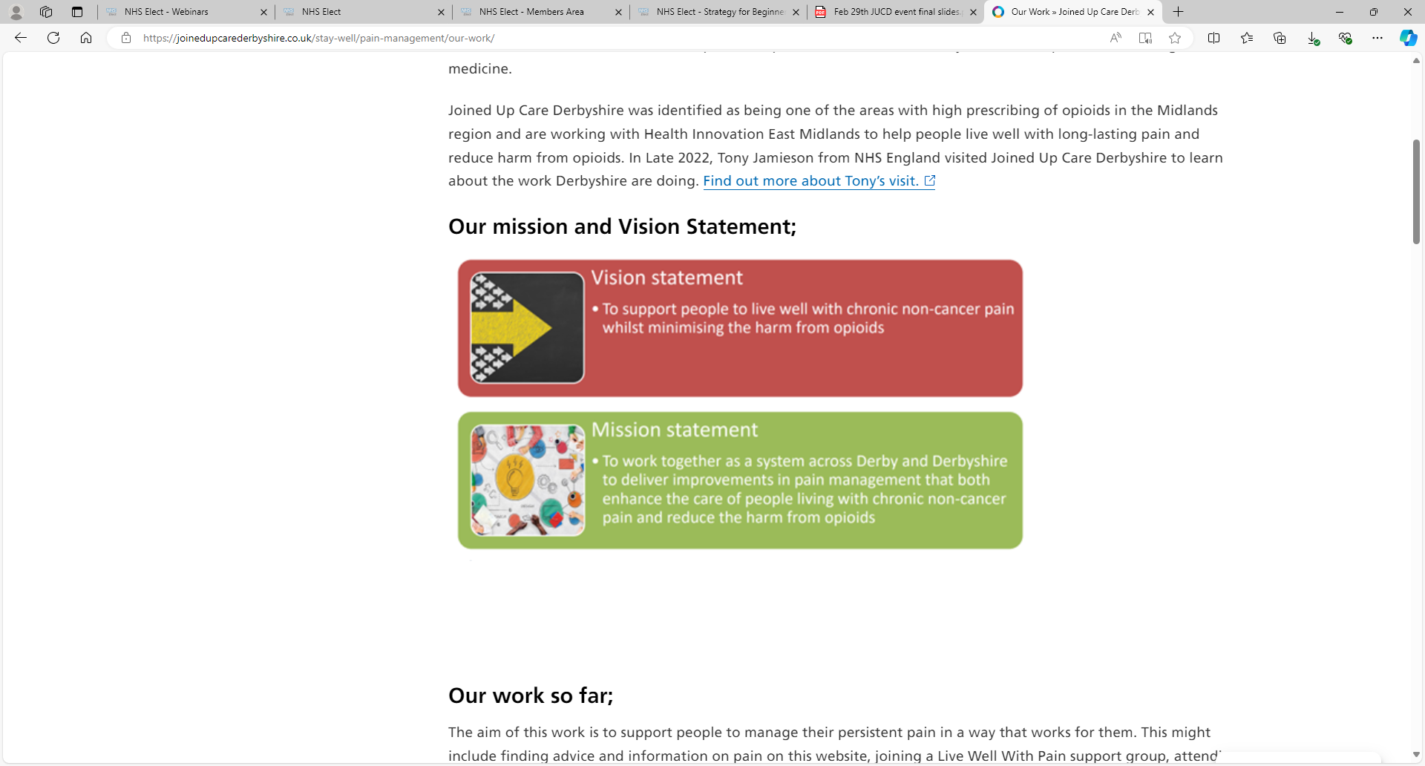
Programme Setup
The vision and mission statements for the programme are below.
Above is a visual on the delivery groups and how we all work together as a ‘collaborative’.

Slide 8
Driving Change
Delivery is via the working groups.
The Core Group have oversight.
The programme is accountable to the Integrated Pharmacy Medicines and Optimisation Board

Slide 9
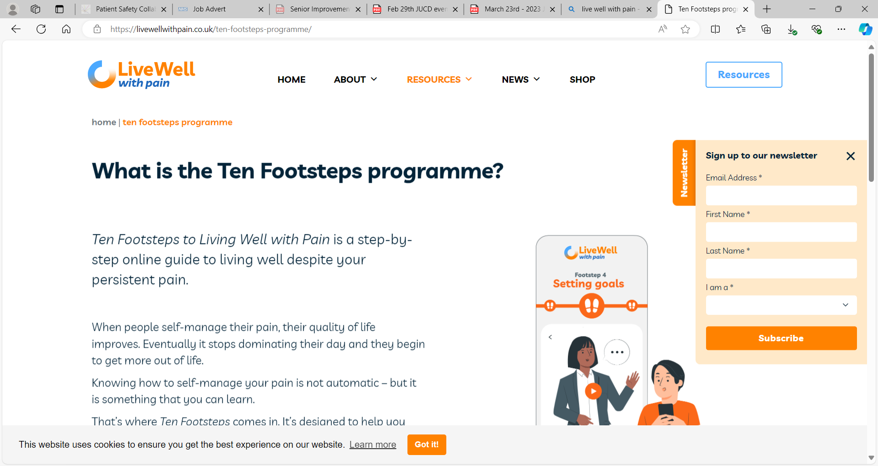
Ten Footsteps Practitioners and Support Groups
81 people have trained to become a ‘Ten Footsteps Practitioner’. (Healthcare professionals such as Pharmacists, Social Prescribers, Health & Wellbeing Coaches, Link Workers, Physiotherapists and a GP).
Many of these healthcare professionals have set up (or support) Live Well With Pain support groups for their GP Practice or Primary Care Network.
There will soon be seventeen established ‘Lets Live Well With Pain’ support groups following on from the one we had initially at Lister House Surgery;
  South Dales PCN – Wirksworth Eco Centre Group and Ashbourne Group
  Chesterfield and Dronfield PCN – Whittington Moor Church Hall Group
  North East Derbyshire PCN – Group initiation imminent
  Erewash PCN - Erewash Voluntary Action office - Long Eaton group and Ilkeston Arena Church group.
  Greater Derby PCN – Fairdene Court Community Room, Rebecca House Community Room, Pride Park Stadium, From Aug 24; Spondon, Darley Abbey, Allestree and Pride Park (David Lloyd)
  PCCO PCN – Alvaston Humber Close Community Room
  Derby City South PCN – Sinfin Moor Church Group, Age UK site, Findern Village Hall

Slide 10
Ten Footsteps Practitioner Feedback On The Course
Feedback on the training has been really positive;
I've been using the health check and chronic pain explanations, which seem to be landing well with patients.
I appreciated the content delivered by the physio trainer looking at common challenges facing people living with ongoing pain and sharing her tips and techniques on pacing and setting realistic goals.
The training was brilliant. The pace flowed really well. One trainers Health Psychology knowledge and experience was really helpful in emphasising the psychological impact for someone living with ongoing pain.
I found the course insightful and help us plan effectively for the new service we are running.
The information given by people who have experienced pain management was particularly helpful.
The course was good the lived experience and the assessment tools were a good take away from the course for me.
It’s definitely improved my confidence in supporting people with chronic pain, especially a number of new/existing clients with Fibromyalgia.

Slide 11
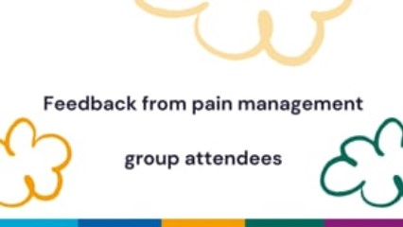
Positive feedback from pain management group attendees.
If any PCNs currently without a group would like to consider setting one up, we may be able to support staff with facilitation guides and training. Email paula.whitehurst1@nhs.net for more information.

Slide 12
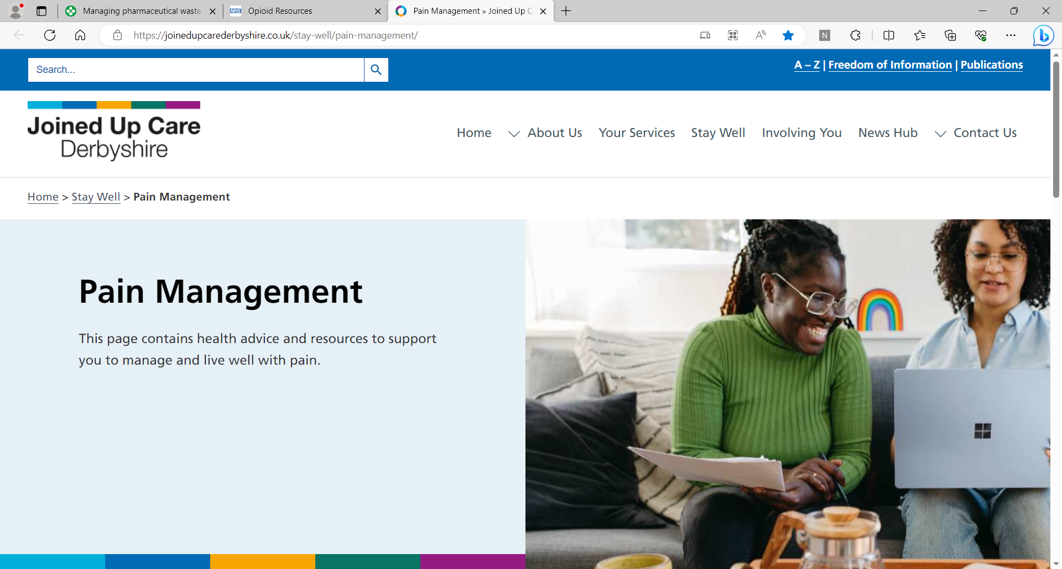
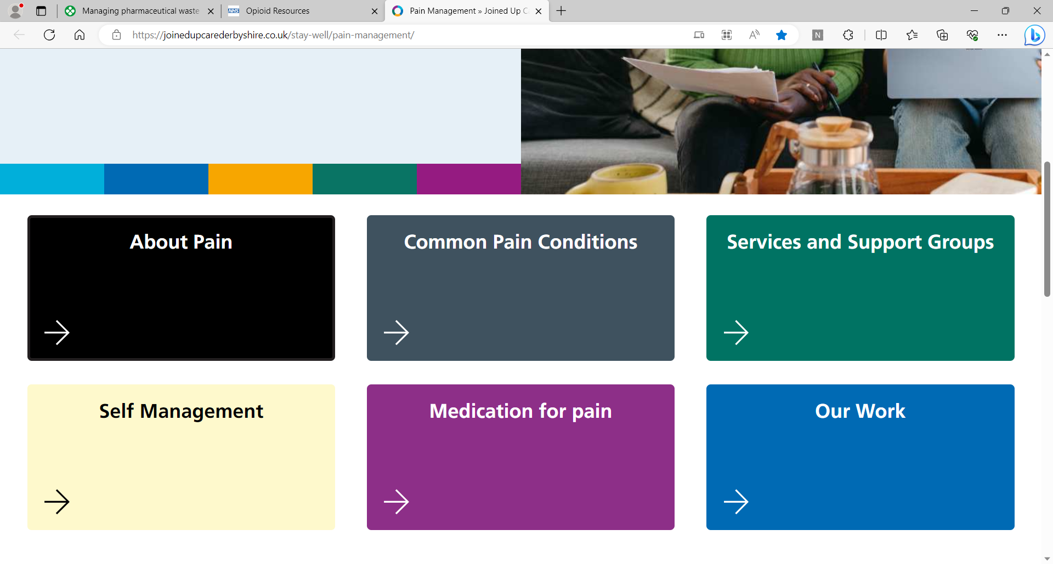
Local Pain Management Website Pages
Resources Developed
Pain Management resources can be accessed on the JUCD Pain Management web page. This has useful information for patients. We would like to promote this to patients.

Slide 13
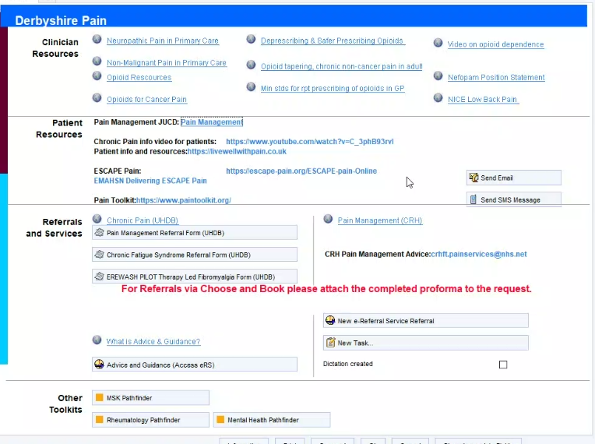
Pathfinder Links for clinicians
Resources Developed
‘Pathfinder’ within the clinical system has been updated with useful resources for clinicians.
We aim to keep linked in with the development of pathfinder as this goes web based.

Slide 14
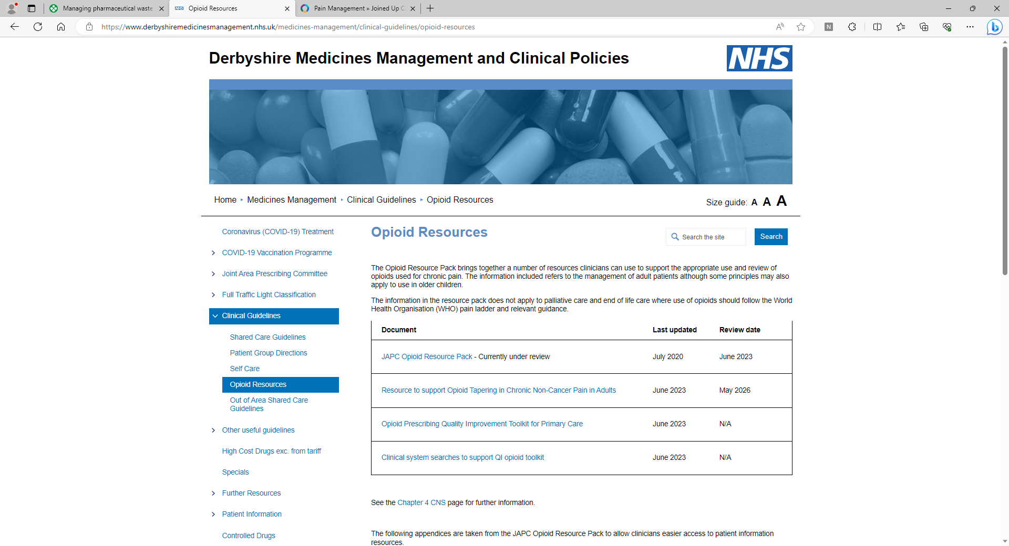
ICB Medicines Management Webpages
Resources Developed
Derby and Derbyshire ICB’s Medicines Management website has a section for opioid resources for clinicians.
Resources available:
Opioid Tapering Guideline
Opioid Quality Improvement Toolkit
Opioid resource pack
Repeat prescribing minimum standards for opioids
‘Let’s Live Well with Pain’ Course Implementation and Facilitation guides
Information on this programme of work

Slide 15
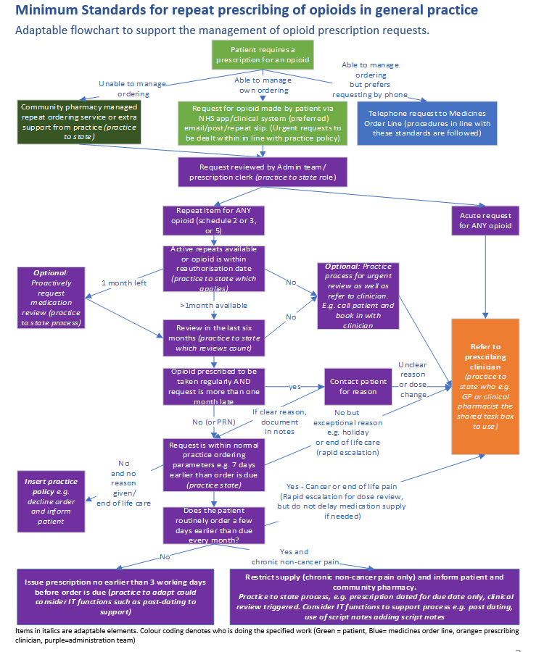
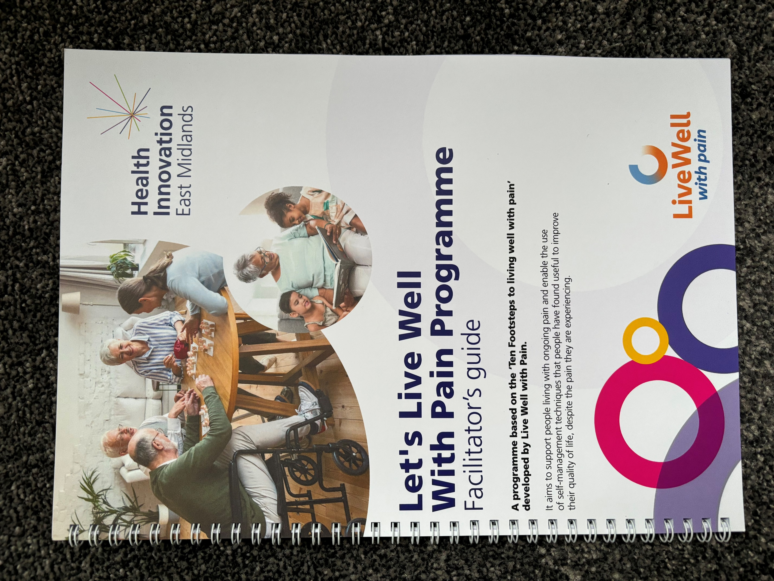
Minimum Standards and Facilitators Guide
Resources Developed
The Live Well With Pain course implementation and facilitation guide was designed to help PCN’s/Practices set up pain management support groups. It is based on the Lister House model.
The minimum standards for repeat prescribing of opioids document is a set of common standards that can be adopted by all GP practices to optimise and support safe opioid prescribing.

Slide 16
Digital Tools
Resources Developed
Two digital Live Well With Pain questionnaires have been developed that can be sent from SystmOne via AccuRx to a patient.
  Health and Wellbeing Check tool
  Medicines Decision Guide.
Completed questionnaires can be saved into the patients record to help with consultations where pain is discussed.
An action plan can be generated that can be printed for the patient to take away and work on.
The tools will be evaluated by Durham University.
Other Programme Information
Further information and Derbyshire patient stories and case studies can be found on the
Improving the management of chronic non cancer pain – reducing harm from opioids web page.

Slide 17
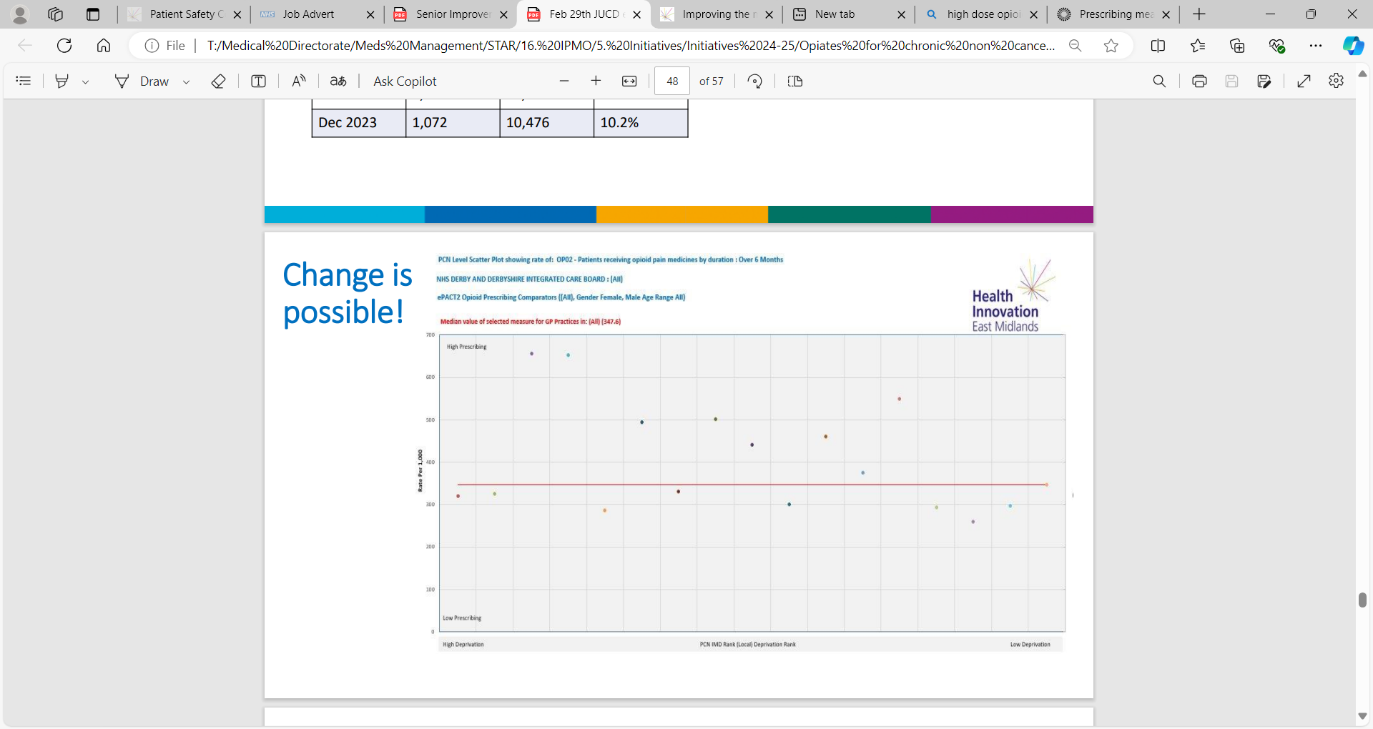
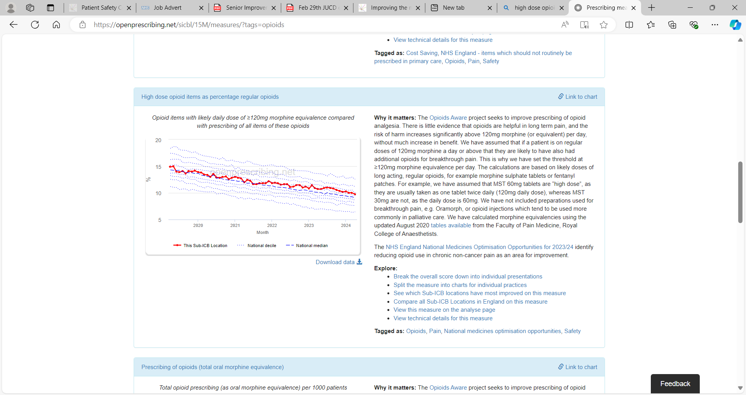
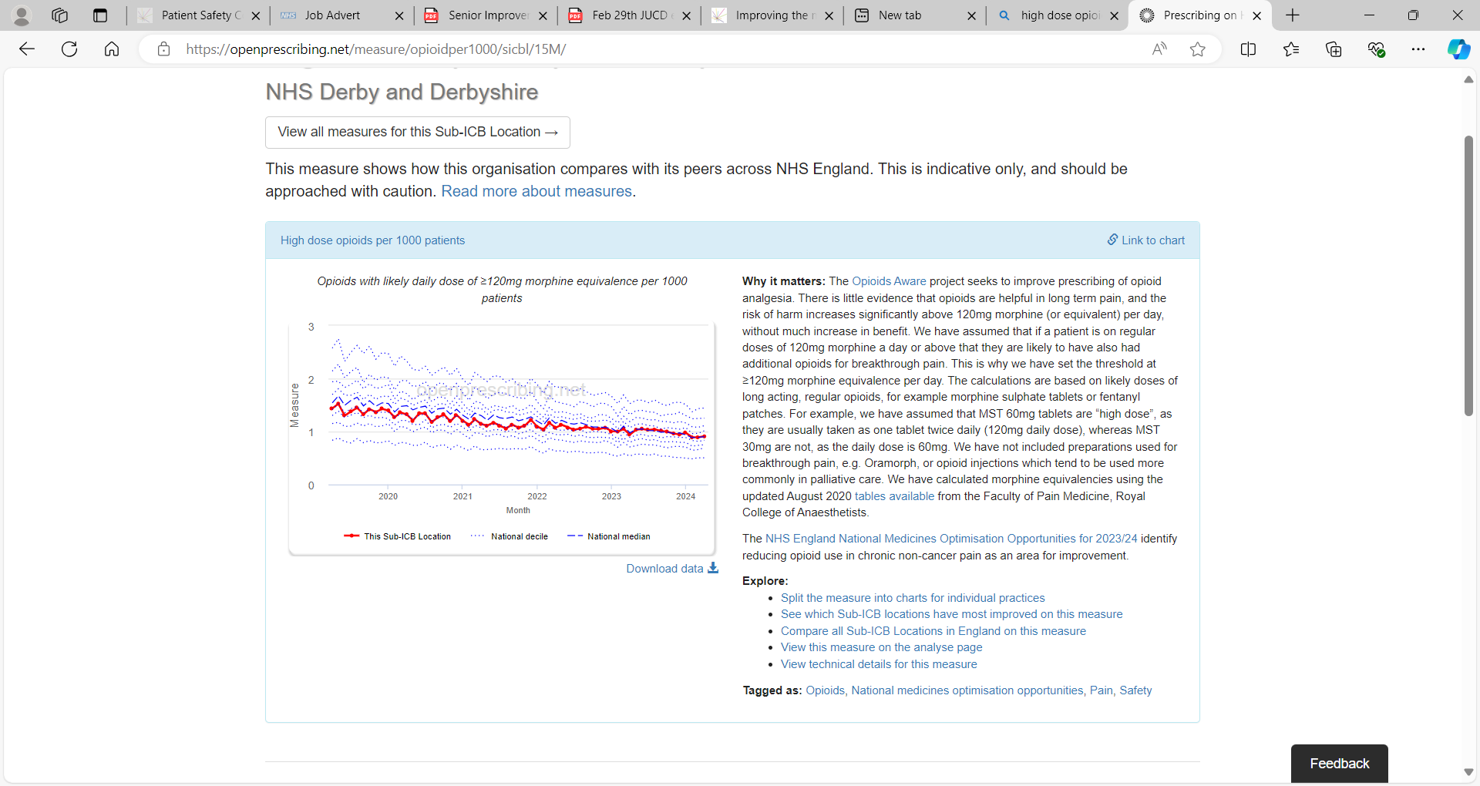
Positive Endings
The MedSIP Methodology Report (Dec 2022) states that 'for every 62 people who stop opioids (or do not start) prevent one death'.
There is little evidence that opioids are helpful in long term pain, and the risk of harm increases significantly above 120mg morphine (or equivalent) per day, without much increase in benefit.

Slide 18


Contact Details
Name: Paula Whitehurst
Title: Lead Pharmacy Technician
Tel: 07584 512 967
Email: paula.whitehurst1@nhs.net

