Slide 1



Introduction to Our Dental Recovery Plans
Mark Stuart
Engagement Officer

Slide 2
Today’s session
Today’s session is about Our Dental Recovery Plans, where we will update you on NHS dentistry improvements across the county.
Clive Newman will be taking us through Our Dental Recovery Plans
An opportunity to ask questions and give any feedback
What will today’s session influence?
Feedback and comments from today’s session will be fed into the system
You can be kept up to date with information by accessing the engagement platform HERE

Slide 3
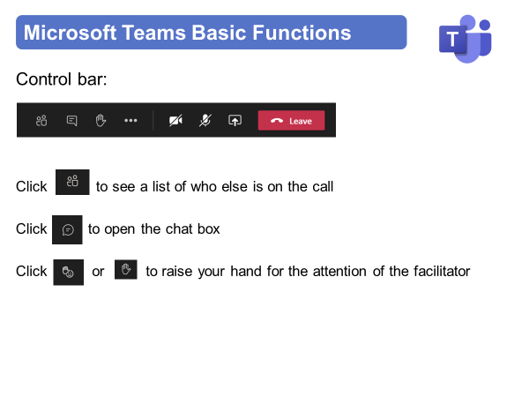
Instructions for today

Slide 4
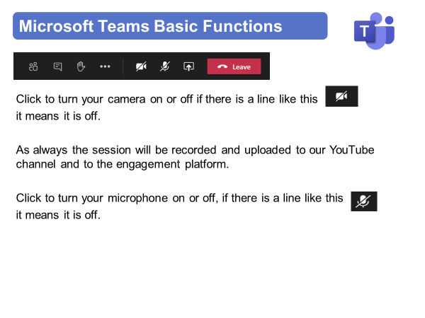
Instructions for today

Slide 5
Instructions for today
Part of the session will be interactive, and we will ask you a few questions.
You will be able to answer the questions in a few different ways:
Scan the QR code with your smartphone camera, which will take you directly to Slido.
If you prefer, we’ll share a Slido link in the chat so you can join via your computer.
Type in the chatbox, and we will copy your response into Slido.
Raise your hand if you want to speak, and we can type in your response for you.

Slide 6
Virtual Meeting House Rules
So we can hear the person speaking you may be automatically muted. Please stay muted while others are speaking
To ensure everyone's questions and views are captured we ask that you raise your questions in the chat box please:
We want everyone to have a chance to contribute today

Slide 7
Virtual Meeting House Rules
Please remember to:
Listen with an open mind
Respect each other’s views
Try to keep in line with the agenda
If the point has already been raised please try not to repeat it

Slide 8
Contact Details
Name: Mark Stuart
Title: Engagement Officer
Email: mark.stuart@nhs.net
Web: https://joinedupcarederbyshire.co.uk

