Slide 1



Introduction to
All Move in Erewash (AMiE)
Mark Stuart
Engagement Officer

Slide 2
Today’s session
Today’s session is about All Move in Erewash (AMiE), which is a local initiative focused on supporting people with long-term conditions and disabilities to be more active. This session will explore the impact of AMiE and highlight other inclusive movement initiatives across Derby and Derbyshire.
Sarah Knapp, Physical Activity Inclusion Officer (Erewash Borough Council), Jade Gresham, Strategic Lead (Active Derbyshire), Christopher Frost, Community Physical Activity and Wellbeing Lead (Amber Valley CVS), Katy West, Senior Physical Activity and Health Co-ordinator (Derby City Council) will be taking us through All Move in Erewash (AMiE)
An opportunity to ask questions and give any feedback
What will today’s session influence?
Feedback and comments from today’s session will be fed into the system
You can be kept up to date with information by accessing the engagement platform HERE

Slide 3
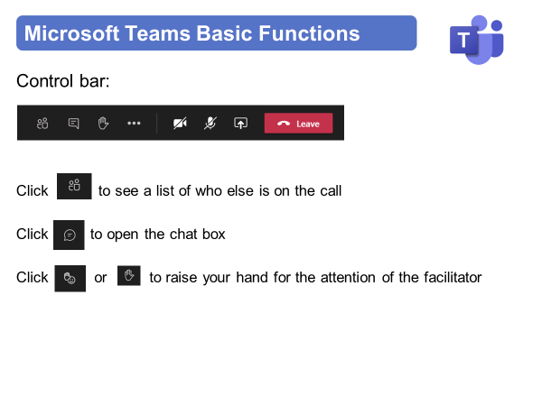
Instructions for today

Slide 4
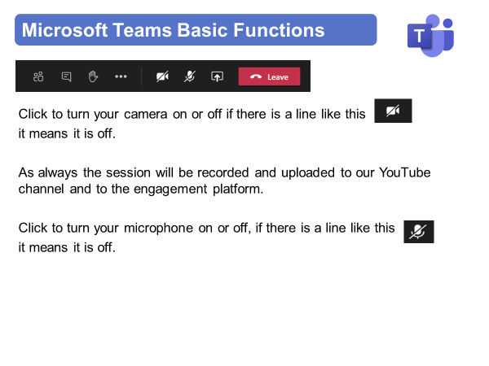
Instructions for today

Slide 5
Virtual Meeting House Rules
So we can hear the person speaking you may be automatically muted. Please stay muted while others are speaking
To ensure everyone's questions and views are captured we ask that you raise your questions in the chat box please:
We want everyone to have a chance to contribute today

Slide 6
Virtual Meeting House Rules
Please remember to:
Listen with an open mind
Respect each other’s views
Try to keep in line with the agenda
If the point has already been raised please try not to repeat it

Slide 7
Contact Details
Name: Mark Stuart
Title: Engagement Officer
Email: mark.stuart@nhs.net
Web: https://joinedupcarederbyshire.co.uk

