Slide 1
Introduction to
How we use your data
Sally Longley
Engagement Specialist

Slide 2
Today’s session
Today’s session is about how NHS organisations across Derby and Derbyshire use patient data to improve healthcare.
Ged Connolly-Thompson​, Lis Ries​ and Hils Poole​ will be taking us through ‘How we use your data’
An opportunity to ask questions and give any feedback
What will today’s session influence?
Feedback and comments from today’s session will be fed into the system
You can be kept up to date with information by accessing the engagement platform HERE

Slide 3
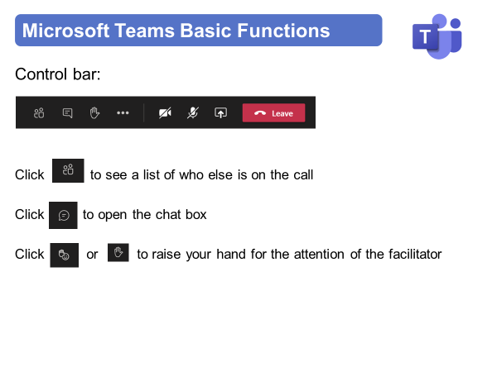
Instructions for today

Slide 4
Instructions for today

Slide 5
Virtual Meeting House Rules
So we can hear the person speaking you may be automatically muted. Please stay muted while others are speaking
To ensure everyone's questions and views are captured we ask that you raise your questions in the chat box please:
We want everyone to have a chance to contribute today

Slide 6
Virtual Meeting House Rules
Please remember to:
Listen with an open mind
Respect each other’s views
Try to keep in line with the agenda
If the point has already been raised please try not to repeat it

Slide 7
Contact Details
Name: Sally Longley
Title: Engagement Specialist
Email: Sally.Longley@nhs.net
Web: https://joinedupcarederbyshire.co.uk

