Slide 1



Introduction to Place
Lee Mellor
Communications and Engagement Specialist

Slide 2
Today’s session
Today’s session is about ‘Place’, which involves commissioners, community services providers, local authorities, primary care, the voluntary and community sector, and the public working together to meet the needs of local people.
Angela Wright, Kate Brown and Dr Ian Lawrence will be taking us through Place
An opportunity to ask questions and give any feedback
What will today’s session influence?
Feedback and comments from today’s session will be fed into the system
You can be kept up to date with information by accessing the engagement platform HERE

Slide 3
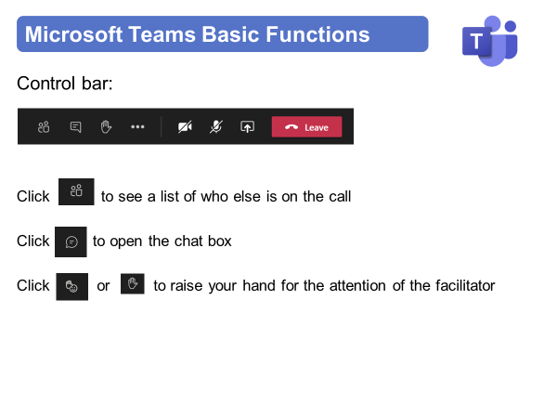
Instructions for today

Slide 4
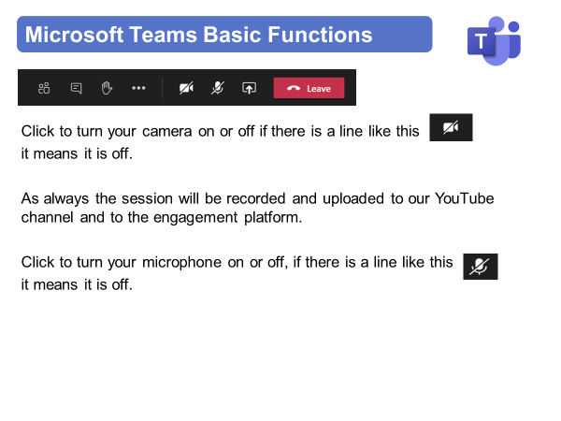
Instructions for today

Slide 5
Instructions for today
Part of the session will be interactive, and we will ask you a few questions.
You will be able to answer the questions in a few different ways:
The main way - scan the QR code with your smartphone camera - this will take you to Slido where you can type in your response
You can raise your hand to talk and we can type the response for you
You can put a response in the chatbox and we will copy and paste the response for you

Slide 6
Virtual Meeting House Rules
So we can hear the person speaking you may be automatically muted. Please stay muted while others are speaking
To ensure everyone's questions and views are captured we ask that you raise your questions in the chat box please:
We want everyone to have a chance to contribute today

Slide 7
Virtual Meeting House Rules
Please remember to:
Listen with an open mind
Respect each other’s views
Try to keep in line with the agenda
If the point has already been raised please try not to repeat it

Slide 8
Contact Details
Name: Lee Mellor
Title: Communications and Engagement Specialist
Email: lee.mellor1@nhs.net
Web: https://joinedupcarederbyshire.co.uk

