Slide 1
Introduction to the Urgent Emergency Care (UEC) System
Mark Stuart
Engagement Officer

Slide 2
Today’s session
Today’s session is about the Urgent Emergency Care (UEC) System, and will give an overview of the Urgent and Emergency Care Services that are available.
Andrew Sidebotham, Associate Director for Urgent and Emergency Care will be taking us through the Urgent Emergency Care (UEC) System
An opportunity to ask questions and give any feedback
What will today’s session influence?
Feedback and comments from today’s session will be fed into the system
You can be kept up to date with information by accessing the engagement platform HERE

Slide 3
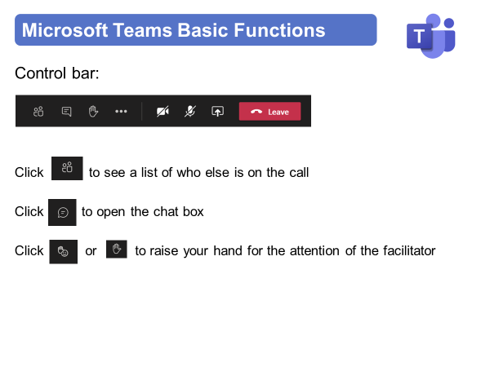
Instructions for today

Slide 4
Instructions for today

Slide 5
Virtual Meeting House Rules
So we can hear the person speaking you may be automatically muted. Please stay muted while others are speaking
To ensure everyone's questions and views are captured we ask that you raise your questions in the chat box please:
We want everyone to have a chance to contribute today

Slide 6
Virtual Meeting House Rules
Please remember to:
Listen with an open mind
Respect each other’s views
Try to keep in line with the agenda
If the point has already been raised please try not to repeat it

Slide 7
Contact Details
Name: Mark Stuart
Title: Engagement Officer
Email: mark.stuart@nhs.net
Web: https://joinedupcarederbyshire.co.uk

