Slide 1



How the NHS uses your data to improve care
Notes:
Today we’re going to talk about how the NHS uses patient data to improve care, what Population Health Management means, and how a new tool—the Federated Data Platform—is helping us do this better.
We all want better healthcare. But to plan services, spot problems early, and support people before they get seriously ill, we need to understand what’s happening in our communities. That’s where data comes in.

Slide 2
Welcome and house rules
Listen with an open mind​ and respect each other’s views​
If a point or question has already been raised, please try not to repeat it​
To ensure the best audio quality, everyone will be placed on mute. Please ensure you remain muted whilst others are speaking​, you can unmute if you would like to ask a question during the Q&A
There will be plenty of opportunities for you to ask questions
If you have any very technical or specific questions, we will pick these up after the meeting and send a follow up email

Slide 3
Topics we will be covering
What is patient data
How does the NHS use patient data to improve care
Population Health Management
Tools we can use
Data security

Slide 4
What is data?
But not exclusively! Can be sound, text, or images
‘Information, especially facts or numbers, collected to be examined and considered and used to help decision-making’
-Cambridge English Dictionary
Getting the data is only the first part of the process… the whole point of it is to examine it and draw inference from it

Slide 5

How does that differ from information?
Information is data that has been processed, organised or structured in a way which makes it meaningful. Information is data given context, relevance and purpose.
i.e. a list of numbers without context is often useless!

Slide 6
Lots of information is collected about us all the time…
GP care, hospital care, screening tests, research, infectious disease notifications
Birth certificate and registration
Loyalty cards, subscriptions, 23 and Me
Death certificates
Childhood immunisation data
Exam results
Birth
Childhood
Adulthood
Death
Employment and NI data
School readiness and enrolment
Census and survey data, electoral rolls
Hospital mortality statistics
Newborn screening

Slide 7
What specifically is patient data?
GP records (diagnoses, prescriptions, test results)
Hospital records (admissions, treatments, discharge summaries)
Social care data
Demographic information (age, postcode, ethnicity)
Lifestyle factors (smoking status, physical activity)

Slide 8
This information is really important:
For individuals- ensuring people receive the right care, in the right place, at the right time and ensuring healthcare professionals know everything they need to know to take care of you
For the health system- we use (anonymised) health and care data:
  To understand what services are needed, where, and for how many people
  To try and recognise illness early or prevent it before it happens
  To detect when people might be missing out on care that would benefit them
Notes:
By looking at patterns in data, we can identify people who might be at risk of complications or future health issues, this means we can put interventions and support in place to prevent these things happening. FOR EXAMPLE: Data can help us identify someone who is at higher risk of having a heart attack, we can then invite them to get a blood pressure check to identify if they have hypertension.
The NHS needs to plan services to meet the needs of the population, understanding our population helps us commission appropriate services in the right places.
We can also use data to identify people who might need to come in for a health check if they haven’t had one for a while.

Slide 9


Slide 10
What is Population Health Management?
Population health management (PHM) is a way of using data to describe groups of people in detail according to their health needs
This then allows us to design services specifically for those groups in ways that work for them
It also shifts the focus from just treating illness when it happens to finding ways we can prevent illness happening in the first place because we can identify those at risk
PHM recognises the importance of things like the places we live and work, and the environments we live in for our health.
Notes:
Population health management (PHM) is a data-driven method for improving population health outcomes. It combines data and intelligence from different sources to describe a population in detail, and enables the identification of those at higher risk of adverse health outcomes. This in turn allows us to target our interventions where they will be of most benefit.
By including information on the wider determinants of health, and bringing parts of the system together, it also has an important role in tackling health inequalities.
Know: PHM brings together a broad range of data across everything that impacts a person’s health. It builds a holistic view of people’s needs to help identify where best to focus collective resources to accelerate prevention programmes and tackle health inequalities and deliver personalised care.
Connect: Connecting across health, social care, public services and the voluntary sector we can ensure people receive the right service at the right time, from the right people.
Prevent: PHM changes the focus from reactive care to proactive, personalised and preventative care – an approach that allows long-term health solutions to be developed. By understanding who’s at risk today we can predict who might be affected in the future. PHM is a critical component in our integrated care system and the foundation to building a healthier future together.

Slide 11
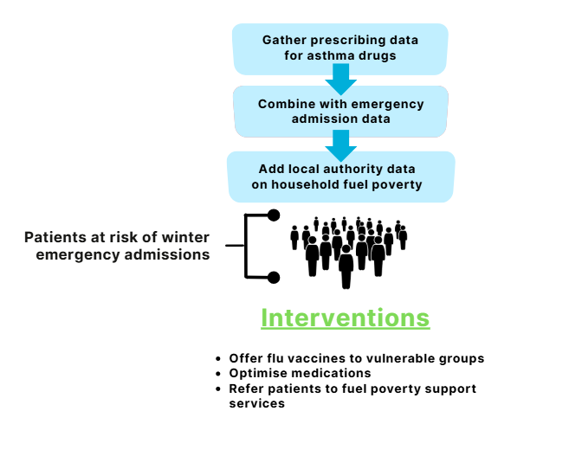
Population Health Management - EXAMPLE
Notes:
Linking data to understand the factors which are driving poor outcomes in different population groups; for example, how many people could be affected by an illness like diabetes or asthma.
Taking preventative action – what help might support those people before any illness develop. For example, by combining prescribing data for asthma drugs, with emergency admissions data with local authority data on household fuel poverty, we can identify which cohort of patients might be more at risk of emergency admissions over winter.
We can then use that information to, for example, ensure that group have been offered a flu vaccine, check their medicines are optimised, or refer them for fuel poverty support services.

Slide 12



Tools we can use for Population Health Management
Publicly available, anonymised data sources:
  ‘Fingertips’ The public health outcomes framework data
  Our local Joint Strategic Needs Assessments (JSNAs)
  Other health needs assessments on specific topics
Data tools and dashboards (not publicly available data):
  RAIDR
  Periscope
  Power BI
  Other programmes for risk stratification used in primary care
Notes:
Overview of tools -deep dive into FDP

Slide 13
Tools we can use – The FDP
The Federated Data Platform (FDP) is a secure data environment which is commissioned by NHSE to provide a way to safely combine data sets from across different parts of the health system
It allows us to bring together all the data we have in one place and use it more effectively
It has been in use since 2023
Derby and Derbyshire is going to be one of the first sites in the country to use a new Population Health Management tool on the FDP. This will help us to spot variation that shouldn’t be there and to plan care more effectively for our citizens
Notes:
The FDP is a new tool that helps us bring together data from different parts of the NHS. It doesn’t collect new data, it helps us use what we already have more effectively.
It allows a secure way to bring data together from various parts of the health service and has been in use since 2023.

Slide 14
Tools we can use- the FDP
The FDP PHM tool has two parts to it:
  The first bit will use the national commissioning datasets only. We already receive these, but this tool will pull them all together in one place and allow us to look at them by population group (e.g. age, geography)
  The second phase of the tool is called the local analytics hub, and this will flow in local datasets as well as national ones, including primary care and social care data

Slide 15
Tools we can use- the FDP
  This is really important because the GP care record has a lot more detail in it around people’s lives and circumstances, whereas the national datasets really only look at stuff that happens in hospitals and secondary care
  Since the vast majority of care that happens in the NHS happens in primary care (GP surgeries and community health centres) it is important to have this info
  The local analytics hub will also eventually allow the data to be de-anonymised for direct care purposes, so we can find lists of people who would benefit from specific interventions and share them with their GPs or hospital doctors.

Slide 16
So, what are the benefits for patients?
Services that better match your needs (rather than those designed on the average national data)
Reduced inequalities in health
More opportunities for proactive or preventative care
More accurate identification of patients at risk of particular conditions so that they can be contacted and proactively offered treatment or prevention

Slide 17
Data security
Every organisation that provides health and care services will take every step to:
  keep data secure
  use data that cannot identify you whenever possible
  use data to benefit health and care
  not use data for marketing or insurance purposes (unless you request this)
  make it clear why and how data is being used
The Federated Data Platform adheres to the NHS England Secure Data Environment policy.
Notes:
All NHS organisations must provide information on the type of data they collect and how it’s used. Data release registers are published by NHS Digital and the Department of Health and Social Care, showing records of the data they have shared with other organisations.
The FDP adheres to NHS England’s Secure Data Environment.
Only authorized personnel can see data, and only what they need. For example, a GP or practice nurse sees identifiable data for their patients; an ICB analyst looking at trends sees pseudonymised data.
Data remains in the local system, it is not shared any wider

Slide 18
What is the National data opt out?
The national data opt out allows patients to opt out of their confidential information being used for research and planning beyond direct care; all NHS organisations must comply.
The ICB checks all data uses against these rules, and monitors usage through regular information asset reviews.
opt-outs do not affect direct care and do not prevent data sharing in emergencies or legal obligations.
Patients can change their preferences at any time.
Notes:
Take lines from

Slide 19
Q&A

