Slide 1
Derbyshire Dialogue
20 March 2024
Social Prescribing
Clare Burgess, Commissioning Manager
Fay Benskin, Personalised Care Role Ambassador

Slide 2
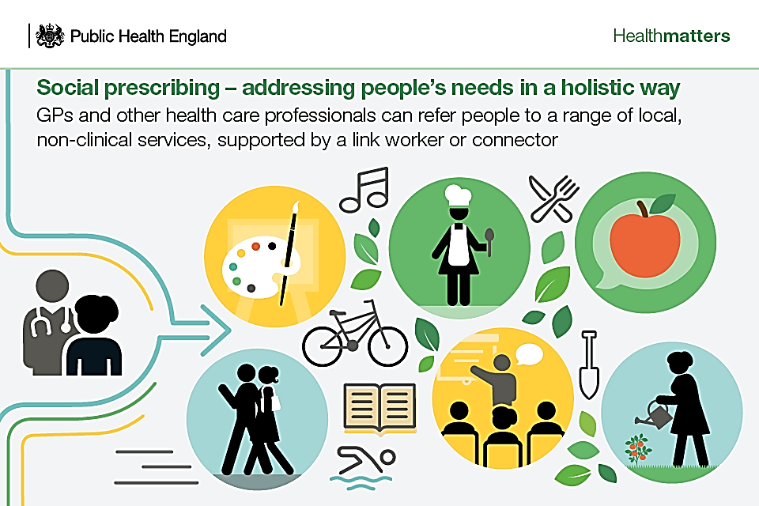
The aim of today’s presentation is to tell you more about Social Prescribing - what it is, where it came from and how it operates in Derbyshire. It will cover:
What is social prescribing?
Derbyshire set up and referral process
Operational context and case study
Difficulties and challenges
Aspirations/calls to action
Q&A
We will be using Slido to ask you questions which you can respond to using your smartphone, so please have your smart phones ready!

Slide 3
Have you heard of Social prescribing?
Yes
or
No

Slide 4
Have you heard of social prescribing?
ⓘ Start presenting to display the poll results on this slide.

Slide 5
What is Social Prescribing?
Write your definition via Slido or the chatbox if you can’t use Slido…………

Slide 6
What is social prescribing?
ⓘ Start presenting to display the poll results on this slide.

Slide 8
Social prescribing was introduced in 2019?
True
False
or

Slide 9
Social Prescribing was introduced in 2019?
ⓘ Start presenting to display the poll results on this slide.

Slide 10
NHS Long Term Plan 2019 – set out the NHS ambitions over the next 10 years
As part of the plan, groups of GPs joined together to form Primary Care Networks (PCNs) to deliver many of the commitments.
Social prescribing was added to GP practices and doctors’ surgeries as part of the NHS Long Term Plan and social prescribing is part of the wider approach to personalised care.
Moving from medical solutions and looking at the patient as a whole and the wider things that are going on in their life.

Slide 11
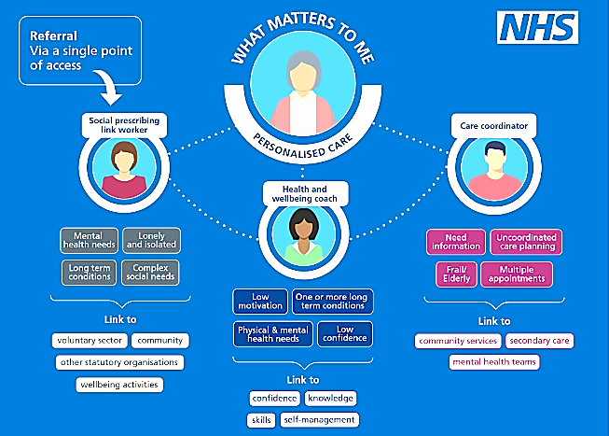
Notes:
Clare

Slide 12
There are three roles which are considered to be personalised care or non clinical roles:
Role | Estimated number in Derbyshire
Social Prescribing Link Worker | 82.88 FTE (full-time equivalent)
Care Co-ordinator | 157.16 FTE (full-time equivalent)
Health and Wellbeing Coach | 16.98 FTE (full-time equivalent)

Slide 13
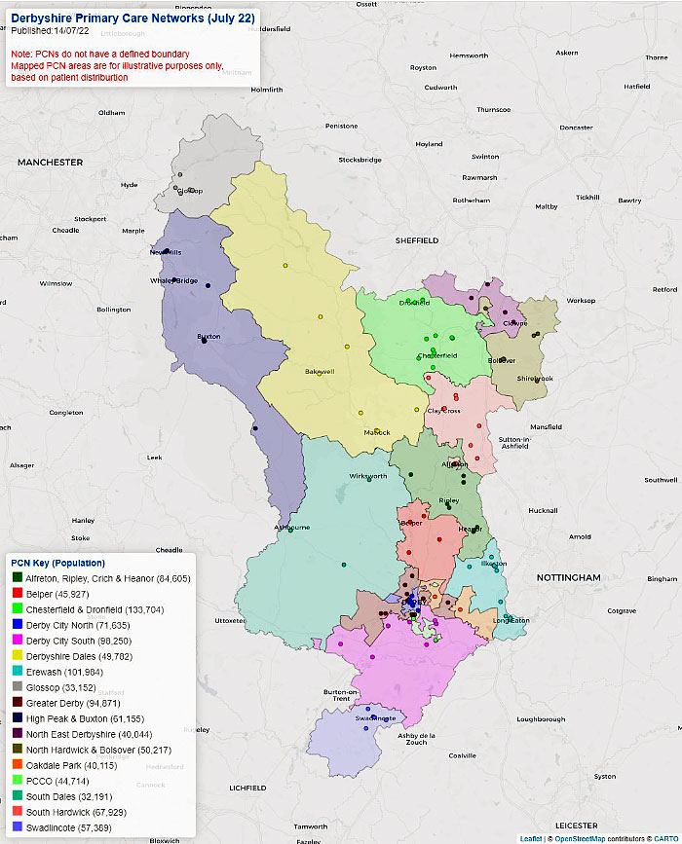
Number of Full Time Equivalent (FTE) Social Prescribing Link Workers in each Primary Care Network in Derbyshire in January 2024
Glossop Community Wellbeing and Asset Based Solutions with £39k small grants pot (ICB-funded social prescribing service)
Thrive children's social prescribing (works across four northern PCNs)
Glossop – 1 SPLW
Derbyshire Dales – 2 SPLW
Chesterfield and Dronfield – 7.04 SPLW
North East Derbyshire – 3.2 SPLW
High Peak and Buxton – 9.52 SPLW
North Derbyshire – 1 SPLW
South Dales – 2 SPLW
North Hardwick and Bolsover – 4.28 SPLW
Oakdale Park – 3 SPLW
South Hardwick – 4.60 SPLW
Greater Derby – 9.4 SPLW
Alfreton, Ripley, Crich and Heanor (ARCH) – 4.53 SPLW
South Dales – 1 SPLW
Belper – 2 SPLW
Erewash – 13.80 SPLW
Derby City North – 5.55 SPLW
PCCO – 3 SPLW
Derby City South – 4.96 SPLW
Swadlincote – 2 SPLW

Slide 14
Social Prescribing Link Workers are either:
Employed by Primary Care Networks (PCNs)
Belper
Chesterfield and Dronfield
Erewash
Greater Derby
North East Derbyshire
South Hardwick
North Hardwick and Bolsover
Oakdale Park
PCCO
Swadlincote
Based in a voluntary sector organisation
Alfreton, Ripley, Crich and Heanor (ARCH) - Amber Valley CVS
Derby City North - Community Action Derby
Derby City South - Community Action Derby
Derbyshire Dales - Derbyshire Dales CVS
High Peak - High Peak CVS
South Dales - Derbyshire Dales CVS
or
Or a mixture
Erewash
Glossop
Notes:
Richard

Slide 15
Social Prescribing Advisory Group (SPAG)
Set up in Derby and Derbyshire in May 2019
SPAG supports the delivery of social prescribing services across Derby and Derbyshire
We have people come to speak about related services and how we link with other services
We try to tackle some of the problems and find solutions

Slide 16
Social Prescribing Maturity Framework: five focus points
Data to show impact
Better funding
Strong leadership
Under-represented groups
Clear referral criteria

Slide 17
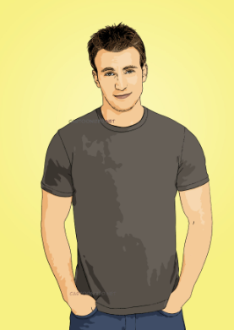
Background
Male: 25 years old
Previous alcohol misuse
Living in supported accommodation
Low mood
Lack of things to keep him busy
Support
Getting to know patient: what matters?
Explored groups and activities: Foodbank referral due to limited income and benefit issues, linked with men's mental health football session, exercise sessions
Stop smoking referral to Live Life Better
IAPT (Improving Access to Psychological Therapies) referral for counselling
Visited local HUBs and wellbeing café together
Outcome
Attending football session and enjoys connecting with others
Stopped smoking
Accessing specialist counselling via IAPT and improved mental health and reduction in low mood
Quote from patient:
“I didn’t realise how much my Social Prescriber could do to help me. I am so happy with the referrals and introductions. I felt fully supported throughout!”

Slide 18
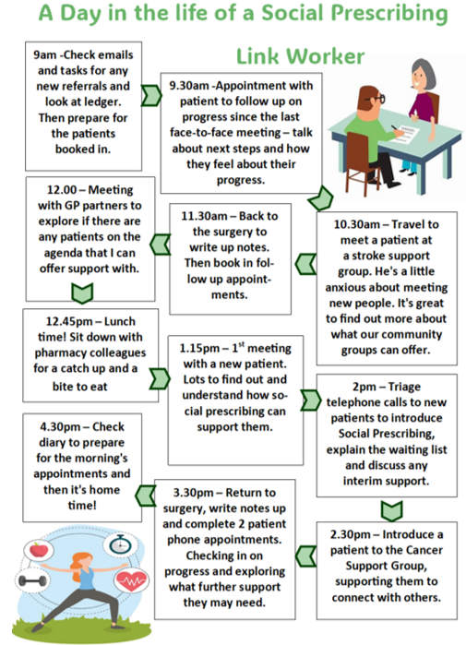

Slide 19
Key points
Short term intervention
Take the time to find out ‘What matters to me?’
Look at all parts of a patient’s life
Build strong relationship and trust with patients
Establish realistic goals then produce action plan
Connect people to wider community support and activities
Address some of the underlying causes of ill health
Motivate people to make changes to their lifestyle to improve health and wellbeing

Slide 20
Any questions?

Slide 21
What do you think could improve social prescribing?
ⓘ Start presenting to display the poll results on this slide.

Slide 22
Is there anything that you can suggest to improve this presentation?
ⓘ Start presenting to display the poll results on this slide.

