Slide 1

Stroke Rehabilitation Services Review
Engagement Plan
NHS Derby and Derbyshire Integrated Care Board

Slide 2
Background
What is happening?
A review is taking place of the Stroke Rehabilitation services across all of Derby and Derbyshire.
Why is a Review Being done?
Community stroke services are very busy because many people need their help. They have a lot of patients to care for, which puts a lot of pressure on the service.
Getting specialist help at the right time for a person's needs can be difficult and there can be a long wait.
A review took place by the East Midlands Integrated Stroke Delivery Network in 2022. They recommended the following:
Review the commissioning of stroke services.
Improve access for all stroke patients.
Address gaps in the Integrated Community Stroke Service.
The aim of the review is to improve the services and address the inequities.
NHS Derby and Derbyshire Integrated Care Board

Slide 3
Background
What are the Stroke Rehabilitation Services?
To help people who have had a stroke get better, there is specific guidance. It shows how hospitals and local services should work together. These plans talk about rehabilitation. It helps people recover after a stroke. Quick and organized care after a stroke can help stop more strokes. It can also cut hospital visits, disability, and death.
Rehabilitation (rehab) helps people get back skills they lost after a stroke. It includes:
Physiotherapy: to help with movement
Occupational Therapy: to help with daily tasks
Speech and Language Therapy: to help with talking
Psychological Support: to help with feelings
Diet and Nutritional Support: to help with eating well
Nursing Support: to help with medical needs
This therapy helps people live better lives after a stroke.

Slide 4
Stroke Rehabilitation Services in Derbyshire
Stroke Rehab services in Derbyshire are complicated and are not the same throughout the County.
When leaving the hospital after a stroke, patients may follow one of four pathways:
Early Supported Stroke Discharge (ESSD): Lasts about 6 weeks and helps people with mild to moderate stroke effects.
Community Rehab Services: For moderate to severe stroke effects.
Hospital Out-patient Services: For moderate to severe stroke effects.
No Further Rehab Needed: For patients who don’t need more help.
Stroke Association Services – Support Services
Three services help stroke patients in Derbyshire:
Stroke Navigator Service: For general support in North Derbyshire.
Communication Support Service helps patients to improve their communication. It is in south Derbyshire and Derby city.
Glossop Stroke Rehabilitation Service - support from hospital to home for residents of Glossop
NHS Derby and Derbyshire Integrated Care Board
NHS Derby and Derbyshire Integrated Care Board

Slide 5
Stroke Rehabilitation Services in Glossopdale
On 1 July 2022, Glossopdale health commissioning moved from Tameside and Glossop Clinical Commissioning Group into the Derby and Derbyshire Integrated Care System.
Glossopdale patients tend to go Tameside General Hospital or Stepping Hill Hospital.
Tameside General Hospital's non-routinely admitted stroke unit offer stroke rehabilitation to all patients admitted following a Stroke. (A non-routine admitting stroke unit means the hospital only directly admit less than 50% of their patients through their Emergency Department as Tameside General Hospital does not have a Hyper Acute Stroke Unit.)
Patients have access to the Community Neuro Rehabilitation team in Tameside. The team provides psychological support if needed. Patients also have access to the Stroke Association service and the Bureau Social Prescribing. Social Prescribing is a unique healthcare approach. It addresses the social, emotional, and practical needs of people.
NHS Derby and Derbyshire Integrated Care Board
NHS Derby and Derbyshire Integrated Care Board

Slide 6
Increased risk and inequalities around Stroke
Age
People are more likely to have a stroke if over 55, although about 1 in 4 strokes happen to younger people. NHS website.
Strokes are occurring at an earlier age in the UK with the age of onset falling between 2007 and 2016 from 70.5 to 68.2 in males and 74.5 to 73.0 years in females.
Protected Characteristics risk factors that can increase risk of a stroke:
Older age
Male sex
Ethnicity
Areas of High Deprivation
People living in England’s most deprived areas are 4 times more likely to die prematurely than someone in the least deprived. When compared to the least deprived areas, the most deprived areas in England have:
Higher death rates from cardiovascular disease.
Lower uptake of rehabilitation.
Higher hospital admissions rates for emergency care
Vulnerable groups
There are no vulnerable groups identified but risk factors for stroke include:
Lifestyle factors:
Smoking, alcohol misuse and drug abuse, physical inactivity, poor diet
Cardiovascular disease:
Hypertension, atrial fibrillation, infective endocarditis, valvular disease, carotid artery disease, congestive heart failure
Other medical conditions:
Hyperlipidaemia, diabetes mellitus, sickle cell disease
NHS Derby and Derbyshire Integrated Care Board
NHS Derby and Derbyshire Integrated Care Board

Slide 7
What are the current inequities around the current service offer?
There are challenges in providing enough care, especially at home. Services don't always meet national standards. This means patients might not get the best care.
There are differences in stroke rehabilitation service delivery across Derby & Derbyshire which means not all patients have the same access to services and the same treatment. For example, not all areas across Derby & Derbyshire offer Early Supported Stroke Discharge.
Considerations when planning engagement
There service offer and pathways differ depending on where someone lives.
There are multiple providers of the different services.
It is unlikely that service users will know which service they are under, which part of the pathway they are at and who is the provider – so to gain an understanding of the multiple services does not feel realistic.
The main difference appears to be between the offer in the South Derbyshire, North Derbyshire, High peak and Glossopdale.
NHS Derby and Derbyshire Integrated Care Board
NHS Derby and Derbyshire Integrated Care Board

Slide 8
Involvement of key stakeholders in the development of the engagement approach
The engagement team has met up with key stakeholders to gain their input around:
Ideas of best methods of engaging with people
If there are any locations or clinics where there might be a good opportunity to do engagement
What some possible barriers may be to engagement and possible solutions to these
What questions would be useful to ask that would support the review
Meetings were held with Patient and Public Partners (patient representatives), Different Strokes, Derbyshire Carers, Derby City Carers, Stroke Association, Chesterfield Royal Hospital, University Hospitals of Derby and Burton, Derbyshire Community Health Services and Derbyshire Health Care foundation Trust and other specialist stroke staff within these services.
Key learning from this is are on the following slides.
NHS Derby and Derbyshire Integrated Care Board
NHS Derby and Derbyshire Integrated Care Board

Slide 9
Summary of key issues raised by stakeholders
The 2 main areas that key stakeholders spoke about were:
Inequity of service
What service you get depends on your post code.
Some areas will have access to stroke services others will not, so will only get a community offer which is not specialised.
Recognised gaps in stroke services, mainly that people with high and multiple needs are referred into lots of other services which often have long waiting times so they can be without support and tools they need for a long time even though their needs are high.
Inequity of service, in the North the ESSD service doesn’t cover High Peak.
Lack of resources
Don’t have enough resources for anything so have big waiting lists.
North – there is a limited psychological input.
South – almost no stroke psychologist support and no community psychology.
There is no community stroke team.
Patients don’t know what to expect from services nor what they should be getting.
NHS Derby and Derbyshire Integrated Care Board
NHS Derby and Derbyshire Integrated Care Board

Slide 10
Summary of key thoughts of engagement methodology raised by stakeholders
All the stakeholders gave valuable feedback and advice in regard to the engagement. Key areas raised:
Areas to take into consideration when planning engagement events
Some people may find doing events in clinics disheartening as they are in them all the time.
Need to consider immunosuppressed people, that areas are well ventilated and if people would feel comfortable.
Timing – not around school holidays/school pickups. Consideration for people with young children.
Workshops – consider the time of day, not first thing. Preferably mid-morning to lunch.
Suggestions of a paper survey as well as online
Areas to take into consideration when developing communications material
Patients' communication and cognitive abilities – have access to aphasia friendly materials.
Terminology – Stroke Survivors, people affected by stroke. Experts by experience. Use the same language throughout documentation.
Possible pictorial.
Midlands stroke voices – like a readers panel, can sense check information and other sources of sense checking.
There was also support offered by specialist to sense check and ensure materials were aphasia friendly.
Questions planning
Questions – to understand gaps.
Would be good to understand experiences of people who have been waiting for a long time.
NHS Derby and Derbyshire Integrated Care Board
NHS Derby and Derbyshire Integrated Care Board

Slide 11
Aims of Engagement
Current services experiences:
To understand what people's currents experiences of services are and to analyse feedback based on geographical locations of North Derbyshire, South Derbyshire, High Peak and Glossopdale. This is due to people accessing different services and providers based of location. Looking at:
Current Service:
What works well
What could be improved
Future services:
What is important for future services
NHS Derby and Derbyshire Integrated Care Board
NHS Derby and Derbyshire Integrated Care Board

Slide 12
Engagement Methodology
To write a Case for Change to demonstrate:
What is the current service
What are the inequities and inequalities
What are the current barriers
Engagement activities
Engagement Platform
Information and Involvement flyer
Engagement Workshops – online and face to face
Survey – online and an option to send out on request with freepost address return
Phone Support – for people to have the option to ring for: ordering a postal survey, support in booking onto events, support for completing the survey, requesting any other accessibility needs.
NHS Derby and Derbyshire Integrated Care Board
NHS Derby and Derbyshire Integrated Care Board

Slide 13
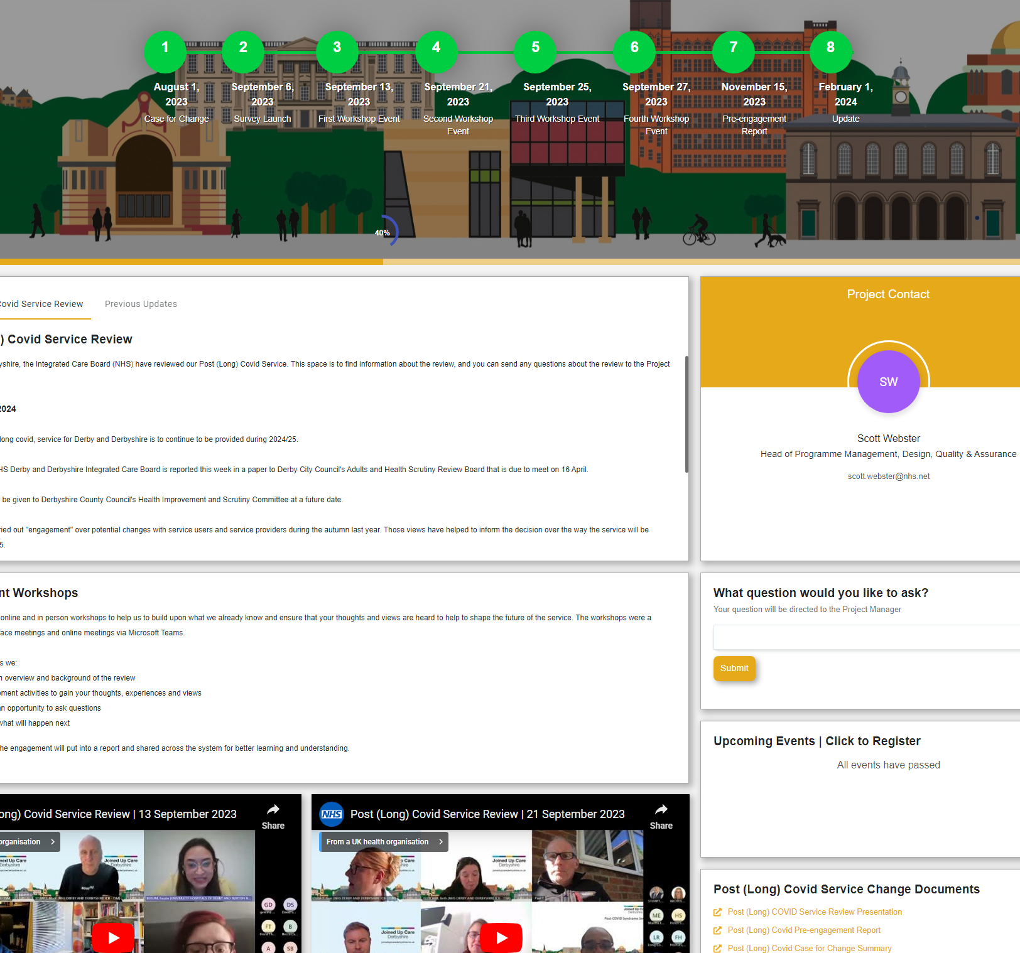
Engagement Platform
The Engagement Platform is online engagement “one stop” platform where people can access for a range of information:
To have documents for the project
Project timelines
Sign up to events
Complete surveys
Direct contact for questions
Videos
FAQs
Updates
NHS Derby and Derbyshire Integrated Care Board
NHS Derby and Derbyshire Integrated Care Board

Slide 14
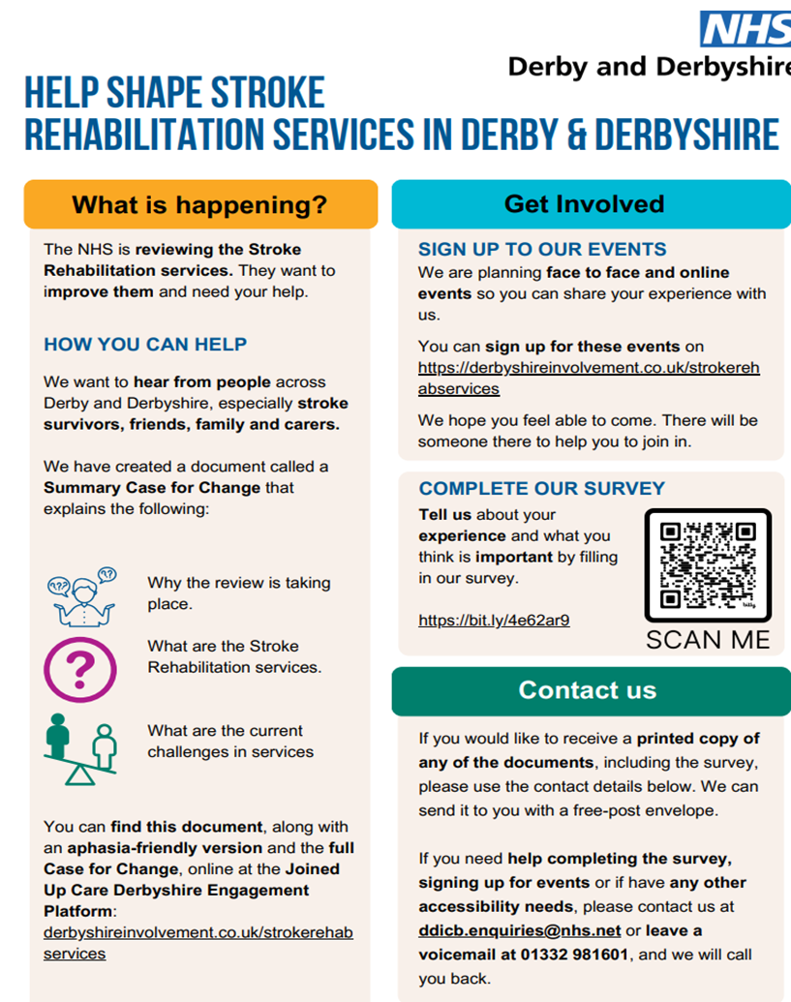
Information and Involvement flyer
We are working with the Stroke Associations and Derbyshire Carers who work with Stroke Survivors and their Carers. We are wanting to provide those people with information about the review and information about how they can get involved. The Information and Involvement letter will include the following information:
That a review is take place
Methods that people can get involved
How to request a survey to be posted (if preferred)
NHS Derby and Derbyshire Integrated Care Board
NHS Derby and Derbyshire Integrated Care Board

Slide 15
Engagement Workshops: face to face
4 face to face events will take place in the following locations:
North Derbyshire
South Derbyshire
High Peak
Glossopdale
These locations have been identified due to the different services and providers in each area. We will be able to identify which is the provider of their services due to the location of the events, but this will also need to be checked with attendees.
Each event will look at:
What works well with the current service
What could be improved
What people feel is important in the future
The local offers, and get feedback about those services
NHS Derby and Derbyshire Integrated Care Board
NHS Derby and Derbyshire Integrated Care Board

Slide 16
Engagement Workshops: online
Two online events, one in the afternoon and one in the evening:
For people to identify which of the 4 key areas they or the person who had a stroke are from so we can collect information based of geographical locations.
First half of the events:
People to be split into different rooms depending on location and to look at:
What works well with the current service
What could be improved
To look at the local offers and get feedback about those services
Second half
What people feel is important in the future services
NHS Derby and Derbyshire Integrated Care Board
NHS Derby and Derbyshire Integrated Care Board

Slide 17
Survey
Access
The survey will be on the engagement platform for people to complete.
People will also be able to request a survey to be sent out to them, with a freepost address for return.
Questions on the survey:
To understand people's currents experiences of services, to analyse feedback based of geographical locations of North Derbyshire, South Derbyshire, High Peak and Glossop. This is due to people accessing different services and providers based of location. Looking at:
What works well
What could be improved
Access and Travel
Future services:
What is important for future services
NHS Derby and Derbyshire Integrated Care Board
NHS Derby and Derbyshire Integrated Care Board

Slide 18
Health Literacy and Aphasia friendly
Surveys and Summary Case for Change will be sent to the following for feedback and sense checking to:
Task and Finish group – with leads from across the system
Patient Representatives
Stroke Associations
Carers Derbyshire
Derby City Carers
Different Strokes
Feedback (August)
It has been suggested by a Speech and Language Therapist that another more Aphasia version of the Case for Change would be beneficial. This has been agreed and developed into communications and engagement planning.
NHS Derby and Derbyshire Integrated Care Board
NHS Derby and Derbyshire Integrated Care Board

Slide 19
Communication plan
The aim of the communication plan is to inform people about the review and ensure they know how to get involved in the engagement. There is a full stakeholder and communication plan - this is just an overview.
Communication materials | Brief overview | Key stakeholders
Summary Case for Change | A public friendly document of the Case for Change | Public, patients and community groups Providers Derby and Derbyshire Healthwatch Out of area stakeholders
Aphasia Friendly Case for Change | Aphasia Friendly Case for Change | Public, patients and community groups Providers Derby and Derbyshire Healthwatch Out of area stakeholders
Information and Involvement flyer | Document informing people that I review is taking place, directing them to where they can get more information and how to get involved. | Public, patients and community groups Providers Derby and Derbyshire Healthwatch Out of area stakeholders
Launch email (with attached documents - posters, social media posts, information and Involvement page) | Email to information, groups, providers and wider organisations about the review and how to get involved. | Public, patients and community groups Providers Derby and Derbyshire Healthwatch Out of area stakeholders
Poster | A printable poster informing people about the review and how to get involved. | (Launch email)
Social media post | Social media Posts informing people about the review and how to get involved. | (Launch email) Internal communications
NHS Derby and Derbyshire Integrated Care Board
NHS Derby and Derbyshire Integrated Care Board

Slide 20
Targeted Communication
Due to looking at high risk groups and Health Inequalities the following groups will be targeted with the communication to ensure they are aware of how to get involved.
Age groups 40+ and 70+
Areas of High Deprivation
Protected Characteristics risk factors that can increase the risk of a stroke:
Older age
Male sex
Ethnicity
There are no vulnerable groups that have been highlighted in regards to inequalities, but risk factors for stroke include:
Lifestyle factors: smoking, alcohol misuse and drug abuse, physical inactivity, poor diet)
Cardiovascular disease: hypertension, atrial fibrillation, infective endocarditis, valvular disease, carotid artery disease, congestive heart failure
Other medical conditions: hyperlipidaemia, diabetes mellitus, sickle cell disease
NHS Derby and Derbyshire Integrated Care Board
NHS Derby and Derbyshire Integrated Care Board

Slide 21
Considerations of access to events and information
Area | Considerations | Notes
No access to Digital systems | Face to face workshops Option to have survey sent out Information and Involvement flyer to be sent out via Carers groups and Stroke Association
Housebound patients | Accessible contact details to be put with information (phone number /email to contact) Online engagement platform Online survey Online workshops Information and Involvement flyer to be sent out via Carers groups and Stroke Association Able to request surveys and documents send out to home address
English as a second language | Accessible information statement to be put on information (phone number /email to contact) Health Literacy considerations completed, and sense checked
Communications difficulties: Aphasia, Dysarthria, Apraxia of speech | Clinical staff, stroke association and Patient Public Partners to support in the design of survey and questions. Online – survey Online workshops Support at face-to-face workshops (Speech and Language Therapist to attend) Health Literacy considerations Accessible information to be put with information (phone number / email to contact) To ask if communication support is needed when attending face to face events Aphasia Friendly Case for Change Engagement events to be co-designed with Speech and Language Therapist
Carers | Information and Involvement flyer to be sent out via Carers groups and Stroke Association Online – survey Online workshops Face to face workshops Option to have survey sent out
NHS Derby and Derbyshire Integrated Care Board
NHS Derby and Derbyshire Integrated Care Board

Slide 22
Feedback
Feedback to be collated into a report
Report to feed into Options development and appraisal process.
NHS Derby and Derbyshire Integrated Care Board
NHS Derby and Derbyshire Integrated Care Board

Slide 23
Contact Details
Name: Beth Fletcher
Title: Engagement Manager
Email: Beth.Fletcher2@nhs.net
Web: https://joinedupcarederbyshire.co.uk
NHS Derby and Derbyshire Integrated Care Board
NHS Derby and Derbyshire Integrated Care Board

