Slide 1


Team Up Derbyshire
How working together is improving healthcare for people who need it in their own homes
Dr Ian Lawrence
NHS Derby & Derbyshire / Derbyshire Community Health Services
Ian.lawrence@nhs.net

Slide 2
What will change?
May 2021
The current state of first line urgent response:
Largely ambulance or general practice​
Single clinician – feel unsupported or that they are alone in problem-solving​
Time pressured – leading to quick, easy and safe decisions – not necessarily the ‘right’ decision
Make safe – can be time consuming and uncertain in the home setting, resulting in reliance on hospitals​ as a ‘place of safety’

Slide 3
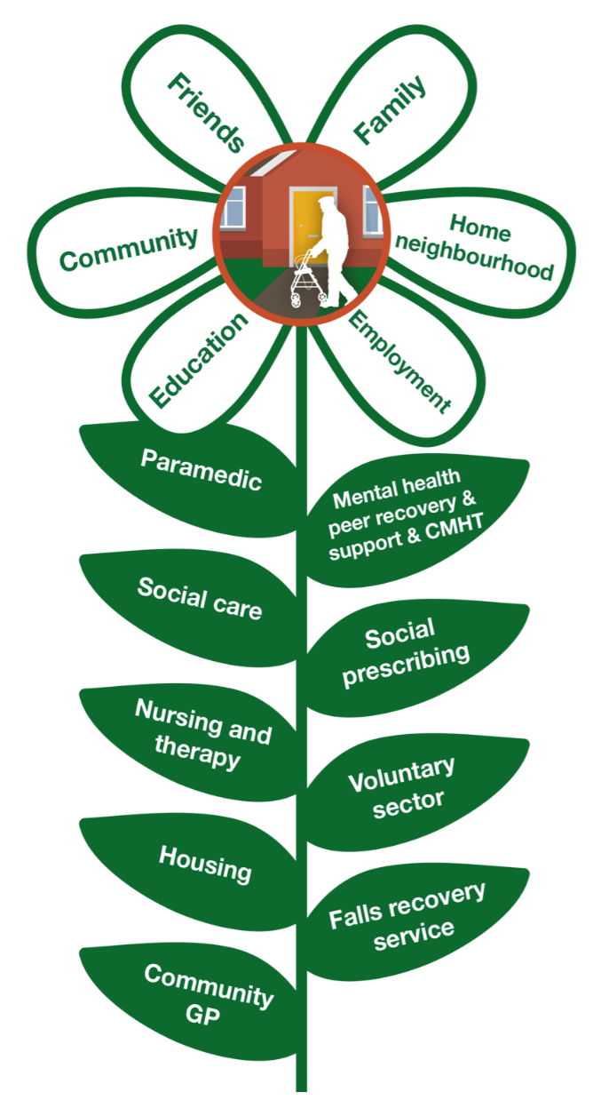
The Team Up vision is that:
Health, Care and other professionals work as one with each other and with their communities to improve the lives of those who need it most.
The Team Up mission is to:
Create the conditions for people to come together and find their own solutions to improving the experience of receiving and providing care.
In working together, we are increasing efficiency, improving effectiveness and, most importantly, improving the health & wellbeing of people who live in Derbyshire.
Notes:
Working together = integration
Create the conditions…!
Then some results

Slide 4
Integration
General Practice at Scale
Urgent Community Response
(nursing & therapy)
Team Up
Adult Social Care rapid response
Falls Recovery Services

Slide 5
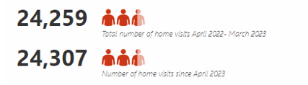
Home Visiting Services

Slide 6


Home Visiting Services
55,332 Home Visits since April 2023
88% of GP practices would recommend their Home Visit Service
86% said that it freed up GP capacity
95% of HVS workforce would recommend their Home Visit Service
81% Trust colleagues to provide high quality care
Data Source: HVS data collection March 2024
HVS GP & workforce survey September 2023
Notes:
Total 79591
24,259 Apr 22-mar 2023
More than twice activity in 2023-24 compared to 2223

Slide 7



Urgent Community Response
(nursing & Therapy)
An additional 1000 responses 2022/23 activity
7,901 2hour UCR since April 2023
Nearly 30,000
same day activity May 23-March 24
At least 97% of visits are managed in the community
13-20%
of referrals coming from Urgent and Emergency services
Consistently overachieved the National 70% target since October 2022
>80% since May 23
Data Source: DCHS
Notes:
13% UEC referrals for 2 hour- increasing to 20% for same day
2 hour performance- >70% since October22, >80% since May 23
Outcome= UEC 2 hr 1%, same day 3%

Slide 8
Creating the conditions – Strengths Based Approaches
Here is the latest guidance
Not sure that’ll work, but if you say so…
It’s still hard.
Is there some more guidance?
The guidance has been through rigorous governance, please implement it!
We need to be better, faster, more productive.
System effort on guidance generation
Learned Helplessness
Notes:
LAC
Universality of helping people find their own way
Learned Helplessness

Slide 9
Creating the conditions – Strengths Based Approaches
You know your community better than we do, can we help you think it through?
OK we have some ideas, but don’t know how.
Oooh, that worked, what can we try next?
Lets support you to develop the skills
We need to be better, faster, more productive.
Resilient Learning System
System effort on networks, skills and infrastructure
Notes:
But you all know this
Same books & TED Talks
All say the same
Appreciative enquiry
Personalisation
Myron’s Maxims
Kotter’s change model….

Slide 10
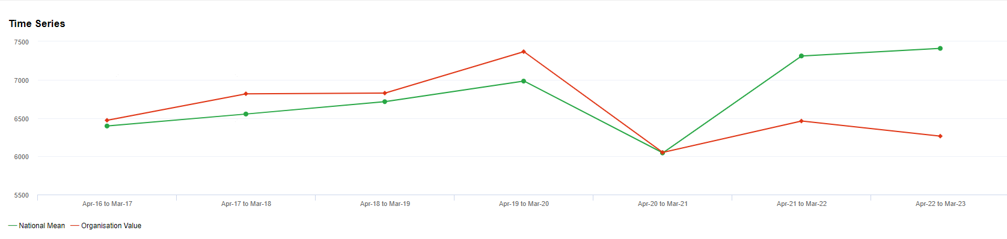
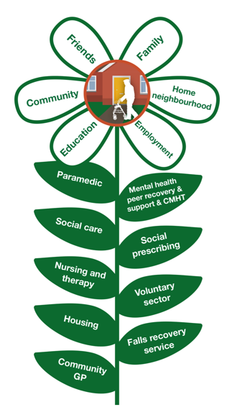
Over 65 years, A&E Attendances per 100,000 Population
Team Up launched April 2021
National Mean
Derbyshire ICB
Source: NHS Benchmarking Network
Date: Apr 22- Mar 23

Slide 11
Over 65 years, A&E Attendances, activity and future trajectory
Data Source: AW Dashboard v2.8

Slide 12

“Polite lady visited me, checked me over, listened to my concerns, treated me kindly and explained things to me. Excellent and much needed service.” South Hardwick HVS
“Felt for once someone listened to what problems l had, and would do their best to solve it for me, gave me confidence in her and have had a good follow-up, thank you very much” Chesterfield HVS
“Very satisfied with all aspects of the care that was given. Really cared explained everything to me and my family, was polite and gave me a thorough check. I cannot praise and thank the lady enough she has restored my faith in medical care.” Chesterfield HVS
“Excellent staff, turned up when they said they would, professional service, talked to me with dignity and clarity and explained things really well.” South Hardwick HVS
“The service I received from the gentleman was amazing. He was very thorough and asked me lots of relevant questions. He was very knowledgeable. He knew his stuff!“ South Hardwick HVS

Slide 13
“My grandad has been visited by a paramedic who said he was from South Dales PCN Team Up team He said it was a new service team and gave my mum a card with a QR code to leave feedback, she said it was brill .” South Dales HVS
“Spoke to patient’s daughter as patient is still in hospital. She said Amy saved her mums life as she has neutrophils sepsis. She is still in hospital very poorly. She said she has issues with the hospital that she is taking further as Amy admitted her mum the previous week but was discharged. Amy also spoke to patient’s other daughter in America who is a director of nursing and she also said how knowledgeable Amy is. Once again, she said she can’t thank Amy enough for saving her mum. ” Swadlincote HVS
“Would just like to put on record my thanks and appreciation of the service, help and support we received from Lyndsey [ ]. We were in despair having seen several doctors, spent time in Hospital etc but nothing had changed, despite J's age, mobility issues and hard of hearing, Lyndsey was so patient, helpful, identifying her issues, changing her medication, getting in touch with the Hospital and arranging an ambulance for her, clearing up the blood she had lost, so supportive, so caring, just finding someone who cared and went the extra mile gave us some hope, can't thank her enough.” Derby City HVS

Slide 14
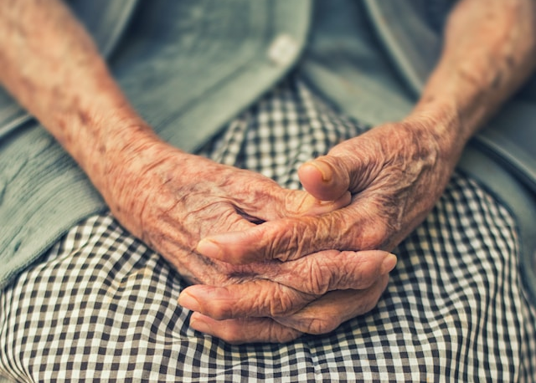
Mary, 92years old
Retired Housewife living in a Care Home
Vascular Dementia, Pacemaker, Macular Degeneration
“The interaction was so positive that it meant the paramedic could get advice via the telephone with the outcome of the patient staying in their preferred place of care instead of being transferred to hospital unnecessarily.”
Rachel, Lead ACP HVS Chesterfield
Source: Case Study kindly shared from Chesterfield HVS

Slide 15

Future development…
Point of Access
Navigation
Coordination
Planning
Helping people with complex needs manage a complex system

Slide 16
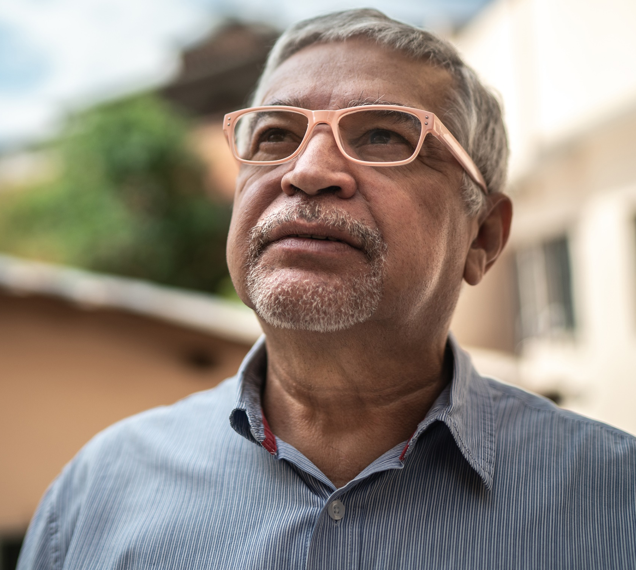
‘George’ was introduced to Charlotte, a Team Up Local Area Coordinator.
He had been diagnosed with Colitis and had increasing levels of anxiety. He had not left his home in three years and was feeling isolated from his family. He had started talking of taking his own life.
Charlotte and George spent time getting to know each other. George felt the biggest barrier to going out was the fear of being incontinent in public. Over five months, they made small steps together, they found incontinence products to help make George feel more comfortable and he started to get out of the house, starting with small walks out of the front door.
George is now attending the community ‘Coffee and Company’ group independently and has started going back to a social group he had not visited for three years.
George is no longer ‘housebound’ and now has the confidence to do his own shopping and has reconnected with his family.
Case study kindly provided by Derby City HVS
“My mental wellbeing had been rapidly deteriorating just before Christmas. I was connected to Charlotte just at the right time as I had virtually given up the idea of trying to cope. Now with Charlotte’s support, my future is looking a lot brighter and the person I once was is slowly returning”
Photo: Illustrative only
Photo for illustrative purposes only

