Slide 1
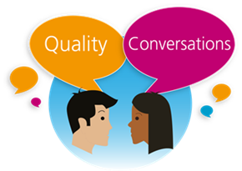


Tips for a behaviour change conversation

Slide 2
Preparation
It is useful to remember that;
  People come with their own solutions
  People listen more to what they say than what I say
  Being given information alone doesn’t make people change
  It is not possible to persuade people to change their habits

Slide 3
Enabling Conversation
Understand their goals
  What & Why
Active Listening
  Be respectful, curious, empathetic and interested
Open Questions
  Help the person explore and broaden perspective
  Help them move on in their thinking
  Develops self-discovery

Slide 4
Ownership & Action
Invite them to generate their own ideas and goals
Vocalising thinking – hearing it ‘out loud in your own voice’ can be powerful
Self determined goals = self accountability
Break down action plans into small steps in the right direction

Slide 5
Feedback & Reflection
Monitor progress
Recognise achievements
Acknowledge effort
Reflect on your part in the conversation
  What went well?
  How did you listen?

