Slide 1
Virtual Wards in Derby and Derbyshire
Victoria Byrne

Slide 2
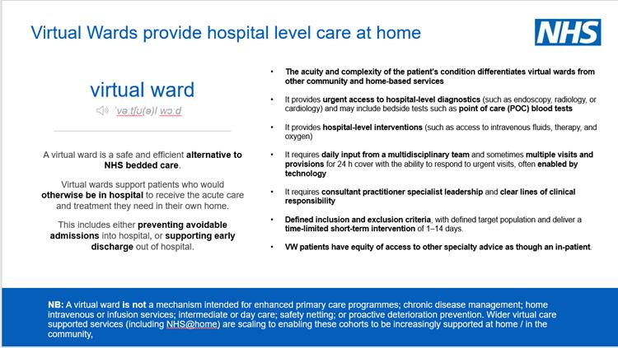

Slide 3
Objectives
To contribute to the key Urgent, Emergency and Critical Care Board Strategic priorities, including:
    Reducing ED attendances and improving access to right care
    Reducing admissions/ Re-admissions
    Reducing length of stay and Improving flow
To deliver 225 virtual ward beds with a use rate of 80% (180 beds in use daily)
To ensure that patients receive timely care in the right setting from the right professional
To reduce reliance on emergency, non-elective care services where this could be avoided by patients receiving care in another setting
To support the delivery of national UEC and ambulance waiting times standards e.g. ambulance response times, 4 hour ED waits target, acute occupancy
To optimise UEC System flow
To reduce inequalities of access to and patient experience of care

Slide 4
What is a Virtual Ward?
Virtual Wards allow suitable patients to get the care they need safely and conveniently at the place they call home (including care homes) rather than in the hospital.
This can sometimes involve: Using monitoring technology Face-to-face visits.
Phone calls.
Visits to hospital to see the Virtual Ward team.
Monitoring technology means you may have to use applications like those you would see on a modern mobile phone and/or wearable technology such as a blood pressure cuff.
All the technology you need will be provided to you with clear instructions.

Slide 5

What happens on a Virtual Ward and who will look after me?
No two patients are the same, so your Virtual Ward stay will be dependent on your condition and how much support you need. This could be anywhere from a few hours to 14 days. Your team will discuss whether you need monitoring technology and how the technology will be managed, any further investigations that might be required, your medications and the level of contact the Virtual Ward team needs to have with you.
The team will contact you once you get home to ensure everything you need is set up and working and will check in on you daily and continue to involve you in your care decisions while on a Virtual Ward.
If at any point you feel unhappy or uncomfortable about being on a Virtual Ward following your admission, you can speak to your named Virtual Ward contact to discuss the best way forward.
A Virtual Ward team will have a range of experts. This could include your hospital doctor, a lead nurse, a group of experienced nurses, a pharmacist and other health professionals such as physiotherapists, speech and language therapists, dieticians and occupational therapists.

Slide 6
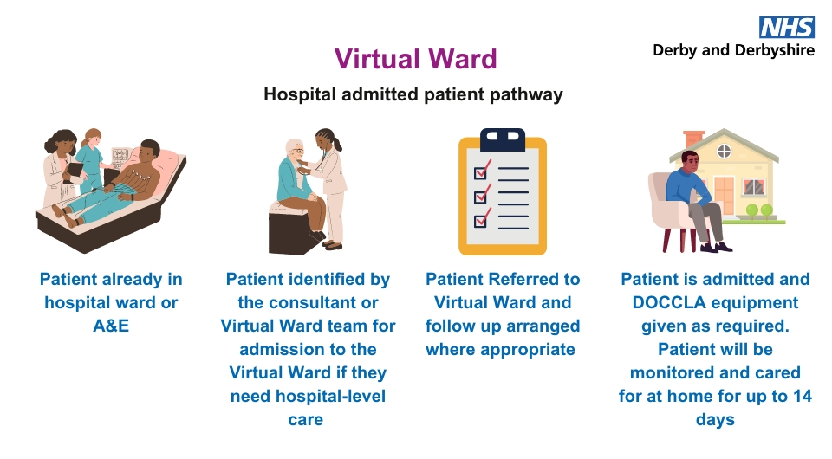
How do I access a Virtual Ward?
If you are suitable for admission to a Virtual Ward and would like to receive hospital-level care in an environment, you are more comfortable in please ask; your health professional will discuss this with you and contact the Virtual Ward team to arrange this.
We currently have 2 virtual wards that can be accessed from home, all others accept patients already in hospital to try and get patients home more quickly.

Slide 7
What Virtual Wards are available in Derbyshire?

Slide 8
Current State
The planned capacity for Virtual Ward beds across Derby and Derbyshire is 225.
The current capacity and utilisation is:
All Virtual Wards have access to remote monitoring – provided by DOCCLA – and Point of care testing is in the process of being rolled out.
May 2024 | Capacity | Average Utilisation
Cardiology | 45 | 74%
Respiratory | 25 | 50%
Community | 50 | 28%
Frailty (North Derbyshire) | 10 | 50%
End of Life and Palliative (North Derbyshire) | 10 | 50%

Slide 9
Average system Utilisation of Virtual Wards
SitRep submission date | Number of beds available | Average number of beds in use | Average Utilisation (%)
22/03/2024 | 165 | 71 | 43%
05/04/2024 | 165 | 62* | 38%*
19/04/2024 | 165 | 54 | 33%
03/05/2024 | 165 | 76 | 46%
17/05/2024 | 170 | 72 | 42%
31/05/2024 | 170 | 76 | 45%
14/06/2024 | 170 | 126 | 74%
Data taken from National SitRep submissions
*Does not include DHU data due to missed deadline

Slide 10
Next Steps
Continue to increase utilisation of beds at 80% and have at least 225 beds available. This would see 180 patients being cared for in the place they call home, every day.
Ensure consistency in provision across Derby and Derbyshire.
Continue to review and pilot pathways to support more patients, including more opportunity to access Virtual Wards without being in hospital first (step up).

Slide 11
Frequently Asked Questions
What technology will I need, and will I need internet broadband to be on a Virtual Ward?
As each patient will have different needs, it’s not possible to say which technology any given patient would need. However, all the technology you would need to be on a Virtual Ward will be provided to you with clear instructions and you will not require your own internet broadband connection to use it.
How is the monitoring technology used?
The monitoring technology is used for observation purposes, which then informs your health professional and Virtual Wards team of any further care you need. The information gathered is treated confidentially.
What if I have questions once I’m back home?
Your healthcare team and the Virtual Wards team will be keeping in touch with you throughout the process, but you will also be given the contact details of your Virtual Wards team.
I’m not sure a Virtual Ward is for me…
It’s completely your choice if you wish to receive care on a Virtual Ward. However, we would recommend you discuss this with your doctor and the Virtual Wards team before coming to a decision so that your questions and concerns can be talked through.
How do I contact the Virtual Ward team?
If you and your hospital team decide a Virtual Ward is right for you, you will be given lots more information about how this will work. This will include all the important information you will need, including how to contact your hospital team.

