Slide 1
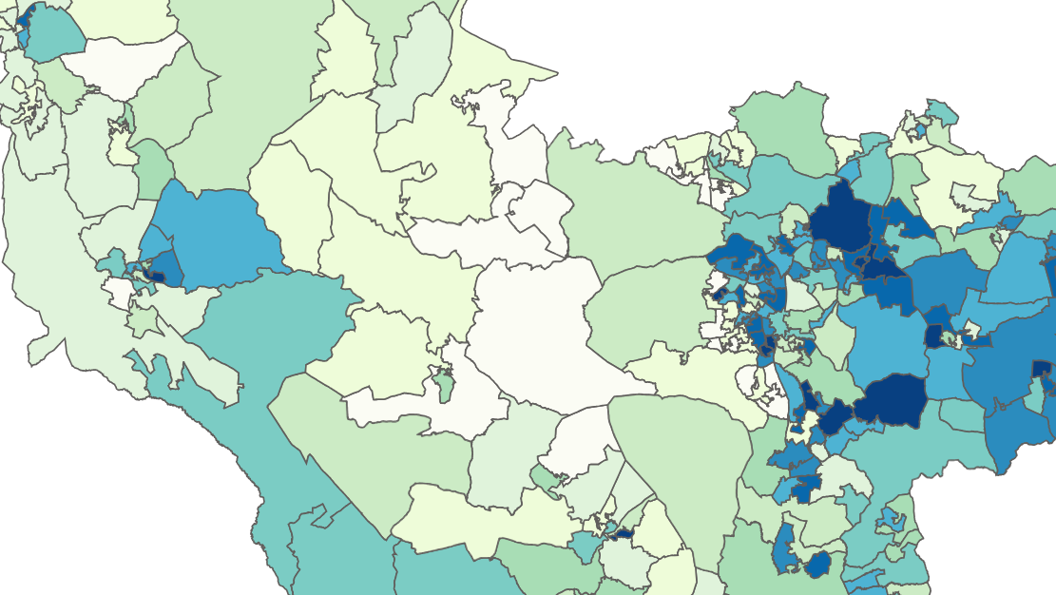

Working Together for Fairer
Health For All
Dr Alice Fenton, Tracey Elder, Tracy Walker, Dr Victor Jeganathan and Dr Jo Hall

Slide 2
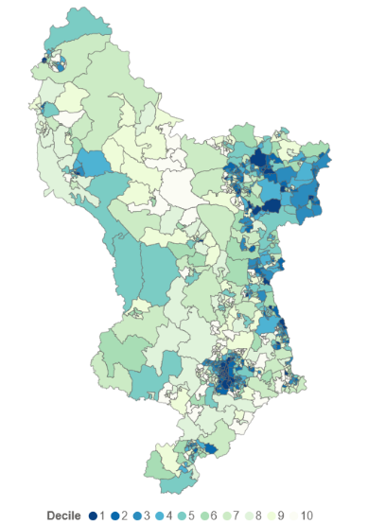
It’s not fair
Health outcomes are not the same across Derby and Derbyshire. This is not fair.
IMD (Index of Multiple Deprivation)
  Income
  Employment
  Health Deprivation and Disability
  Education, Skills, and Training
  Crime
  Barriers to Housing and Services
  Living Environments
IMD 1 areas face the most challenges.
IMD 10 areas face the least challenges.
In Derbyshire there is a difference in how many years of good health people can expect of over 18 years between the most deprived and least deprived areas. This is not ok.
.

Slide 3
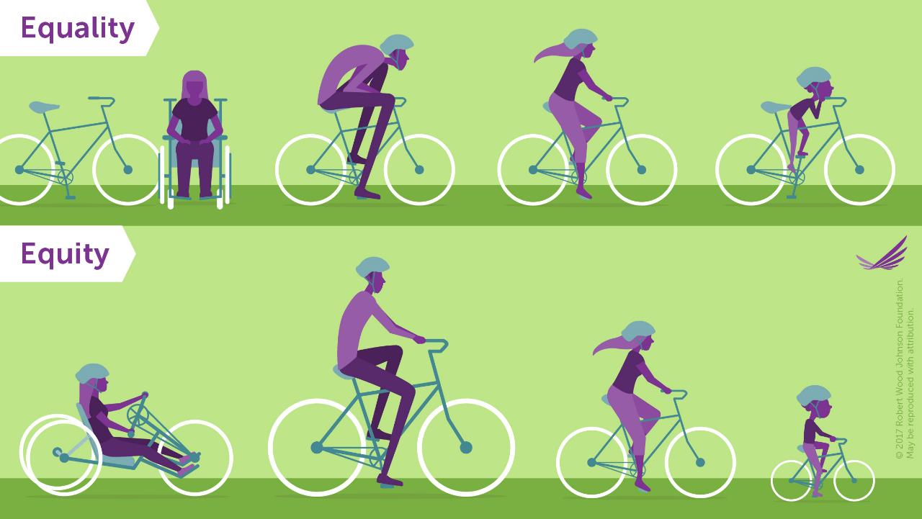
Let’s not treat everyone the same
Different bikes for different people makes things fairer

Slide 4

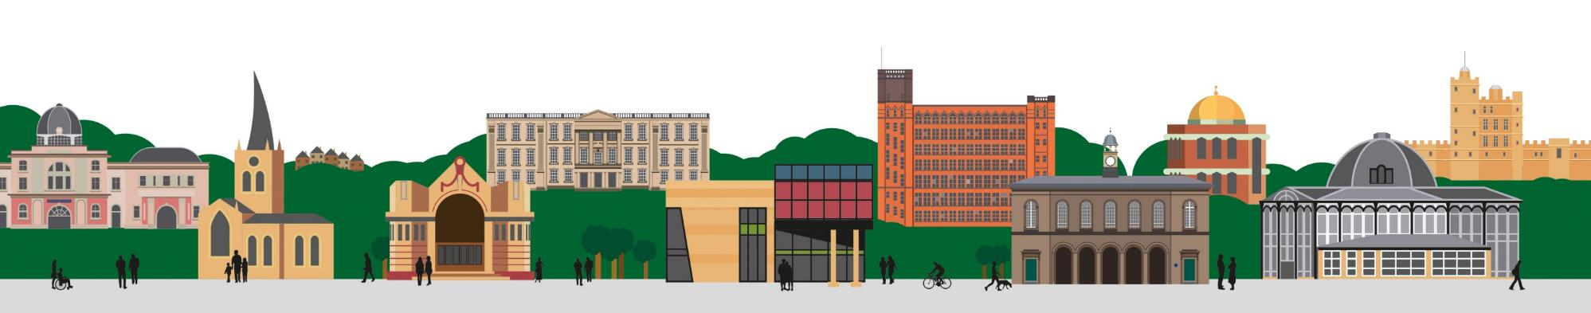

Making Research Fairer…
To make Health Fairer
Tracey Elder Lead Project Researcher / Occupational Therapist
Victoria Davison Project Researcher / Nurse

Slide 5
Health Research
Health Research is inherently biased because the research participants routinely are white and male (Upchurch, 2020)
White British people are 64% more likely to have participated in research than ethnic minority groups (Routen et al 2022)
Women and particularly women from ethnic minorities are less likely to participate in research than men (Bierer et al,2022)
It is recognised that for research to be robust and applicable to all, we need to include people from all walks of life (NIHR INCLUDE framework, 2017)

Slide 6
How can we make research in Derbyshire representative?
We wanted to find out how we could make our research more accessible, appealing and representative of our Derbyshire populations by asking under-served communities what solutions would help them to take part / participate in research.

Slide 7
What did we do?
We spoke to 108 people in 8 different community groups
A Carer Group supporting people with enduring mental health concerns.
A Carer group supporting people with physical and frailty conditions.
A LGBTQ+ group
The Asian Association
The Ukrainian Refugee Social group
The Hub warm space in central Chesterfield
Work Pays (organisation that supports people with functional skills for work)
Barrow Hill Residents Group

Slide 8
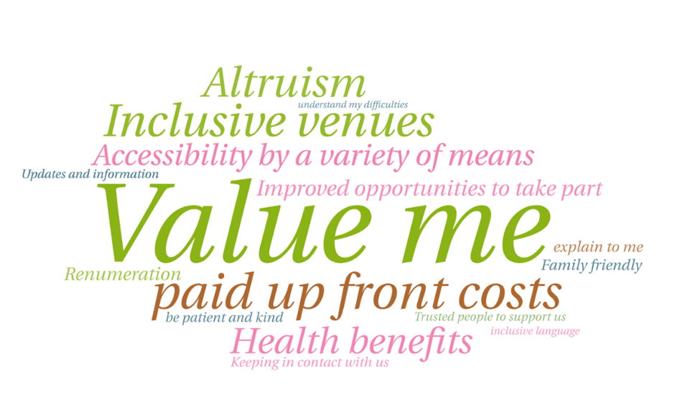
What did people say?

Slide 9
Themes
Barriers and Challenges
My disability or health needs (30)
My caring responsibilities (20)
Poor transport and parking options (14)
Access to research (9)
A busy life (6)
Cost of participating, Language barrier, lack of trust & stress

Slide 10
Themes
Solutions
No cost to me (57)
Easily accessible options (55)
Information and knowledge to be shared with me (24)
A safe space to take part (16)
Help with transport (10)

Slide 11
No cost to me
All expenses are to be met upfront (transport in particular)
It would be nice to be paid to participate with vouchers or money or gifts. A financial incentive
Donation to the group
Provide a raffle with prizes for everyone (benefits concern)
Giving people something back for their time
A really good lunch

Slide 12
Easily Accessible
Community Venue Inclusivity of venues including pets trusted venue Local appointments Good accessibility of venues Face to face at places like a library Use a local venue lik the hub
Able to do at home Online Surveys, Virtual interviews, email, not complicated websites Questionnaires, provide data and/or smartphones.
Flexibility
Home visits
Regular appointments Good availability/choice of appointments
plain speaking easy read. easy/simple to understand
I struggle to write so interviewing would mean I could join in, face-to-face on paper, not a computer
Easy access to my Language
Outside working hours
Blended methods eg skype online face-to-face choices

Slide 13
Information and Knowledge
Being made aware of opportunities Help us find the latest research opportunities Let me know about opportunities
Researchers contacting me, give me the information, just invite me, I would love to join
Better promotion by posters, social media, leaflets, notices, advertising
Involve more NHS services and demonstrate the research taking place
We need engagement events
We need targeted campaigns ‘we want LGBT+ people to participate’ Use rainbows in posters and messaging
Regular updates

Slide 14
A safe space to take part
Welcoming to all
Group events / Group activities are more appealing
Safe space for LGBT+
Focus groups
Good parking for people with a disability and those without
Groups and peer support

Slide 15
Help with transport
Central location
No traveling come to us
Paid taxi upfront
Out-of-pocket expenses upfront
Distance not too far
Good parking

Slide 16
Making Research Fairer.. to make Health Fairer
Fairer access to research leads to fairer health outcomes - just as equitable access to healthcare encourages greater participation in research.
These two elements are deeply interconnected, working together to support underserved communities in achieving better health.
And in learning around how to increase access to research, we have learnt more about things we can do to make healthcare access fairer.

Slide 17
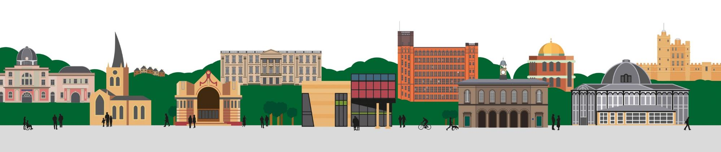
Contact Details
Name: Tracey Elder
Title: Clinical Academic Occupational Therapist
Tel: 01246 515670
Email: tracey.elder@nhs.net
Web: https://joinedupcarederbyshire.co.uk

Slide 18
References
Baker, C. (2019) Health inequalities: deprivation and north/ south divides Insight https://commonslibrary.parliament.uk/health-inequalities-income-deprivation-and-north-south-divides/
Bierer BE, Meloney LG, Ahmed HR, White SA. Advancing the inclusion of underrepresented women in clinical research. Cell Rep Med 2022; 3(4): 100553.
Boaz A, Hanney S, Jones T, Soper B. Does the engagement of clinicians and organisations in research improve healthcare performance: a three-stage review. BMJ Open. 2015 Dec 9;5(12):e009415. doi: 10.1136/bmjopen-2015-009415. PMID: 26656023; PMCID: PMC4680006.
Jonker L, Fisher SJ, Dagnan D. Patients admitted to more research-active hospitals have more confidence in staff and are better informed about their condition and medication: Results from a retrospective cross-sectional study. J Eval Clin Pract. 2020; 26: 203–208. https://doi.org/10.1111/jep.13118
Routen A, Bodicoat D, Willis A, Treweek S, Paget S. and Khunti K Tackling the lack of diversity in health research British Journal of General Practice 2022; 72 (722): 444-447
Smart A, Harrison E. The under-representation of minority ethnic groups in UK medical research. Ethn Health 2017; 22(1): 65–82.
Upchurch, M. (2020). Gender Bias in Research. In Companion to Women's and Gender Studies, N.A. Naples (Ed.). https://doi.org/10.1002/9781119315063.ch7

Slide 19
Examples of good practice
  Increasing Diversity in Research participation a good practice guide for engaging with underrepresented groups B1905-increasing-diversity-in-research-participation.pdf - Google Drive
  Improving inclusion of underserved groups in clinical research: Guidance from the NIHR INCLUDE Project NIHR INCLUDE Guidance July 2020.pdf - Google Drive
  Making sense of health inequalities making-sense-of-health-inequalities.pdf
  Core20PLUS5 (adults) – an approach to reducing healthcare inequalities NHS England » Core20PLUS5 (adults) – an approach to reducing healthcare inequalities

Slide 20


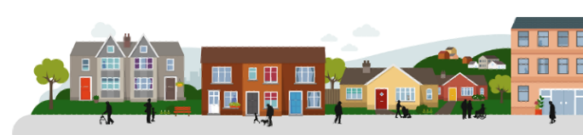
Why When I did someone's blood pressure in Barrow hill did WE end up doing CPR?
Alice Fenton GP Health inequalities + Clinical Lead Chesterfield place

Slide 21
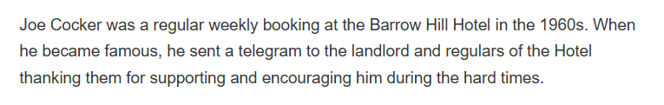
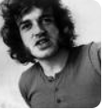
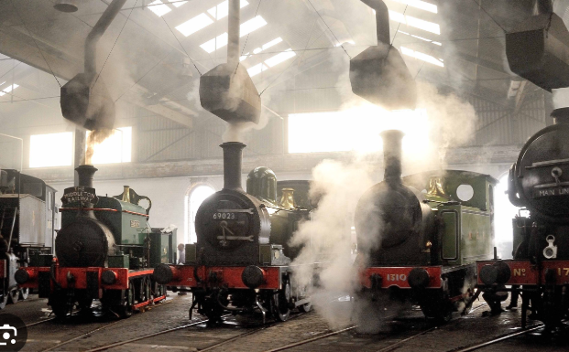
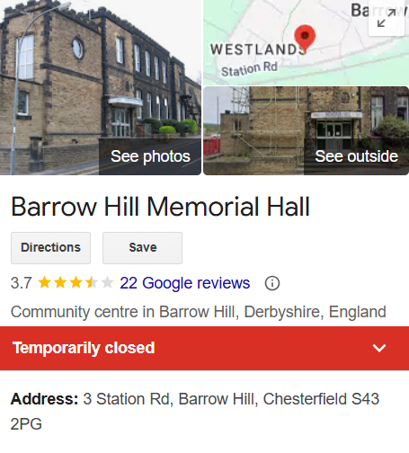
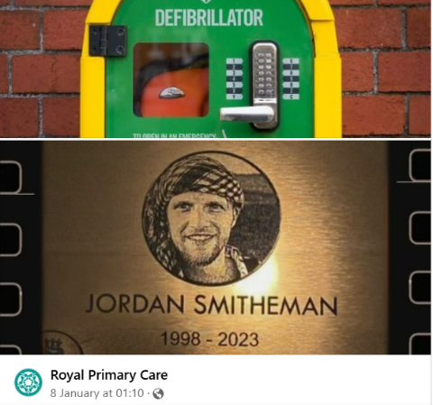
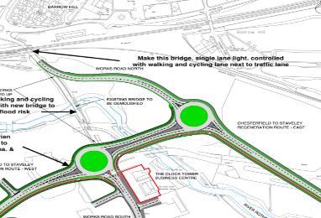
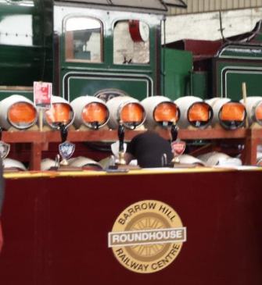
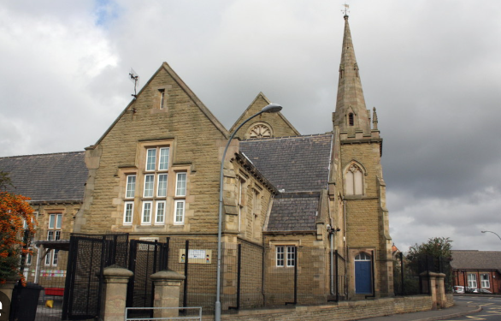
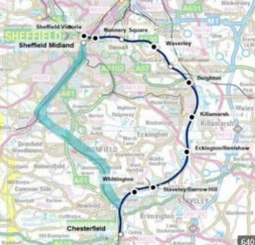
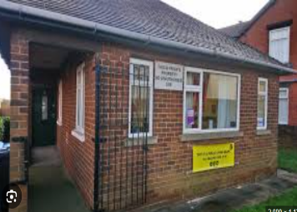
#ProudtobeBarrowhill
Text set let
Notes:
1500 – IMD 1
Barrow Hill is named after Richard Barrow who gained control of all the mines and beds of coal an ironstone in Staveley. He expanded the business and built the foundations of what would become the Staveley Coal and Iron Company.
What facts and figures will strike a cord ---- train station/school/ spirit/ young unneccisary deaths

Slide 22

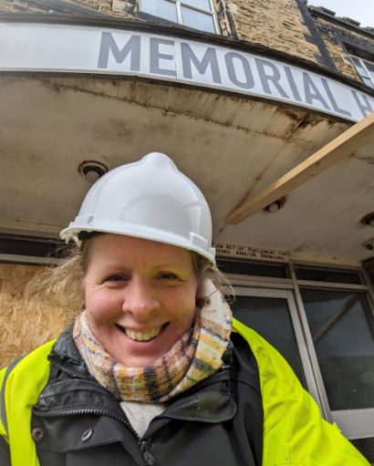
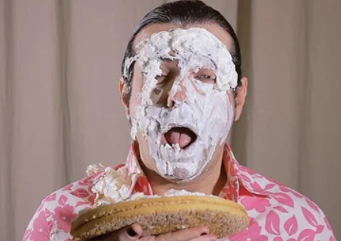
Making Health Care Fairer
Health Care Aint Fair
Or for the faint hearted!
Notes:
Me all bright eyed
Pie in face
Aint fair – spent some time understanding the problem – what it is and how it affects my patients
So picked myself up after an ambarrinsg start to my new life as the person who wanted to solve health inequalities all by them self.
Might have been to medical school but you know nothing ---- hang on --- I am a decent person ------ nope still know nothing ---- Ok pill one for me to swallow

Slide 23
In order to make it fairer we need to know why its not…
Golden Ticket
School/Education/Job/House/Internet access/Support
Do you have the bus fair? Is there even a direct bus?
Do you suffer with Stress/Mental health issues/Disability/Kids/Carer/Income loss/barriers to treatment
Running Late/Well-presented/obese/literacy level/can you afford a prescription?/ Can you afford self-help?
Are you in the right place to be told to stop smoking?
Patient A
Knee Pain Needs an operation
Refer Yes or No?
Patient B
Child with constipation
Give medication Yes or No?
Notes:
Did some thing revolutionary…… I sat and thought what it must be like for patients………. I put people I knew into theire shoes – parents my kids – myself my neighbour
Run the gaunlate – called 70times and got a golden ticket – I mean GP appointment ……… Now your turn to be a Dr
GP receptionists are known for being nosey but yet this vital and crucial information we don’t have – well sometimes we do – but not in the way you might think….

Slide 24
Doing it differently
When there is so much to do does it matter where we start?
Start SMALL
Priority is the people not the disease
Relationships
Value based not target based
Kind – Listen – Support not tell
Relationships
Relationships
Relationships
Relationships
Get Organised
Notes:
Get orgainised
Realistic offers/ Choice/Ask what people want
Value based not target based
Kind – Listen – Support not tell
Equity not equality – Need is different
Target conditions – Core 20+5
Priority is the people not the disease
We are focusing one area of Chesterfield with the greatest health inequalities. By doing this we are giving ourselves the opportunity to really focus on the issues facing that community and how we can work with them to address these. By making the task smaller, we are making it more manageable and hopefully achievable.
We are taking the time to build up relationships with each other in different organisations and roles, to build trust and collective ownership of a issue. To try and get out of the silo'd way of working we may have been used to in the past, to putting the people of Barrow Hill at the centre of our work, and always considering what is best for them.
We have community leaders involved as equal partners in work, who are guiding the approach and keeping it grounded in the voice of people and communities.

Slide 25




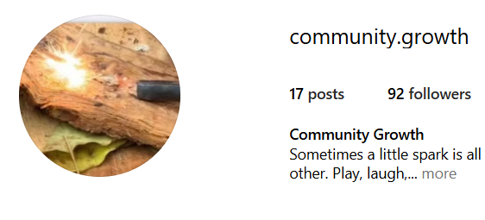



.
Spend time getting to know the community and who operates in that space…..

Slide 26

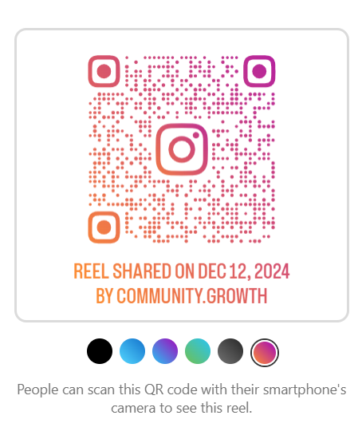
https://www.instagram.com/reel/DDe9djMMKLy/?igsh=MWVjNnc4YWdoenZ4bA%3D%3D
Why When I did someone's blood pressure in Barrow hill did WE end up doing CPR?
Notes:
Because its not a about disease its about people

Slide 27
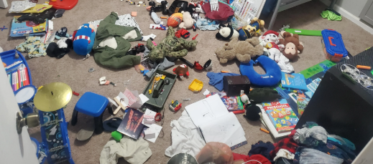
What Have We Learned?
Messy
Not I but we
Need to listen
No short cuts
Rewarding
Flexible + Embrace change
Not afraid to fail
Small changes cause ripple effects and can be achieved with like minded peopled
Ask questions
No money
That it is the right thing to do………
Notes:
Thanks to the help of others – with this presentation – not just my own thoughts
That it's hard.
That there is no resource, or support for this work currently centrally which makes it harder. Even resource allocated to reduce health inequalities, isn’t supporting the work to happen, as it's short term, and potentially focused around performance by results, which is at odds with addressing entrenched health inequalities, that require time to unravel.
That despite this, is it possible to have an impact in small ways if you get the right, likeminded people in a room and use this as motivation and evidence to try to change the way the system thinks about and supports preventative working in Place.
That this is the right thing to do, and because of that people are engaged in it, prioritising it, and are giving their time.
That where there is a will there will always be a way, even if it takes more time.
That this work is rewarding.
Improve health inequalities and deliver a new approach to CVD prevention in a deprived community in Chesterfield. We started by working in Barrow hill with an aim for a joined-up approach which we could then 'scale up' to the rest of Chesterfield. Aim try and sever all our community not just the ones who turn up to appointments. People communities suffer more and benefit less from resources and have lower life expectancy and less years in good health. We are trying to turn the tide on health in equalities
Want to share real life examples of where and how a GP is setting foot out side of a consultation room can be meaningful.
BH – suffered a spate of young deaths in the last 5 years and the community is still living with the tragedy of each of these loses.
Content of presentation:
● Describe the approach you have taken
● Explain the methods used or proposed
Met with local place alliance, barrow hill community trust, community workers, bereaved families, public health, royal primary care GP surgeries, PCN, Chesterfield hospital, Chesterfield city council – health and well being partnership. Asked to pilot CVD prevention in deprived population. We were invited to a memorial event to do CVD prevention but while engaging with the community the 'ask' from them changed. What was needed was CPR and Defib training to use new machines to prevent further unnecessary deaths.
We listened to what people said and changed and flexed the plan of action. Surrendered power and resources and built meaningful relationships.
i.e – employing voluntary sector workers to contact patients for us. Council grants/charity funds and ARRS roles
Linked the community and hospital – asked them to provide free training in Barrow hill
Trying new approaches – Not following classical project model we are practicing a values based approach – Kindness, listening, flexibility and honesty
Listening to the community and taking the agenda of the population to dictate the agenda
Relevance/impact:
● State how the results influence or impact on clinical practice/education/policy/methodology etc
We ran 4 CPR training events had X number CPR training. These events were open to all irrespective of GP/PCN registration. We tried to do things where people live not where GPs are based. We consciously tried to remove red tape and barriers.
Disease prevention should start with the community and not the disease.
Direct conversations with the ICB over policy
Positive community engagement – is open door to rebuilding relationships
Trying to break down barriers to health care – to improve health care.
Trying to connect peoples ….. and influence at an ICB level with commissioning.
Outcomes/discussion:
● How are they important?
● State significant positive AND negative findings
● What will this study/idea change
CPR/ Defibs save lives but the more important out comes were the relationships, education and delivering of promises.
Negatives – not found many blood pressures in the short term but engagement has improved.
The journey to meet the community is important and a step that cant be skipped.
As GP we have the benefit of being a central point and being able to take a holistic approach, reprioritise and balance risk.
Funding doesn’t move quickly enough
We need help to reach uncontactable people
Change the approach and recognise our responsibility to drive change in a collaborative approach.
Listening and working for the community.

Slide 28
Thank you

Slide 29
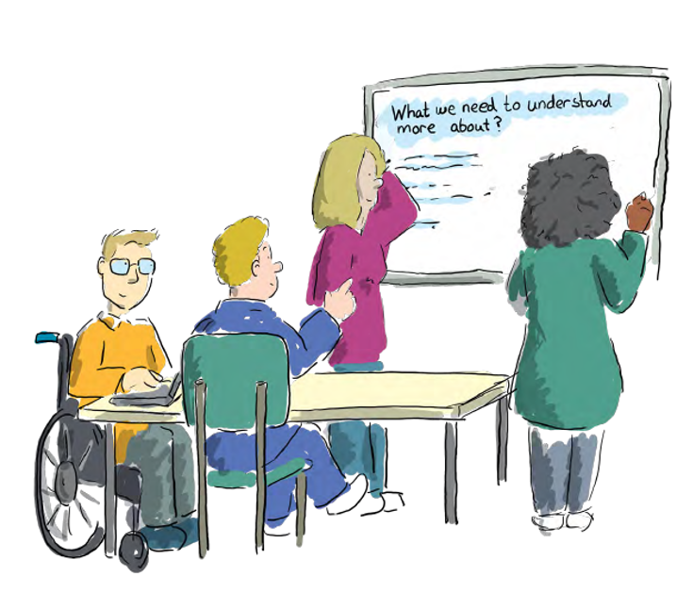

Taking service-level action on health inequalities
Taking service-level action
on health inequalities

Slide 30
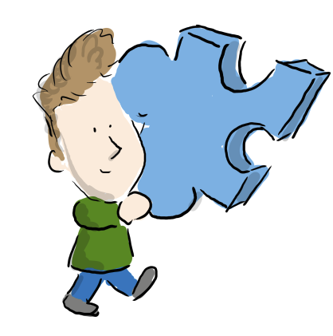

Slide 31
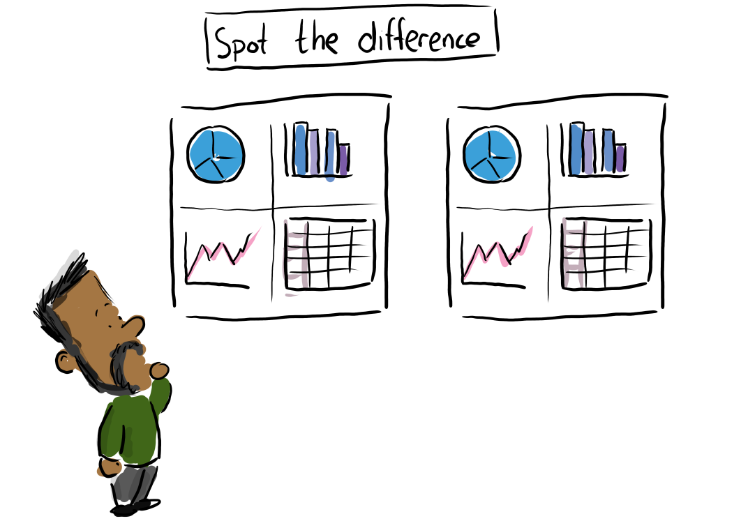

Slide 32
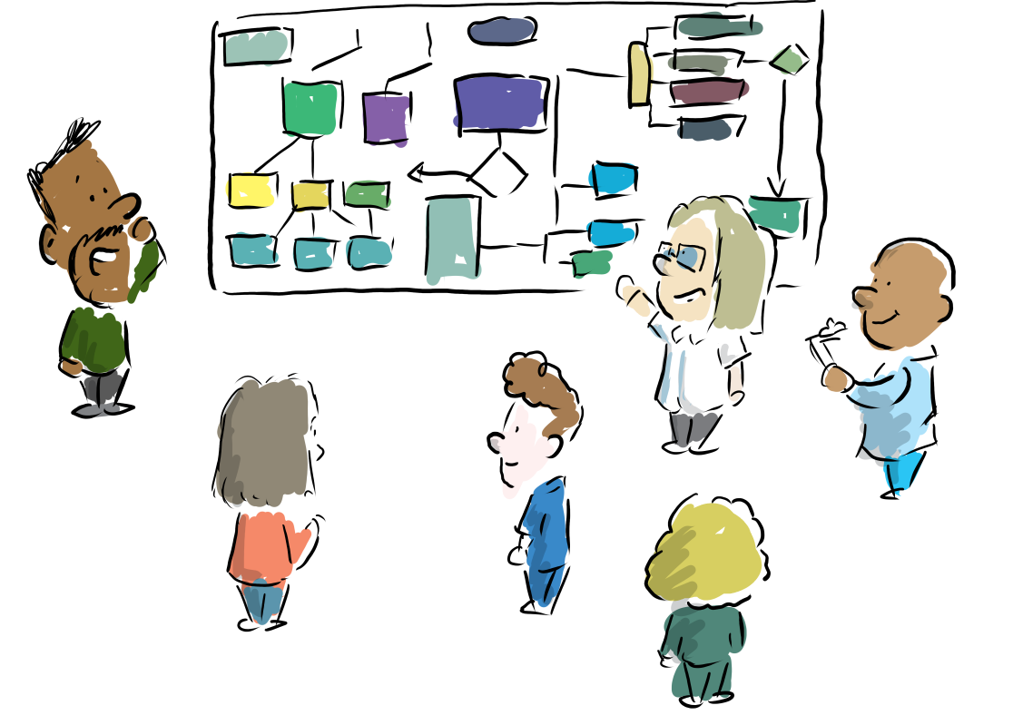

Slide 33
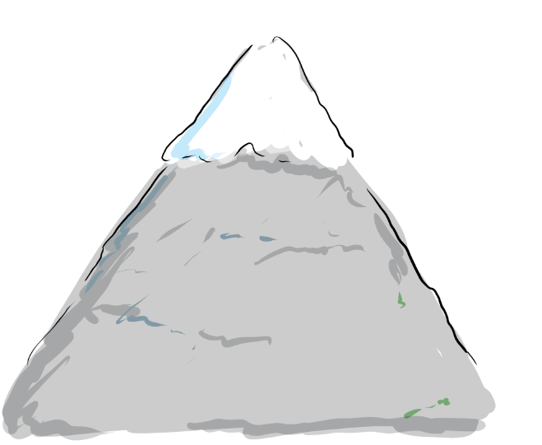
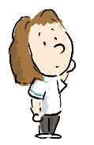

Slide 34
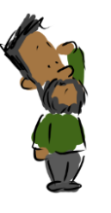

Slide 37
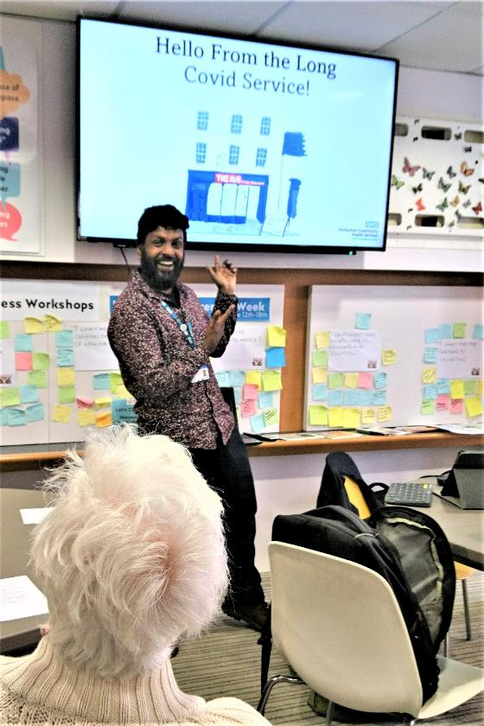
Me delivering a pilot talk about Long Covid!

Slide 38
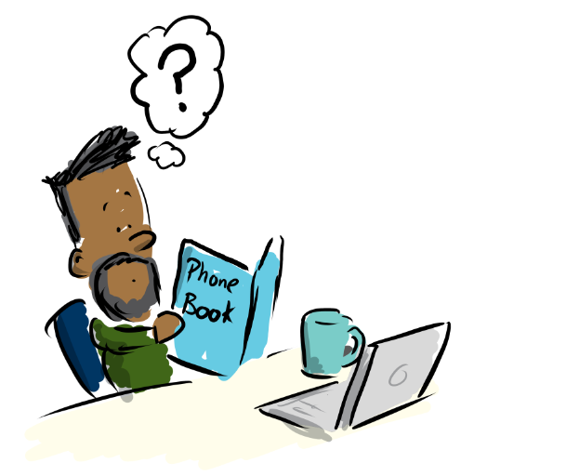

Slide 39
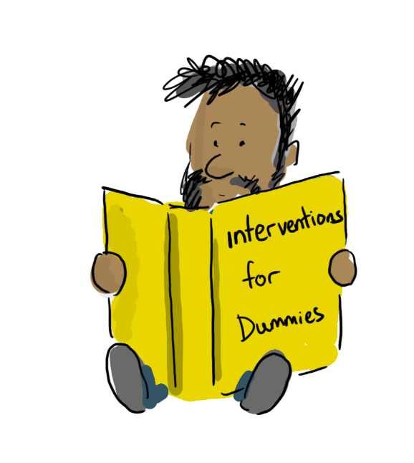

Slide 40
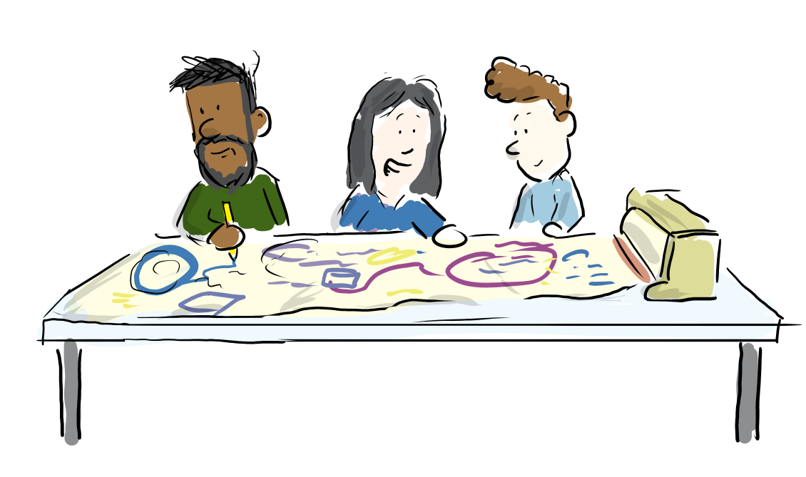

Slide 41
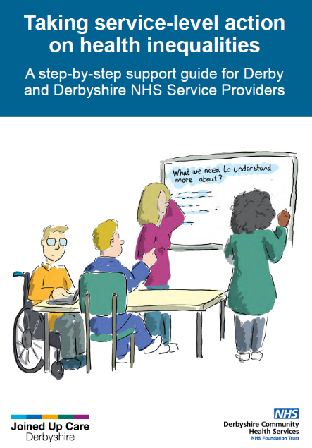
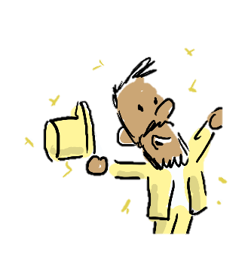

Slide 42
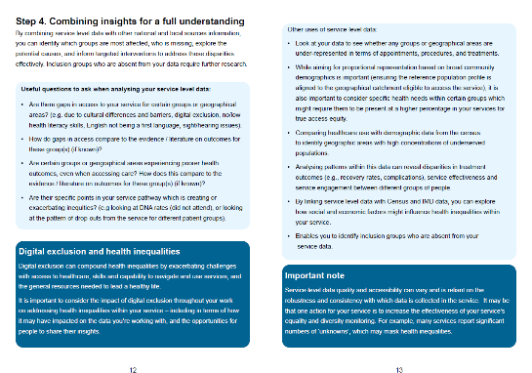
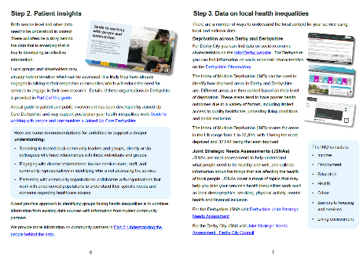
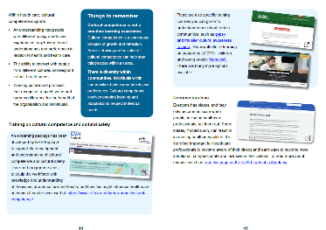
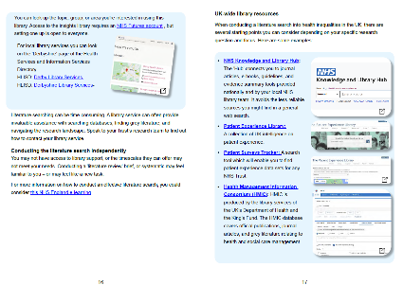
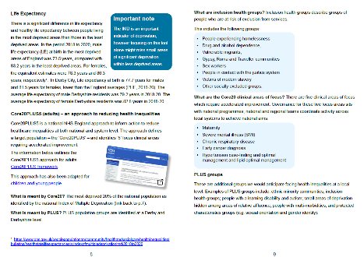
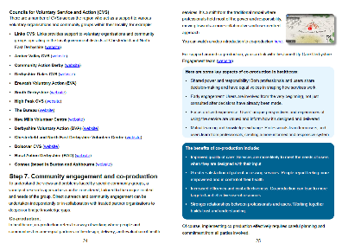
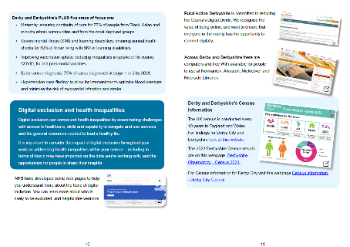
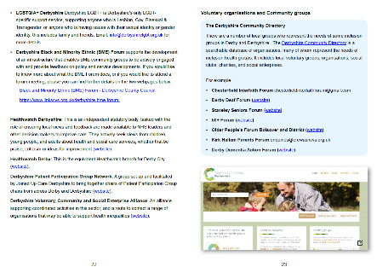
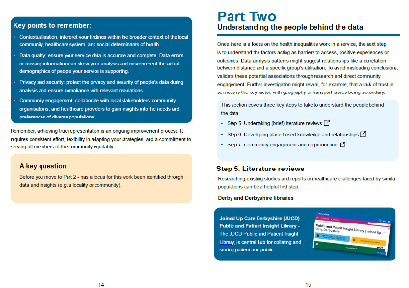
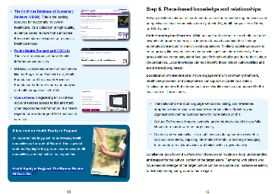
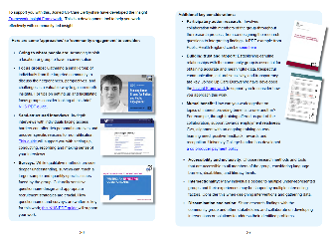
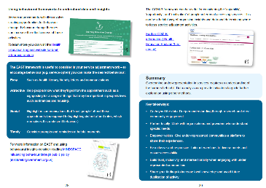

Slide 43
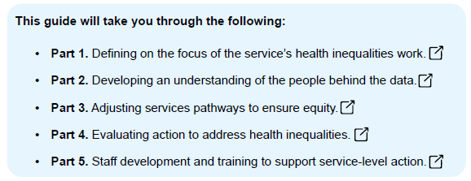

Slide 44
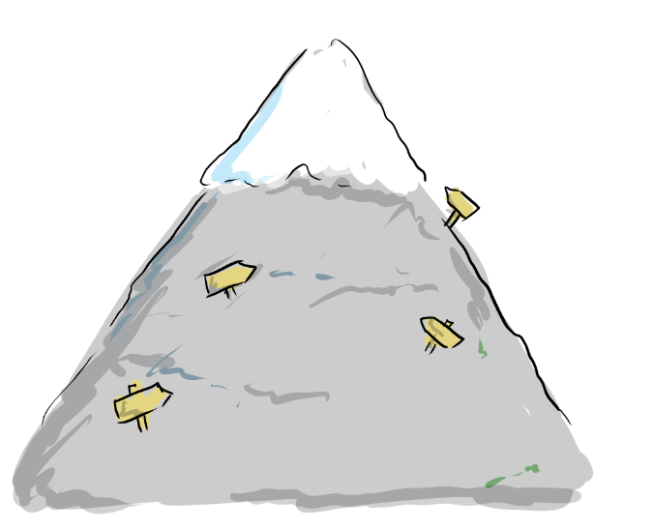
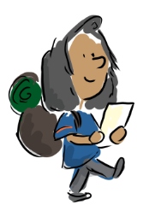

Slide 45


Slide 46


Bitesize information

Slide 47

Key national and local resources and links

Slide 48


Tips on the ‘what’ and the ‘how’

Slide 49


Key questions to build in reflection and quality

Slide 50


