Slide 1

These slides are for you to edit
Feel free to change any aspect to match your brand.
You will need to amend certain slides to match what you have done to make the Suicide Conversation Tool work for your team. We have highlighted these in yellow.
For the slide ‘Two examples’, look in the notes to see the scripts you can use.

Slide 2
Suicide Conversation Tool Training
(Names of individuals delivering training)

Slide 3

Look after yourself
Take a break if you need one, no need to ask.
Confidential, supportive & respectful.
Only share if you feel comfortable.
If you need to chat afterwards, just let one of us know.

Slide 4
Welcome
Aim of today
Introduce a new Tool to support you with any conversations you may have around suicidal thoughts/feelings. We will explore the:
Why
What
Where
When
How

Slide 5

Spotting the signs
Why?
We know some people share thoughts of suicide with us.
We want you to feel comfortable to navigate this conversation if needed and ensure that you & the person you're speaking with feel supported.
We have a duty of care to ensure people are safe and receiving appropriate support.
This is not about you being a mental health professional, this is supporting you in your role as a non-mental health professional.

Slide 6
Spotting the signs
What?
A Tool developed to support a validating and compassionate conversation about someone's safety where there is an identified risk of suicide.
It is aimed at non-mental health professionals.
It might feel like something new but provides structure and aids conversations already happening.
It will help you know the things that are helpful to say and do if people tell you they are feeling suicidal.

Slide 7
Spotting the signs
Where?
Provide guidance to team members on where they can locate the Suicide Conversation Tool template

Slide 8
Spotting the signs
When?
If someone shares thoughts of suicide with you whilst you are supporting them.
If someone shares these thoughts via email/text.
This includes people who may suggest they are feeling suicidal but do not say it outright:
  ‘‘I just don’t see the point in it all anymore’’
  ‘‘I may as well not be here’’
It’s ok to ask people:
‘‘Are you thinking about ending your life?’’

Slide 9
Spotting the signs
When?
When do you go through the tool?
Examples...
"I just want it to stop"
"Don't want to be here"
"It would be better if I was dead"
"I'm a burden"
"Last week I almost.."
Gut reaction that you want to check in with someone – if it feels right to do it, that's ok.
If someone is feeling low or depressed, it doesn't mean you need to do this tool.

Slide 10
Spotting the signs
How?
If someone discloses thoughts of suicide with you, take some time in your conversation to go through the Suicide Conversation Tool with them.
‘I’m glad you felt able to share these thoughts with me/Thank you for sharing those thoughts with me. It sounds like things are really hard at the moment/you are experiencing some difficult thoughts at the moment. Would it be ok if I ask you some more questions about these thoughts? It will help me to get the right support in place for you, if needed.
Some of these questions might not feel relevant for you, but please answer as honestly as you can’.
Confidentiality reminder – if you have not already spoken about confidentiality during the conversation, discuss this before completing the Suicide Conversation Tool.
Replace this with a print screen of your own version of the document here

Slide 11
How?
The questions are written in a way that they can be read out loud
Are you currently having (or recently had) thoughts about ending your life?
Have you made a plan of how to end your life?
Have you made any preparations or taken any action towards ending your life?
Do you have access to the means to end your life?
Have you made any previous attempts to end your life?
Do you have any contact with mental health services at the moment?
Is anyone else aware that you have been thinking about suicide?
What, if anything, is stopping you from acting on the thoughts of ending your life at the moment?
Do you have a safety plan to follow? A safety plan is a tool to help to keep you safe. It can help you to manage thoughts of suicide. It is personal to you. Someone can help you to create the plan, but you’re the one who decides what goes into it, and what might work for you. To get started, how would you feel about thinking about things that might help to keep you safe whilst you wait for a professional to get in touch? This could be things like talking to someone, listening to music, or getting some fresh air.

Slide 12
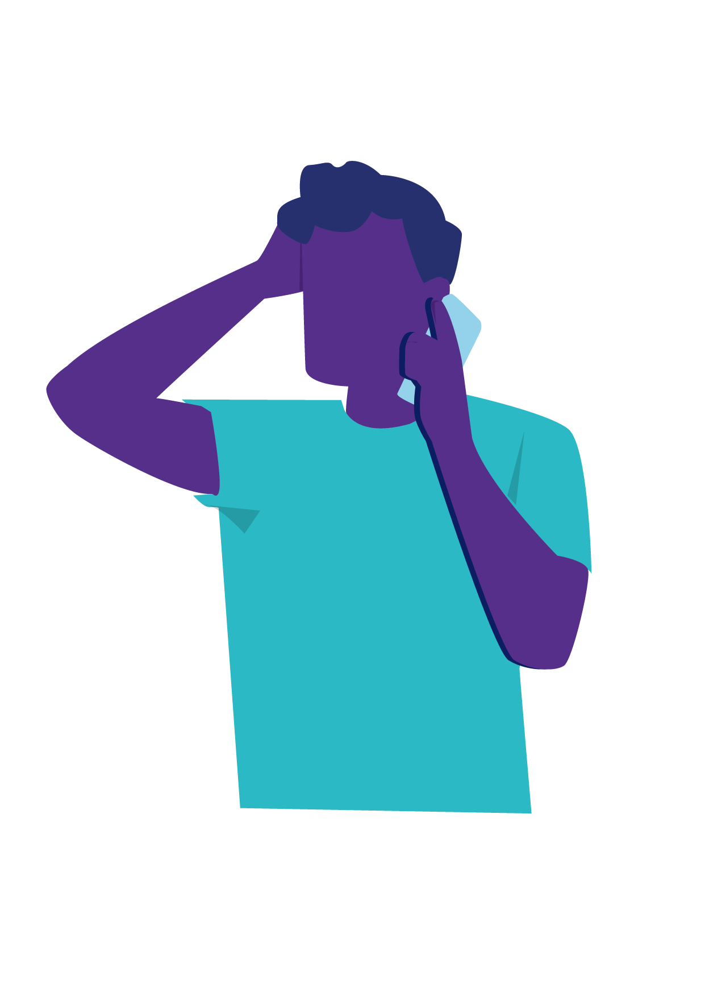

Two examples
Notes:
Examples which can be shared with training attendees. The two facilitators taking turns to play the person in distress and responding team member, demonstrating active listening skills and an empathic approach whilst sticking to the Suicide Conversation Tool Template provided.
Example one
Are you currently having thoughts about ending your life? “Yes, just every now and then I think, what is the point, everyone would be better off without me”.
Have you made a plan of how to end your life? “No, I wouldn’t know how. I’m just fed up of being here”.
Have you made any preparations or taken any action towards ending your life? ”No”.
Do you have access to the means to end your life? “No, well I suppose I could hurt myself if I wanted with paracetamol or something, but I haven’t got enough I don’t think”.
Have you made any previous attempts to end your life? “No, never felt like this before ever”.
Do you have any contact with mental health services at the moment? “No, but the doctor did prescribe me some antidepressants a while ago, sometimes I forget to take them”.
Is anyone else aware that you have been thinking about suicide? ”No, I wouldn’t want my family knowing, they would only worry even more”.
What, if anything, is stopping you from acting on the thoughts of ending your life at the moment? ”I suppose my family, I’d hate to hurt them, but I just feel like I am a burden on them. I do want to see my son grow up”.
Do you have a safety plan to follow? ”No, sorry, I don’t know what that is”.
A safety plan is a tool to help to keep you safe. It can help you to manage thoughts of suicide. It is personal to you. Someone can help you to create the plan, but you’re the one who decides what goes into it, and what might work for you. I can send you some information about making a safety plan, if you would like me to?
To get started, how would you feel about thinking about things that might help to keep you safe whilst you wait for a professional to get in touch? This could be things like talking to someone, listening to music, or getting some fresh air. “Well, I always feel a bit better when I’ve been on a walk but I’m struggling to find the motivation to do that. I could call my mate John and ask him if he fancied meeting up, he is a good friend”.
Example two
Are you currently having thoughts about ending your life? “Yes, daily”.
Have you made a plan of how to end your life? “Yes, I know exactly how I would do it, I just haven’t decided when”.
Have you made any preparations or taken any action towards ending your life? “Yes, I’ve started writing a note to my dad”.
Do you have access to the means to end your life? “Yes, I’ve got loads of medication in the bathroom, some of it is my mental health medication and I have medication for pain relief too”.
Have you made any previous attempts to end your life? “Yes, I think it was about this time last year. Obviously, it didn’t work. I was in hospital for a while afterwards.”
Do you have any contact with mental health services at the moment? “I’m supposed to have a CPN (community psychiatric nurse), but I’ve not spoken to her in a while, she visits every now and then. I can’t remember her name, but I think she is with Chesterfield Mental Health team”.
Is anyone else aware that you have been thinking about suicide? ”Yes, my CPN knows and my brother”.
What, if anything, is stopping you from acting on the thoughts of ending your life at the moment? ”Not much really, my dad I suppose. He isn’t very well at the moment”.
Do you have a safety plan to follow? “Yes”.
Can you remember where it is? How would you feel about taking a look at it, and following some of the steps on it? “Yes, there are some contact numbers on there, but I don’t want to call them. I feel a bit better after talking to you. I’ve got my mate coming over later and the company helps me calm down sometimes”.

Slide 13
What next when it's not urgent?
Send the person the ‘Mental Health Support Signposting email’
Send the person the ‘Urgent Mental Health Support’ text message
Let a member of the management team know that you have completed the Suicide Conversation Tool with someone and ask them to review it

Slide 14
What if it is urgent?
If there is an immediate threat to life, we need to contact emergency services.
For example, they have just taken an overdose, or there is an immediate intention to end their life (e.g. they say when the call is over, they have a plan to).
Stay on the phone with the person
Request urgent support from a manager by (internal process for seeking immediate support)
A manager will contact you ASAP to support you
& contact 999

Slide 15
What happens next?
A manager will review the Suicide Conversation Tool within the hour and decide the most appropriate actions.
In all cases, we will update the GP & provide signposting support & advice. In some cases, we may need to contact the person’s GP more urgently or contact the person's allocated mental health professional.
The supporting manager will contact you to confirm any
further actions required.

Slide 16
Important points to remember
The majority of people who feel suicidal do not actually want to die - they just want the situation they are in or the way they’re feeling to stop.
We must take thoughts of suicide seriously, every time.
It isn’t your job to change these thoughts, but we can help people to see that there is hope.
‘‘There is hope that we can find some ways to help you feel safe’’
Listening to someone and validating their feelings does not mean that you are agreeing with them.
‘‘I get it, you feel trapped, and this feels like a way out’’
You don’t need to be perfect. Be your usual, caring, empathic self.

Slide 17
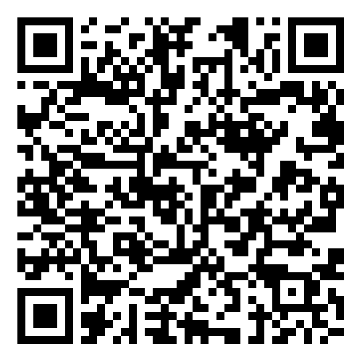
Support for you
You aren’t on your own
If you have had a difficult conversation, you might find it helpful to talk to someone else about how you are feeling afterwards, e.g. a colleague or line manager.
You might find some of the wellbeing support services available in (organisation) to be helpful.
Consider completing the Zero Suicide Alliance training to help you build your knowledge and confidence: https://www.zerosuicidealliance.com/suicide-awareness-training.
Zero Suicide Alliance training

Slide 18
Thank you for listening
If you have any further questions, please email us

